Slide 1
AI and the Future of Work
A workforce designed to be replaceable is replaceable
Bhaskar Vanamali, Danilo Assmann
VDA SYS - June 24th, 2026

Slide 2
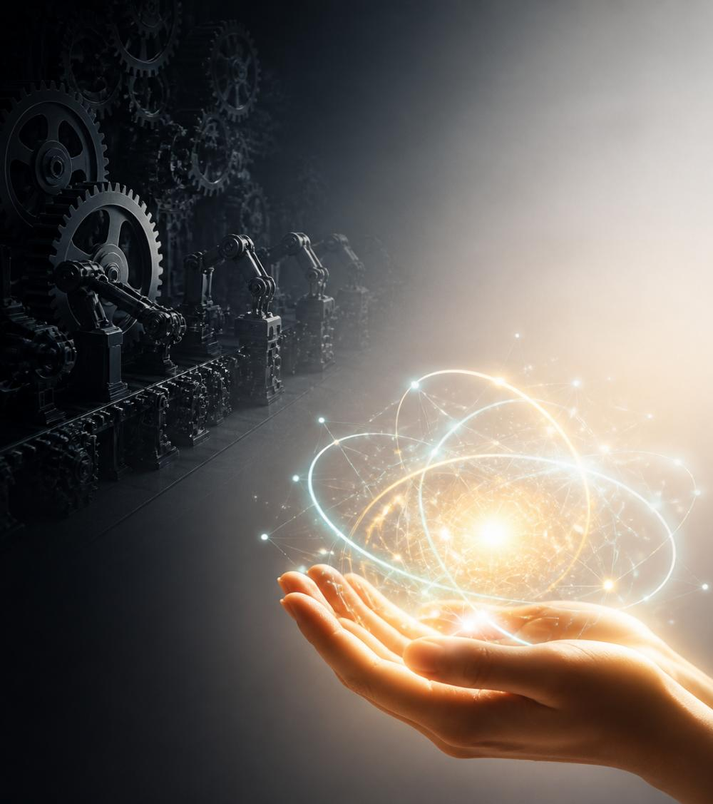

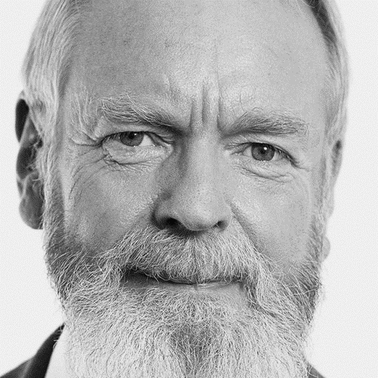
Welcome

Slide 3
Welcome von Bhaskar (NVIDIA CI)
Welcome
Good morning, everyone. Welcome to VDA SYS 2026.
Look around this room. You are the people who build safety and security into vehicles, ensure high quality of your products. You write the standards, design the processes, run the audits, carry the ASPICE assessments. You are the backbone of automotive quality. And today, Danilo and I want to talk with you — not at you — about something that is reshaping this work from the inside out.
I'm Bhaskar Vanamali. I work at NVIDIA at the intersection of automotive systems and AI — and I've spent the better part of two decades thinking about how organizations learn, adapt, and sometimes fail to do either.
My late colleague Hans-Jürgen Kugler and I started talking here at the VDA SYS about AI 10 years ago and predicted that it would change the way we are working.
As a result, together with colleagues I designed the draft for MLE-processes you see in ASPICE nowadays.
We also had series of talks on organizational culture and other topics. All that plays into today’s keynote.
So, here we are.

Slide 4
Welcome
20 years
Notes:
And in 2017, right here at VDA SYS, we both gave talks on the same day — in the same track — without having coordinated beforehand. Bhaskar spoke about teal organizations. I spoke about the psychological foundations of self-organization.

Slide 5
“Doomscrolling Anonymous”
Welcome
What do I do?
Give you a talk in
“doomscrolling” mode.
(Welcome to GenZ and all TikTok addicts…
“I am Danilo and I get lost on scrolling.” “Hello Danilo”)

Slide 6
Welcome
“I don’t know what to say.”
The initial idea was simple.
But everything changes unbelievable fast …
if you prepare slides 1 week in advance, they are outdated
I feel overwhelmed – u2?
Notes:
Even as Keynote-Expert: Let’s be honest …
Now that I am standing here, I don’t know what to say. Even for me, everything is changing too fast. Every week 30 new tools.

Slide 7
What is “AI”?
Welcome
Over the last 14 years algorithms moved to neural networks – and nobody cared
  in Hardware and Backends
From 2023 LLMs (Chat-Bots) took over and spread fast
  1-2 years until they reached mainstream
  LLMs are only one variant of neural networks application
  when we talk about “AI”, we mean all possible technologies
OpenClaw (as one version of personal agents) spread even faster
  3 weeks until mass market
Notes:
Phase 1: Klassische Algorithmen (bis ca. 2012)
In den frühen ADAS-Systemen (Spurhalteassistent, Verkehrszeichenerkennung, ACC, Notbremsassistent) bestand die Wahrnehmungskette fast ausschließlich aus handentwickelten Algorithmen:
Kantendetektion (Canny)
Hough-Transformation für Fahrspuren
SIFT, SURF, Haar-Features
Template Matching
Kalman-Filter
Radar-Tracking
Regelbasierte Klassifikatoren
Der typische Ansatz war:
Sensor → Feature Extraction → Objektkandidat → Klassifikator → Tracking
Jeder Schritt wurde von Ingenieuren explizit programmiert.
Gerade bei Bosch, Continental, Valeo, ZF/TRW, Hella oder Mobileye bestand die Wahrnehmungskette damals überwiegend aus solchen Verfahren.
Phase 2: Der ImageNet-Schock (2012–2015)
2012 gewann das neuronale Netz AlexNet den ImageNet-Wettbewerb mit großem Abstand.
Für die Computer-Vision-Community war das ein Schockmoment:
Plötzlich waren neuronale Netze besser als die besten handgebauten Bildverarbeitungsverfahren.
Innerhalb weniger Jahre wurden CNNs (Convolutional Neural Networks) zum dominierenden Forschungsansatz.
Damals begann auch im Automotive-Bereich die Frage:
Können wir statt Fahrspuren und Fahrzeuge explizit zu programmieren die Erkennung einfach lernen lassen?
Phase 3: Erste Serienanwendungen (2015–2018)
Ab etwa 2015 tauchten die ersten ernsthaften Deep-Learning-Projekte bei OEMs und Tier-1s auf.
Typische Anwendungen:
Verkehrszeichenerkennung
Fußgängererkennung
Fahrzeugklassifikation
Freiraumerkennung
Spurmarkierungserkennung
Wichtig:
Die neuronalen Netze ersetzten nicht das ganze System.
Man hatte typischerweise:
Klassisches Tracking
Klassische Sensorfusion
Klassische Zustandsautomaten
Klassische Plausibilisierung
aber
Deep Learning für die Objekterkennung.
Also eher:
Klassische Architektur + neuronaler Detektor
als
End-to-End-KI.

Slide 8
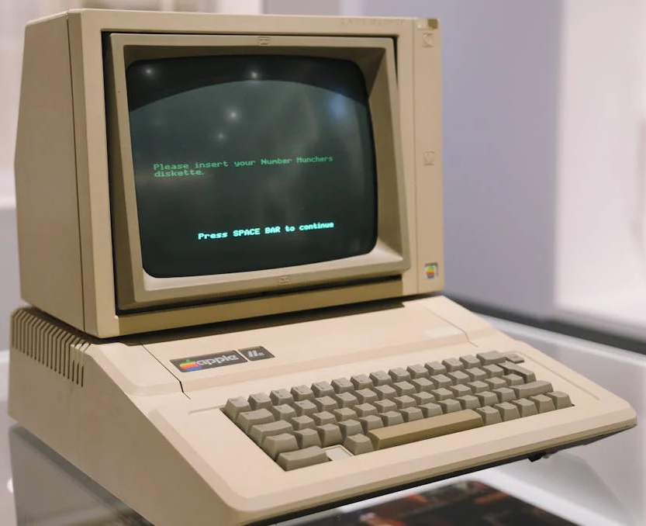
Reminder: The Current State of AI (and the difficulty with predictions)
Welcome
Notes:
To visualize the current state, we need
a reference we understand better
Let’s talk about computers
That’s the current level of LLMs
Awesome at it’s time, but a relict from
retrospective

Slide 9
AI Context
Welcome
We still don’t know what happens inside LLMs
  we just don’t understand what’s going on
LLMs have limitations by design
  No true ethic
  Lack of context (experiencing and understanding the world)
  Technical issues like hallucination; but actually this is totally human

Slide 10
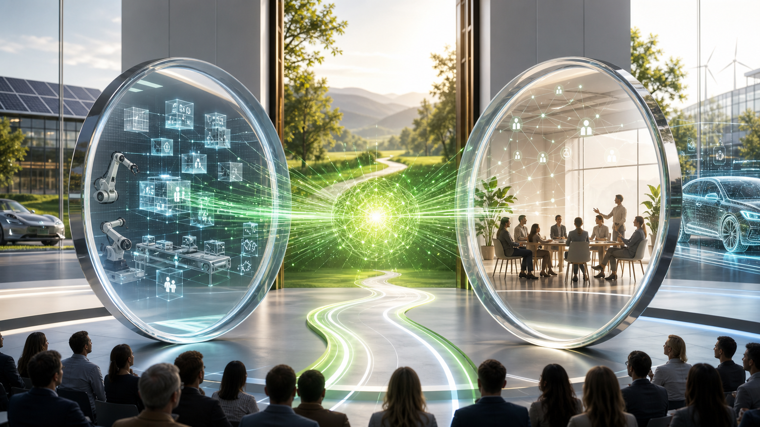

Slide 11
Bhaskar (NVIDIA)
Welcome
Same core idea. Two different lenses. And that's exactly what we're going to do again today.
You will have to bear with us. Two different styles and the two lenses reflect the technical view (old school, my topic) and the cultural emotional view in hip style by my young and overeager colleague (new style, catering for the new generation with the attention span of a short on youtube)
You will notice that I have 11 slides and Danilo has 110 slides, so definitely two styles. Have patience with him. He is so dynamic.
But honestly, have patience, because we present two different views of the same topic and come to a joint conclusion.
The title of our talk is: What Does AI Mean for the Future of Our Work? And the subtitle — which we mean very seriously — is: A workforce designed to be replaceable is replaceable.
That's not a threat. It's an invitation to think differently about how we design work, roles, and organizations in the age of AI.

Slide 12
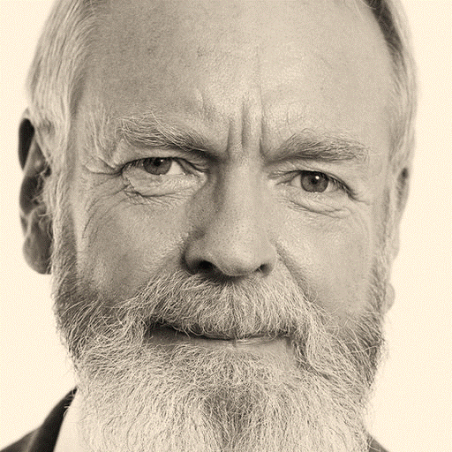
Hans-Jürgen as “The Prophet”
Welcome
9 years
Notes:
Same year we had our talks at VDA SYS, we repeated that experience at the Christmas event of Kugel Maag.
We were sitting with Hans-Jürgen at lunch and he talked already about the implications of AI in business. It would take another 6 years, until we hear of ChatGPT

Slide 13
“The Prophecy”
Welcome
“The first jobs to be replaced
will be management roles.”
Notes:
At this time there was one big robotic vision: The self-driving car in 2025!

Slide 14
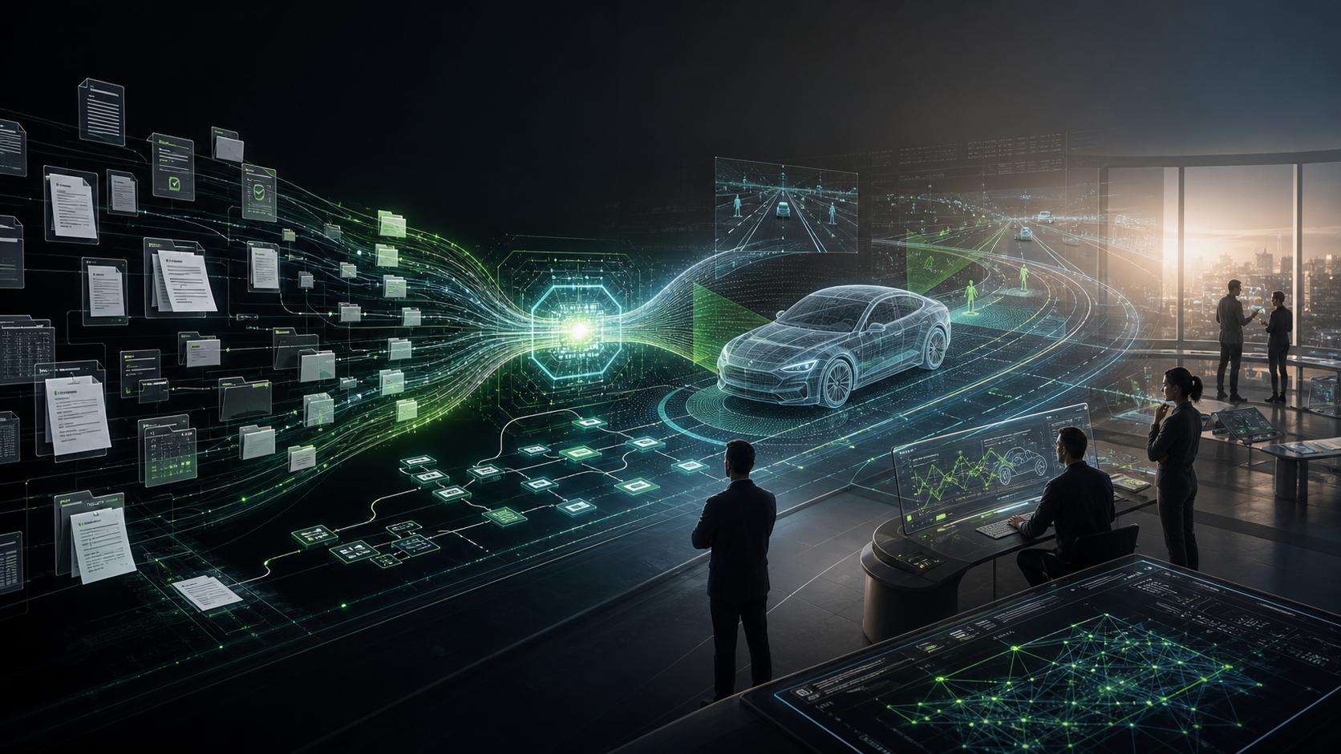
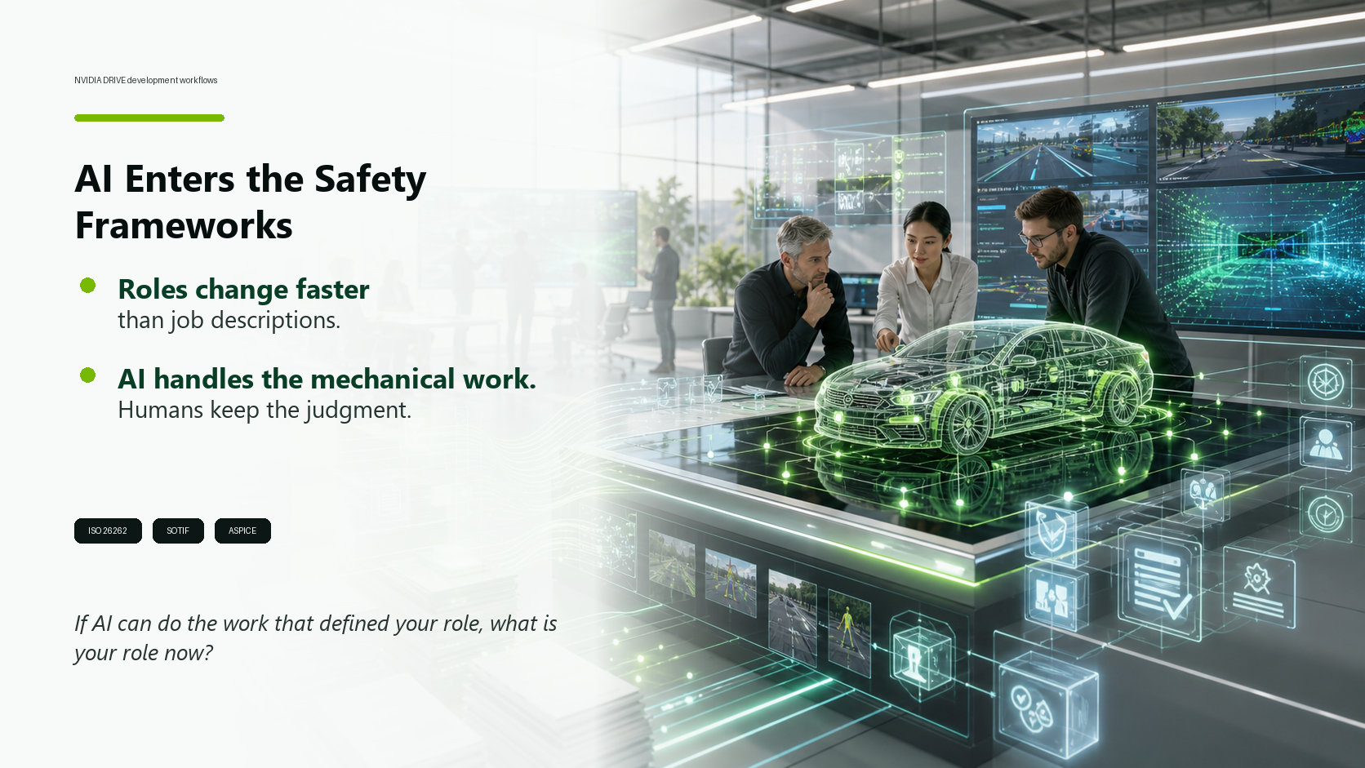

Slide 15
Bhaskar (NVIDIA)
Welcome
I would like to time travel with you to last year’s VDA SYS:
There were two papers on AI, one from Borg Warner with Omni and another by ARM, about AI-augmented reviews.
At the time it sounded great and we just experimented with AI. Now, this can be done by any of you with Agentic AI which is improving on a daily basis. What will we address in a year or 5 years?
Two personal stories:
  Just on Monday, a colleagues of mine and my self, we both admitted that initially we thought we could sit this technology out because we are retiring at some point. It turns out we cannot. It is not our way of doing things and overall working is changing too fast. We have to embrace it.
  Second story: It turned out, both of us developed a virtual assistant with agentic AI, even though we are technically inept, but agentic AI reached a level that even I am able to create scripts which do my bidding.
So coming back to the initial time travel. Where we needed specialized companies a year ago, we have now agentic AI which supports us and we can use the benefits of AI ourselves.
At NVIDIA, we see this every day. The tools that engineers and managers use to do their work are changing faster than the job descriptions that describe those roles. And in automotive — one of the most process-heavy, documentation-intensive industries on the planet — the impact is especially visible.
Take the NVIDIA DRIVE platform. Our autonomous vehicle stack isn't just about self-driving cars — it's about the engineering infrastructure that makes it possible to validate, verify, and certify AI-driven systems at the level of rigor this industry demands. ISO 26262. SOTIF. ASPICE. These aren't just acronyms — they're the frameworks your teams live and breathe.
And now AI is entering those frameworks — not to replace the judgment they require, but to handle the mechanical, pattern-driven, documentation-heavy work that consumes so much of your time. Test case generation. Evidence aggregation. Generation of documentation. Traceability matrices. Audit preparation.
The question Hans-Jürgen raised in 2017 is now the central design question for every engineering organization: If AI can do the work that used to define your role, what is your role now?

Slide 16
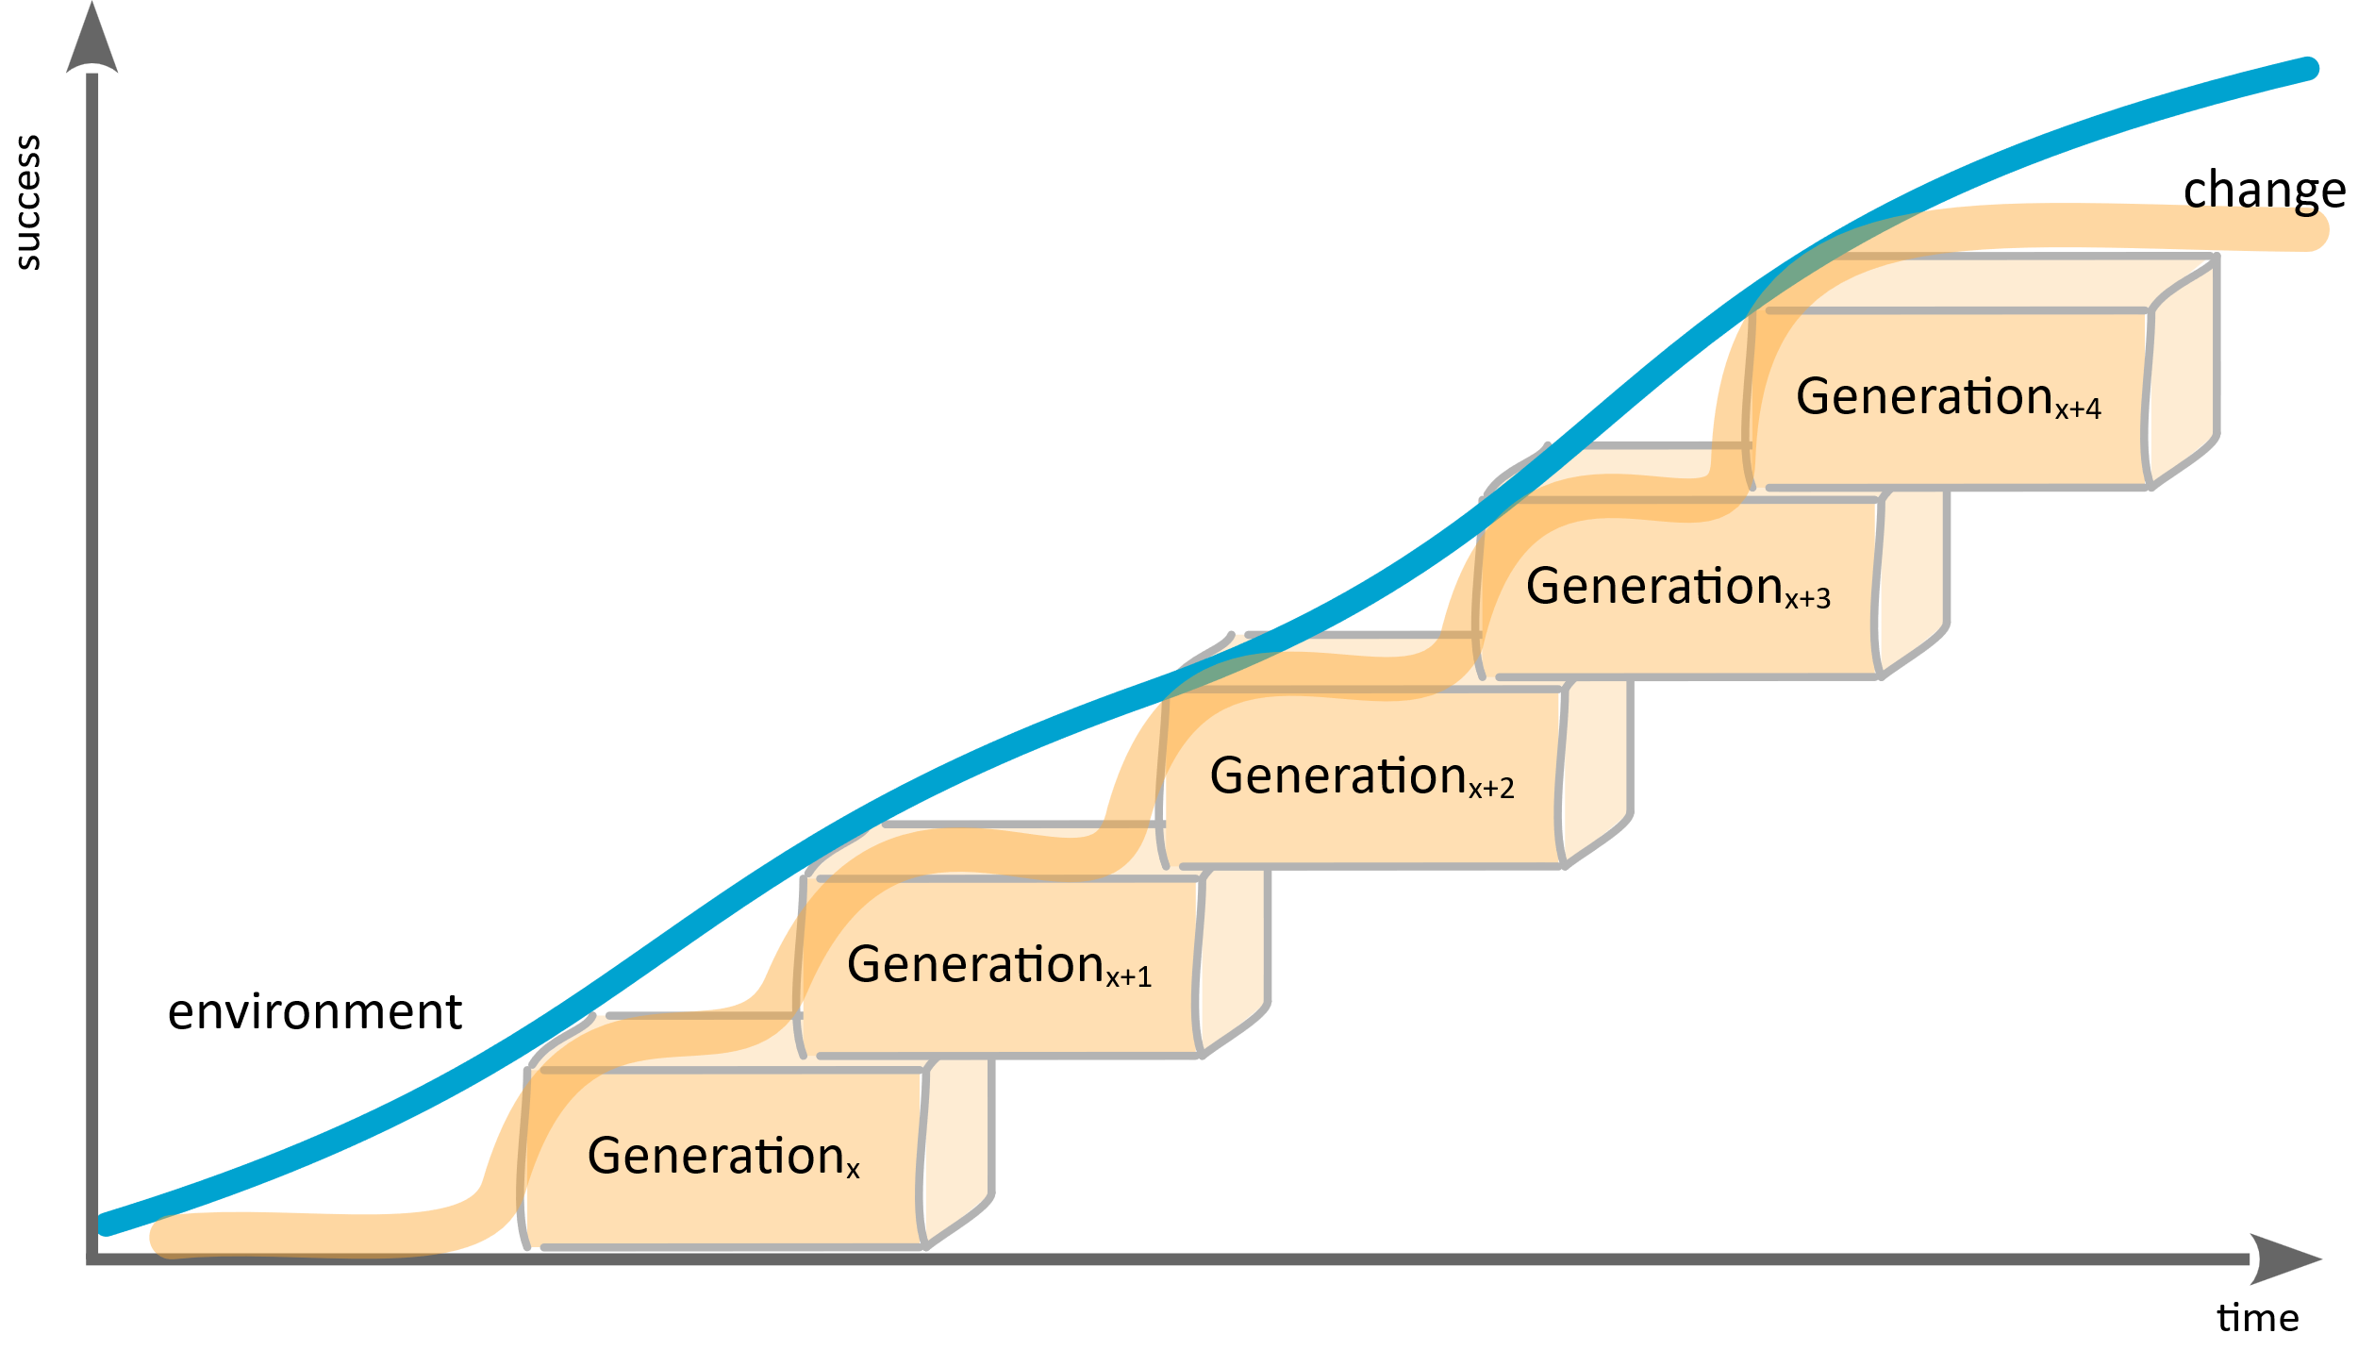
How Populations Should Learn (The Slide that explains Everything)
Welcome
Notes:
Survival over time

Slide 17
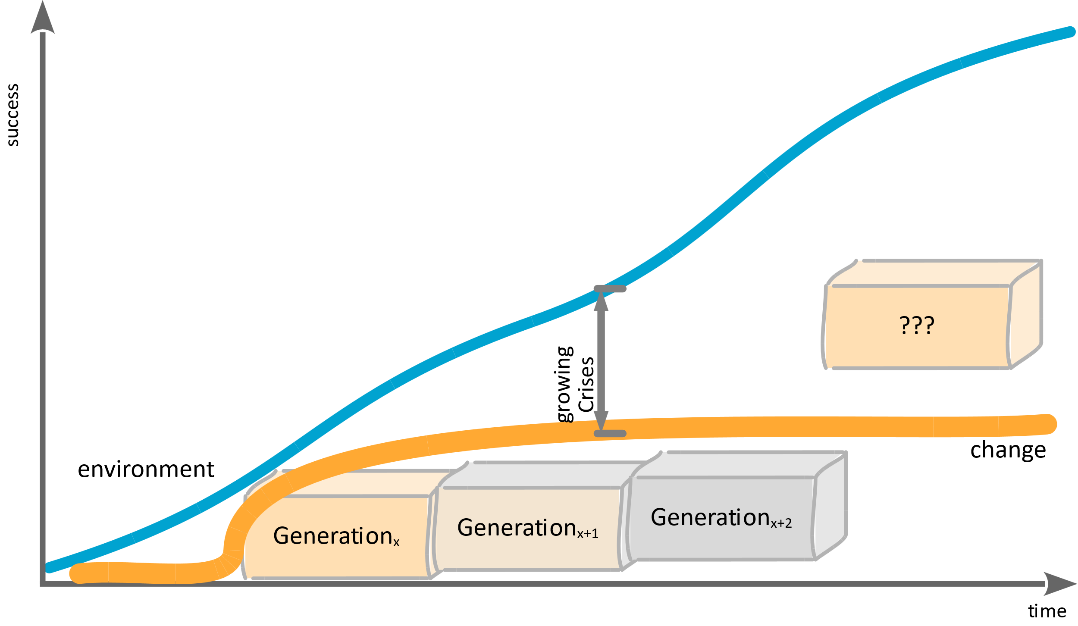
What we did the last 1000 years …
Welcome
“I’m right and you’re not”
Notes:
Suppression is repression. Creates standstill. And stupidity. We loose connection.
Which leads to a crises and then a huge transformation. The need for change projects and transformations is the indicator of this mechanic.

Slide 18
Welcome
The Challenging Thought in the Back of Our Minds:
Can you imagine that AI takes
away your job?
How do you feel?

Slide 19
Welcome
What is your emotional reaction?
Defense? Denial? Excuses? Not me?
Finding examples were LLMs suck?
Comparison to other technological changes (in the past)?
The “there will be new different jobs” pattern? …
Notes:
“why are you so emotional?” I mean what is the value of your life, if you don’t have a job? Please be professional and die silently.

Slide 20
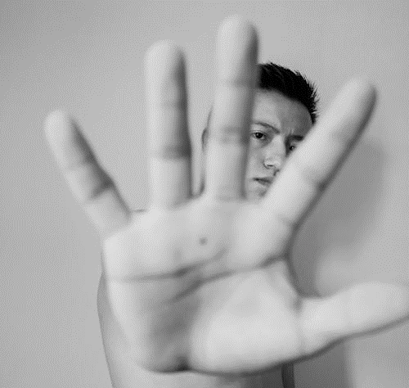
Welcome
“Resistance is
just fear.”

Slide 21
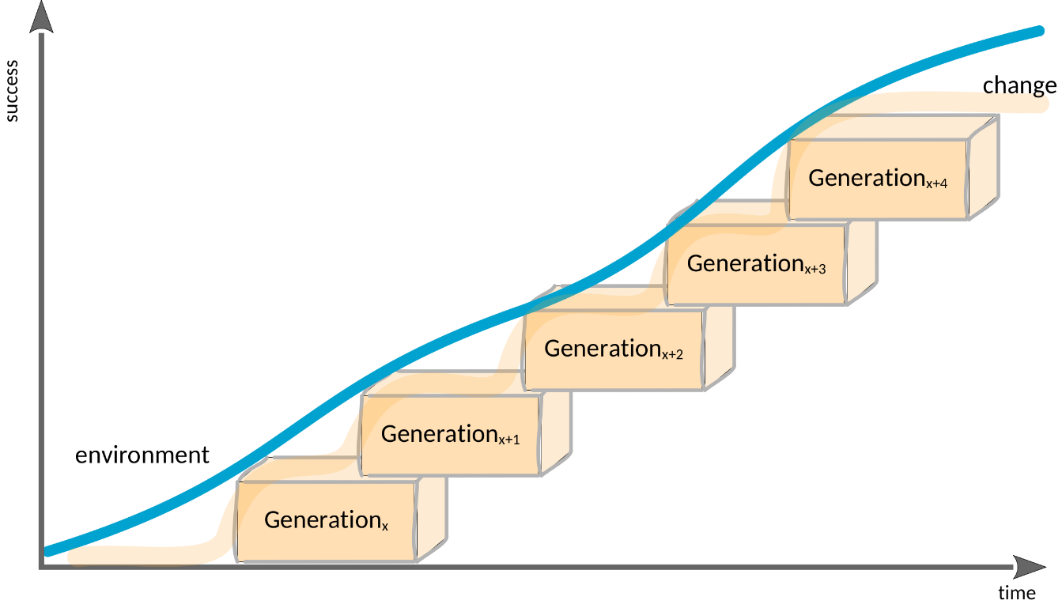
Willingness to Adapt and Survive
Welcome
“The willingness to learn,
is called intelligence.”
Notes:
Humble and open … Little defensiveness, and a lot of trust.
And maybe we all experience currently a bit defensiveness, because we are affected

Slide 22
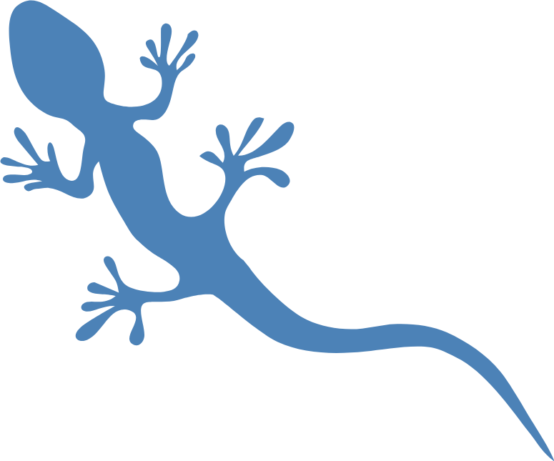
Welcome
“Culture is the set of implicit shared tools and patterns for dealing with emotional uncertainty.”
Notes:
Fear-Mode is always disconnected and therefore uncertainty …
Because we are not in our habitat.

Slide 23
Welcome
So what is fear?
And how to be smart?

Slide 24
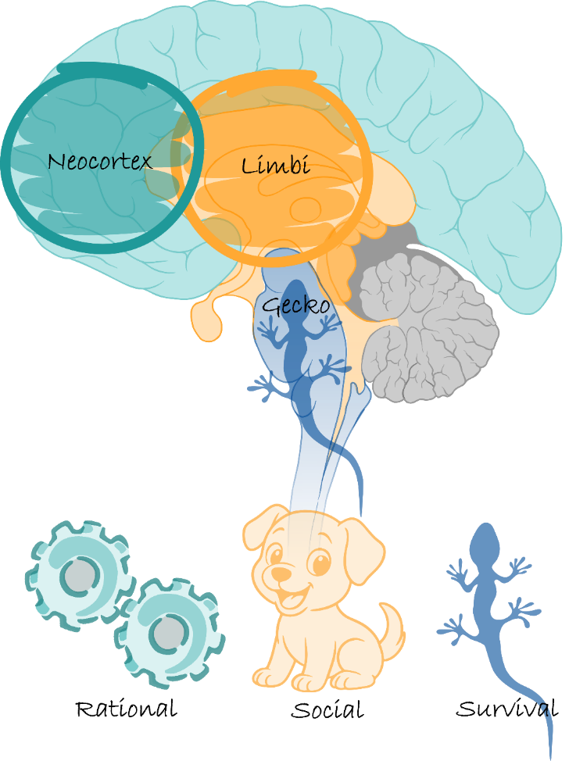
Meet your Brain :)
Welcome
Notes:
Gecko aktiv, bedeutet dass der Rest runtergeregelt ist. Wir denken dann an die Momente, in denen unser Adrenalin hoch ist, aber das kann auch ein Dauerzustand sein. Also Angst-Modus, nicht nur Moment.

Slide 25
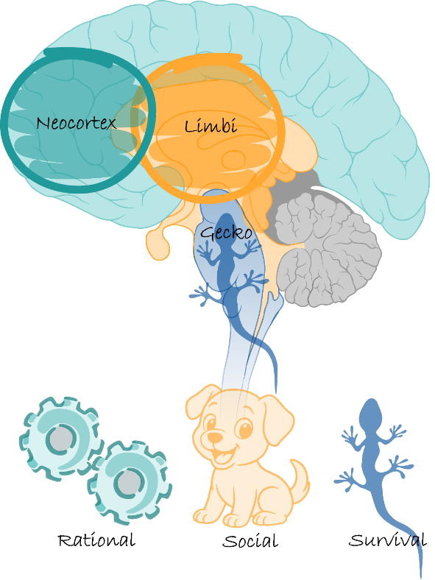
Welcome
Modes of Operation
survival
functioning
living

Slide 26
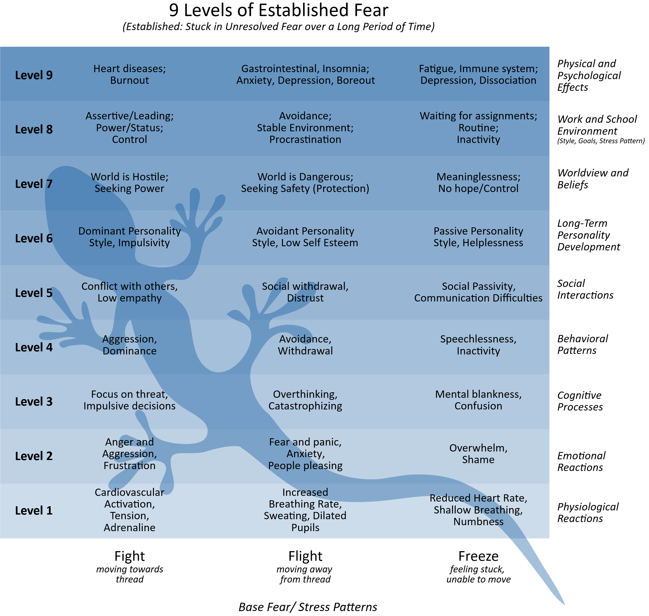
Some interesting marker for fear mode
Welcome
Fear-Mode vs Fear-Moment
Fear can be a permanent state
  survival mode
  rat race
  autopilot
Often we find “fawn” mechanisms for
the underlying fight, flight, freeze
  “fawn” is just social accepted disguise
Notes:
verkleiden

Slide 27
Agenda
Fear > Forecast > Future

Slide 28
Agenda
Fear > Forecast > Future

Slide 29
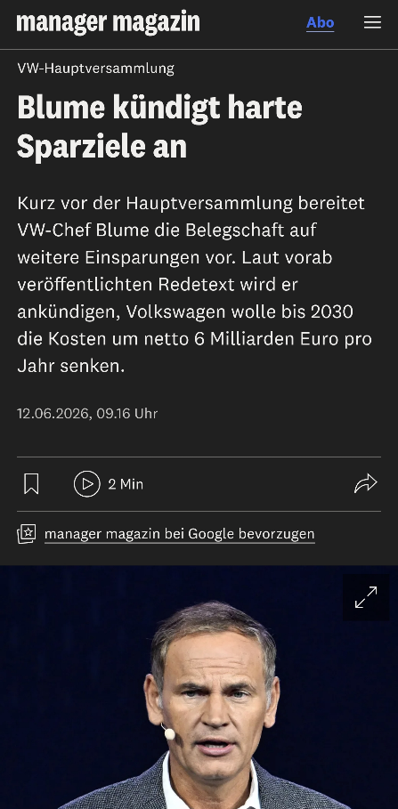
Waves of layoffs already before AI
Fear > Forecast > Future
The first thing is that people have always been—and continue to be—laid off to improve the numbers
The priorities are clear and won’t change
Costs before People
Even politicians view the people merely as a labor force and no longer as a social community

Slide 30
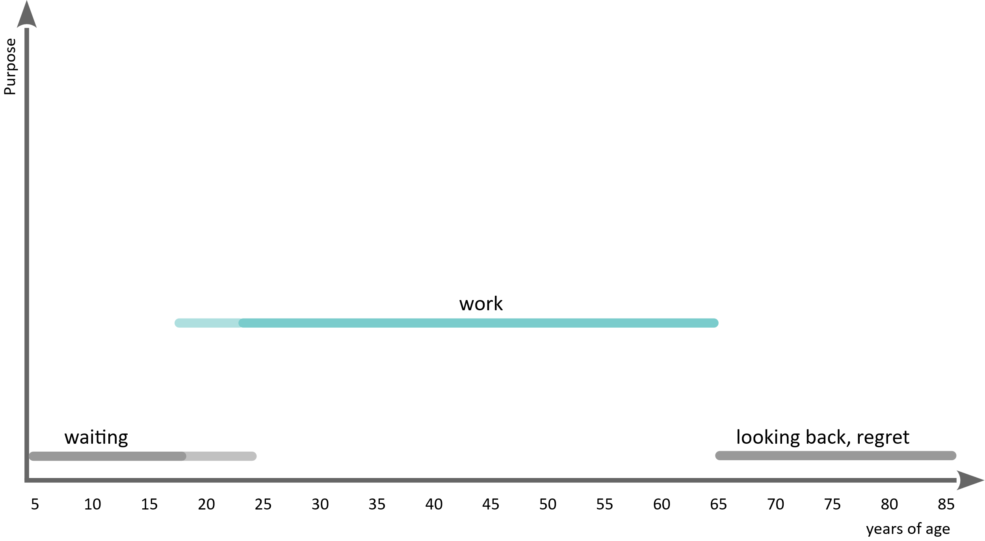
Current Inner Model in Our Society: “Meaning of Life”
Fear > Forecast > Future
Notes:
Preparation for work. And being useless after work. (Before and after you are just cost.)
The main focus of all preparation is to get your labor.

Slide 31
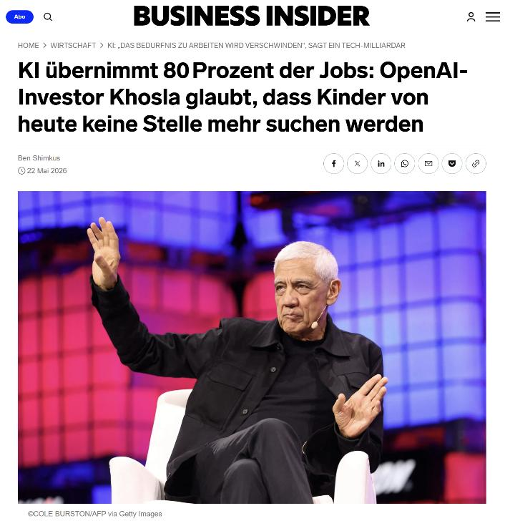
On Top of that the Forecast
Fear > Forecast > Future
AI Will Take Over 80% of Jobs

Slide 32
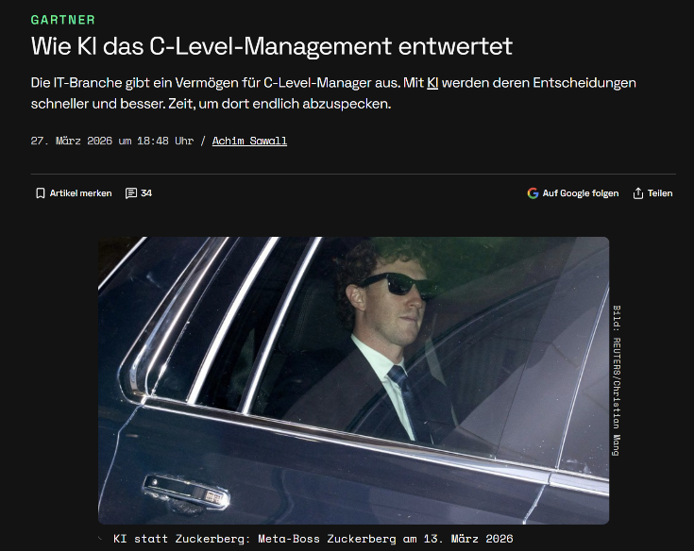
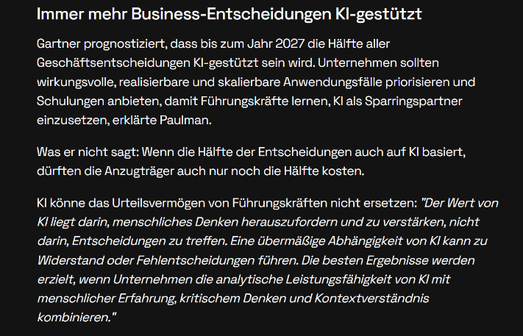
How AI Is Eroding the Value of C-Level Management
Fear > Forecast > Future
It’s not replacement yet, but until 2027 around 50% of business decision AI supported
(Human in the Loop)
  Gartner: Wie KI das C-Level-Management entwertet - Golem.de

Slide 33
The Quiet Takeover … Integration in current Processes
Fear > Forecast > Future
Systems and software engineering:
  AI tools generate code, draft requirements, produce test cases, and flag inconsistencies in specifications
  What used to take a junior engineer a week now takes an AI an afternoon
Quality management and assessment:
  automated documentation, evidence aggregation, compliance checks, and audit preparation are moving from human-hours to compute-minutes
Management and staff functions:
  status reporting, risk registers, meeting summaries, stakeholder communication, planning scenarios. These are AI's natural habitat — text-based, rule-adjacent, pattern-driven
Notes:
New challenge: AI is producing to much, therefore creating bottleneck in review

Slide 34
Update in Worldview
Fear > Forecast > Future
Shopify (Tobi Lütke, 2025)
  “Before hiring a human, prove that AI cannot do the job.”
Duolingo (Luis von Ahn, 2025)
  “Become AI-first.”
Meta (2026)
  “Reorganizing around AI.”
Klarna
  “We went too far.”
Notes:
1. Shopify
Headline:
"Before hiring a human, prove that AI cannot do the job."
Tobi Lütke führte 2025 die Regel ein, dass Teams zunächst nachweisen müssen, warum KI die Aufgabe nicht übernehmen kann, bevor neue Stellen genehmigt werden. AI-Nutzung wird Teil von Performance Reviews.
Signal:
Headcount ist nicht mehr die Standardlösung.
AI wird zur ersten Ressource.
Menschen werden für Aufgaben eingesetzt, die nach AI-Einsatz übrig bleiben.
2. Cloudflare
Headline:
"Builders and Sellers stay. Measurers are at risk."
Matthew Prince unterscheidet inzwischen drei Gruppen:
Builders
Sellers
Measurers
Als besonders gefährdet sieht er viele Rollen rund um Reporting, Compliance, interne Kontrolle, Middle Management, Operations und ähnliche Mess- und Koordinationsfunktionen. Gleichzeitig berichtet Cloudflare von einer explosionsartigen internen AI-Nutzung über nahezu alle Bereiche hinweg.
Signal:
Nicht Entwickler zuerst.
Nicht Vertrieb zuerst.
Sondern die Schicht dazwischen, die Informationen sammelt, verdichtet und weiterreicht.
3. Duolingo
Headline:
"Become AI-first."
Luis von Ahn erklärte Duolingo 2025 zu einer "AI-first company". AI-Nutzung sollte in Performance Reviews berücksichtigt werden, und externe Tätigkeiten sollten schrittweise entfallen, wenn AI sie übernehmen kann. Nach öffentlicher Kritik wurde die Kommunikation später relativiert.
Signal:
AI-Kompetenz wird Teil der Stellenbeschreibung.
Nicht nur Tools ändern sich.
Die Erwartungen an Mitarbeitende ändern sich.
4. Klarna
Headline:
"We went too far."
Klarna wurde zum bekanntesten Beispiel für aggressive AI-Automatisierung. Das Unternehmen reduzierte die Belegschaft massiv, ersetzte große Teile des Customer Supports durch AI und stoppte Einstellungen. Später räumte CEO Sebastian Siemiatkowski ein, dass die Qualität gelitten habe. Inzwischen werden wieder Menschen eingestellt und manche Aufgaben zurückverlagert.
Signal:
AI ersetzt nicht automatisch Menschen.
Die eigentliche Frage ist: Welche Kombination aus Mensch und Maschine liefert die beste Qualität?
5. Meta
Headline:
"Reorganizing around AI."
Meta hat 2026 tausende Mitarbeitende in AI-Rollen umgeschichtet und ganze Organisationsbereiche neu ausgerichtet. Zuckerberg spricht inzwischen offen über Fehler und Lernprozesse während der Transformation.
Signal:
AI wird nicht als Tool eingeführt.
AI wird zur Organisationslogik.

Slide 35
New Organization-Architectures Fulfilling the Prophecy
Fear > Forecast > Future
Cloudflare (Matthew Prince, 2026)
  “Builders and Sellers stay. Measurers are at risk.”
ClickUp (Zeb Evans, 2026): 100x Output
  “AI is changing how engineering organizations are designed.”
  Builders, Agent Managers, Front-Liners
Notes:
1. Shopify
Headline:
"Before hiring a human, prove that AI cannot do the job."
Tobi Lütke führte 2025 die Regel ein, dass Teams zunächst nachweisen müssen, warum KI die Aufgabe nicht übernehmen kann, bevor neue Stellen genehmigt werden. AI-Nutzung wird Teil von Performance Reviews.
Signal:
Headcount ist nicht mehr die Standardlösung.
AI wird zur ersten Ressource.
Menschen werden für Aufgaben eingesetzt, die nach AI-Einsatz übrig bleiben.
2. Cloudflare
Headline:
"Builders and Sellers stay. Measurers are at risk."
Matthew Prince unterscheidet inzwischen drei Gruppen:
Builders
Sellers
Measurers
Als besonders gefährdet sieht er viele Rollen rund um Reporting, Compliance, interne Kontrolle, Middle Management, Operations und ähnliche Mess- und Koordinationsfunktionen. Gleichzeitig berichtet Cloudflare von einer explosionsartigen internen AI-Nutzung über nahezu alle Bereiche hinweg.
Signal:
Nicht Entwickler zuerst.
Nicht Vertrieb zuerst.
Sondern die Schicht dazwischen, die Informationen sammelt, verdichtet und weiterreicht.
3. Duolingo
Headline:
"Become AI-first."
Luis von Ahn erklärte Duolingo 2025 zu einer "AI-first company". AI-Nutzung sollte in Performance Reviews berücksichtigt werden, und externe Tätigkeiten sollten schrittweise entfallen, wenn AI sie übernehmen kann. Nach öffentlicher Kritik wurde die Kommunikation später relativiert.
Signal:
AI-Kompetenz wird Teil der Stellenbeschreibung.
Nicht nur Tools ändern sich.
Die Erwartungen an Mitarbeitende ändern sich.
4. Klarna
Headline:
"We went too far."
Klarna wurde zum bekanntesten Beispiel für aggressive AI-Automatisierung. Das Unternehmen reduzierte die Belegschaft massiv, ersetzte große Teile des Customer Supports durch AI und stoppte Einstellungen. Später räumte CEO Sebastian Siemiatkowski ein, dass die Qualität gelitten habe. Inzwischen werden wieder Menschen eingestellt und manche Aufgaben zurückverlagert.
Signal:
AI ersetzt nicht automatisch Menschen.
Die eigentliche Frage ist: Welche Kombination aus Mensch und Maschine liefert die beste Qualität?
5. Meta
Headline:
"Reorganizing around AI."
Meta hat 2026 tausende Mitarbeitende in AI-Rollen umgeschichtet und ganze Organisationsbereiche neu ausgerichtet. Zuckerberg spricht inzwischen offen über Fehler und Lernprozesse während der Transformation.
Signal:
AI wird nicht als Tool eingeführt.
AI wird zur Organisationslogik.

Slide 36
Zeb Evans (ClickUp)
Fear > Forecast > Future
“The skill is no longer coding.
The skill is judgment.”
We see the deep acceptance of the value of human 2 human interaction externally
The human 2 human internally is missing; fourth “role”: The Connectors
Notes:
Zeb Evans
@DJ_CURFEW
Today we reduced headcount by 22%. The business is the strongest it's ever been. So I think it's important to be direct about what I'm seeing and why. First, I made this decision and I own it. I did it because the way to operate at the highest level of productivity is changing, and to win the future, ClickUp needs to change with it. Second, this wasn't about cutting costs. Most savings from this change will flow directly back into the people who stay. We'll be introducing million-dollar salary bands. If you create outsized impact using AI, you'll be paid outside of traditional bands. Most importantly, I have the deepest gratitude for those affected. We're doing this from a position of strength specifically so we can take care of people properly. Everyone affected receives a package aimed at honoring their contributions and easing the transition. I only see two options: wait for this to play out gradually in the market or be honest about what I'm seeing and act proactively. THE 100X ORGANIZATION The primary change is that we're restructuring around what I call 100x org. The goal is 100x output. The roles required to build at the highest level are fundamentally different than they were a year ago. Incremental improvements to existing systems won't get us there. We need new ones. That means creating enough disruption to rebuild rather than iterate on what's already broken. The common narrative is that AI makes everyone more productive. It doesn't. Many of the workflows of today, if left unchanged, create bottlenecks in AI systems. These roles will evolve. But waiting for that to happen naturally means falling behind now. The 100x org is actually heavily dependent on people - infinitely more than today. This is only possible with 10x people that have embraced and adopted new ways of working. THE BUILDERS, AGENT MANAGERS, AND FRONT-LINERS — THE BUILDERS: 10X ENGINEERS I don't think most companies have internalized what's actually happening with AI in engineering. The common narrative is that AI makes all engineers more productive. That may be true in isolation, but at an organization level - that is the farthest thing from reality. Here's what we've validated recently at ClickUp: the great engineers, the ones who can orchestrate, architect, and review, are becoming 100x engineers. They're not writing code. They're directing agents that write code. The skill is judgment. AI makes the best engineers wildly more productive, and everyone else using AI slows these engineers down. Think about it - the bottlenecks are (1) orchestration - telling AI what to do, and (2) reviewing - what AI did. Everything is leapfrogged and no longer needed. So who do you want orchestrating and reviewing code? And how do you want your best engineers to spend their time? If your best engineers are spending time reviewing other people's code, then this is inherently an inefficient bottleneck. These engineers can review their agent's code much faster than reviewing human code. The new world is about enabling your 10x engineers to become 100x. The wrong strategy is to push every engineer to use infinite tokens. Companies doing this are celebrating 500% more pull requests. But customer outcomes don't match the volume of code being generated. I call this the great reckoning of AI coding, and every company will face this soon if not already. More code is just another bottleneck to the best engineers, and ultimately to your company's impact as well. — THE BUILDERS: 10X PRODUCT MANAGERS Product management and design roles are merging. Designers that have customer focus, become more like product managers. And product managers that have intuition for UX become more like designers. The bottleneck of user research is gone. It takes us just one mention of an agent to kickoff research and analyze results. The bottleneck of product <> design iteration is also gone. The product builder iterates on their own, along with agents and skills that ensure alignment with quality and strategy. Also controversial today - I believe that the wrong strategy is to have your PMs shipping code - that just introduces another bottleneck that the best engineers will waste their time on. To be clear, PMs should be coding but they should do this in a playground to iterate, validate, and scope. That code should not go to production. Everything outside of managing systems, orchestrating AI, and reviewing output becomes a bottleneck. That's why the other roles that are critical along with these are the systems managers (to reduce bottlenecks) along with a bottleneck you can't replace - customer meeting time. — THE SYSTEM MANAGERS Ironically, the people that automate their jobs with AI will always have a job. They become owners of the AI systems - agent managers. We have many examples of these people at ClickUp. The underlying systems in which we operate are absolutely critical to get right. I think most companies are delusional to think they can iterate on existing systems and compete in this new world. You must create enough disruption so that old systems are deprecated entirely. If there's any definition for 'AI native' that's what it is. — THE FRONT-LINERS In a world that will become saturated with AI communication, the human touch will matter more than anything to customers. This is a bottleneck that you shouldn't replace - even when agents are high enough quality to do video meetings. One-on-one meeting time with customers is something that shouldn't be automated. The systems around the meetings should be - so that front-liners spend nearly 100% of their time with customers. REWARDING 100X IMPACT In a world where companies are able to do so much more with less, where does that excess money go? In our case, much of the savings in this new operating model will flow directly back to those that enabled it. We must reward people that create productivity accordingly. This aligns incentives on both sides. Plus, in a world where your best people create 100x impact, you can't afford to lose them. You should aim to retain these employees for decades. The context they have and their ability to efficiently orchestrate and review will be nearly impossible to replace. Compensation bands of today should be thrown out the door. We're introducing $1 million cash/year salary bands with a path available to nearly everyone in the company if they produce 100x impact by creating or managing AI systems. THE FUTURE Nearly every company will make changes like these. The ones that do it proactively will define what comes next. The future is not fewer people. It's different work, new roles, and better rewards for those who embrace it. We're already seeing entirely new roles emerge, like Agent Managers, that didn't exist a year ago. ClickUp is positioning to lead this shift, not just internally, but for our customers too. I've never been more certain about where we're headed.

Slide 37
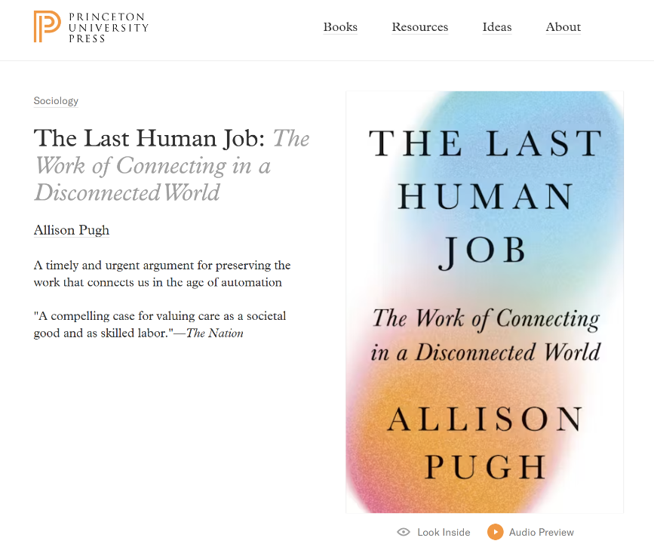
But there is a “BUT”
Fear > Forecast > Future
Smart people already look at the post AI future …

Slide 38
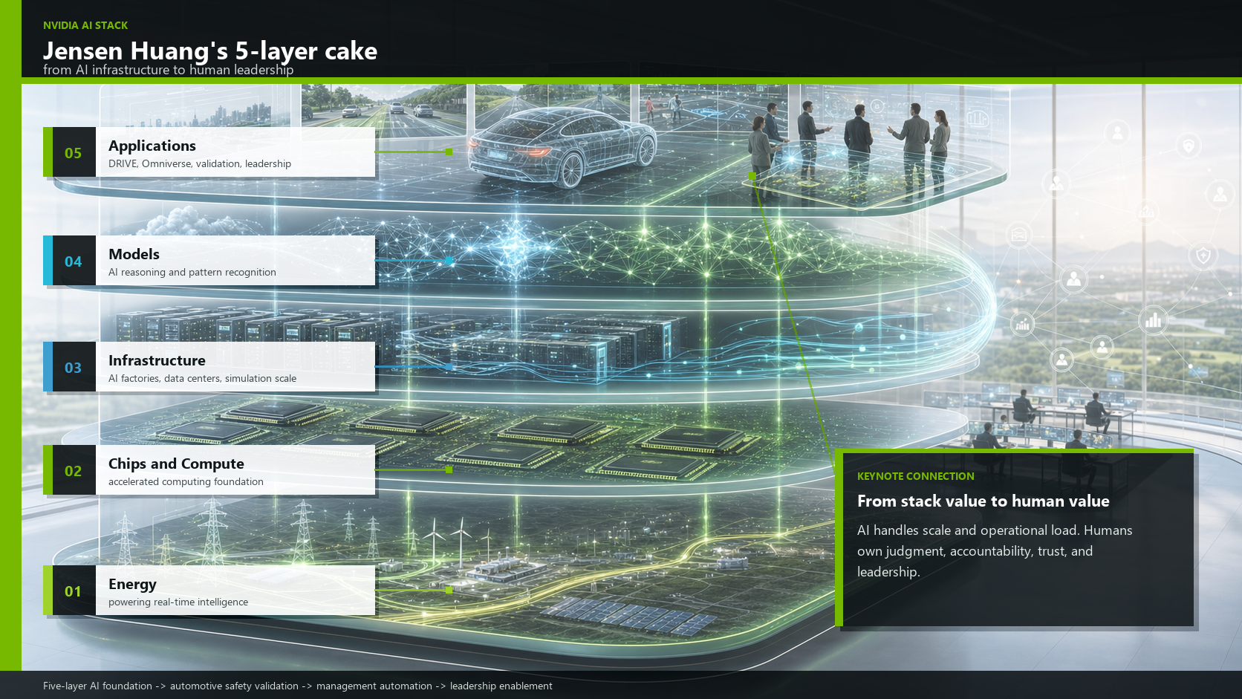

Slide 39
Bhaskar (NVIDIA)
Fear > Forecast > Future
Jensen often describes the AI economy as a five-layer cake, from energy up to applications. This keynote is about the people who make that crucial fifth layer safe and viable. We are showing the automotive industry that while AI factories generate the intelligence, it is the human-in-the-loop who must provide the judgment, accountability, and leadership to bring that intelligence to the road.
You are the gatekeepers of the "Application" layer (Layer 5) Jensen’s model defines the top of the cake—the Application layer—as the place where AI reaches the end user and where the ultimate economic value is realized
However, the automotive application layer is safety-critical and highly regulated (ISO 26262, SOTIF, ASPICE)
Because the models in Layer 4 cannot assume moral or legal responsibility, "human-in-the-loop" architecture becomes the mandatory bridge to make tokens viable in the real world
Both models reject the "Job Destruction" myth Jensen uses the five layers to prove that AI is a massive job creator, requiring everyone from construction workers to build the Layer 3 physical AI factories, to engineers designing the Layer 5 applications
AI doesn't eliminate human work; it transforms it. By using AI to automate documentation and test-case generation, top engineers are freed up to focus on deep architectural safety conversations
AI does not eliminate work; it eliminates the excuse that there is no time for leadership

Slide 40
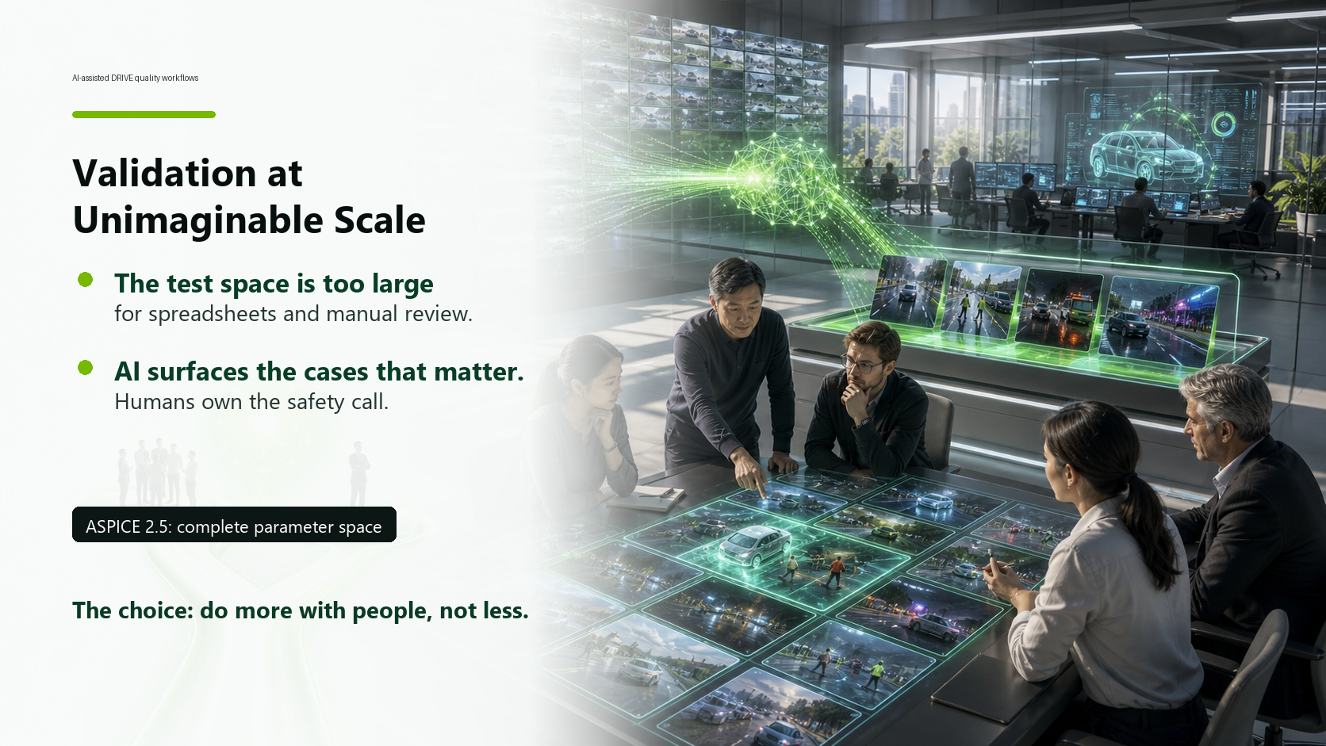

Slide 41
Bhaskar (NVIDIA)
Fear > Forecast > Future
At NVIDIA, we've been building AI-assisted quality workflows into the DRIVE development process but we are also using it to support our daily work. Our management encourages us to experiment with and use AI on a daily basis.
When you're validating an autonomous driving system — when you need to demonstrate that your perception stack behaves safely across tens of thousands of edge cases — you cannot do that with spreadsheets and manual review. The test space is simply too large.
NVIDIA Omniverse generates synthetic scenarios at scale. Our AI testing infrastructure runs millions of simulation miles, identifies failure modes, and surfaces the cases that matter, similar to the keynote yesterday by Jian Peng — the ones that need human review, human judgment, human accountability. The AI doesn't replace the safety engineer. It makes the safety engineer's work possible at a scale that was previously unimaginable.
Some of you may remember the ASPICE version 2.5. It stated that you have to test the system/SW over the complete range of allowed application parameter combinations. At the time this seemed inconceivable and not practical. We removed the statement in version 3.1. Now, AI can support us in deciding which test cases should be included and which ones may be omitted. AI will come up with solutions but we have to decide if they are meaningful in our context.
In Jian Peng’s talk he explained that they have boards which decided on the right approach. This is what we discuss here. AI does not have a legal or moral understanding. We have to make those calls.
But here's the uncomfortable truth that sits underneath this efficiency story: when AI can do more, organizations often choose to do the same with fewer people — rather than to do more with the same people. That's a choice. And it's a choice with consequences.

Slide 42
Fear > Forecast > Future
“I’ve never seen a single technical issue, without an underlying human issue.”
I learned that late …
Notes:
Von meiner Erfahrung hierhin, ist der Weg noch nicht so ganz klar. Das noch schärfen.

Slide 43
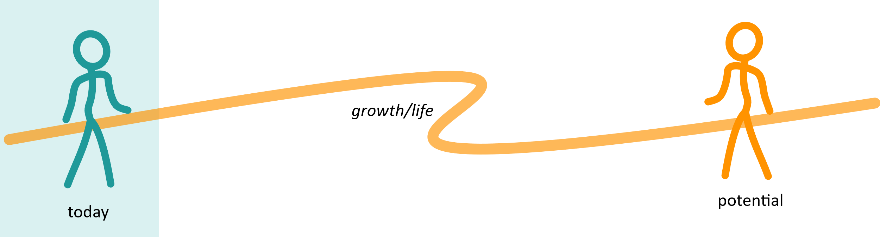
Soft Resistance – Sounds so logical
Fear > Forecast > Future
The need to feel safe keeps us stuck in the past (current).
This is the reason we miss the opportunity to design our future.

Slide 44
Experiment
Fear > Forecast > Future
Please, all of you stand up …
Check the following sentences,
and sit down, if it seems familiar.
(Basically, you ever heard them in your first years of life;
maybe 5 to 7 years old.)
Notes:
Die sind gut, weil sie alle dasselbe Grundmuster tragen: Nicht „ich sehe, was gerade in dir passiert“, sondern „bitte unterbrich deinen inneren Zustand und passe dich an“. Das baut kein Zelt mit Gewalt, sondern mit Wiederholung. Irgendwann lernt das Kind: Mein echtes Erleben ist weniger wichtig als die Form, die erwartet wird.

Slide 45
Fear > Forecast > Future
“Don’t make such a fuss.”

Slide 46
Fear > Forecast > Future
“Don’t make such a fuss.”
“Stop being so sensitive.”

Slide 47
Fear > Forecast > Future
“Don’t make such a fuss.”
“Stop being so sensitive.”
“Don’t be so loud.”

Slide 48
Fear > Forecast > Future
“Don’t make such a fuss.”
“Stop being so sensitive.”
“Don’t be so loud.”
“Behave yourself.”

Slide 49
Fear > Forecast > Future
“Don’t make such a fuss.”
“Stop being so sensitive.”
“Don’t be so loud.”
“Behave yourself.”
“Who do you think you are?”

Slide 50
Fear > Forecast > Future
“Don’t make such a fuss.”
“Stop being so sensitive.”
“Don’t be so loud.”
“Behave yourself.”
“Who do you think you are?” “Don’t be selfish.”

Slide 51
Fear > Forecast > Future
“Don’t make such a fuss.”
“Stop being so sensitive.”
“Don’t be so loud.”
“Behave yourself.”
“Who do you think you are?” “Don’t be selfish.”
“What will people think?”

Slide 52
Reminder: Resistance is your Solution to the Experience
Welcome
“Resistance is
the solution.”
“Don’t be yourself, but be as you’re told, is the lesson.”

Slide 53
All of it keeps us in the Box – Resistance Mode
Fear > Forecast > Future
The need to feel safe keeps us stuck in the past (current).
This is the reason we miss the opportunity to design our future.

Slide 54
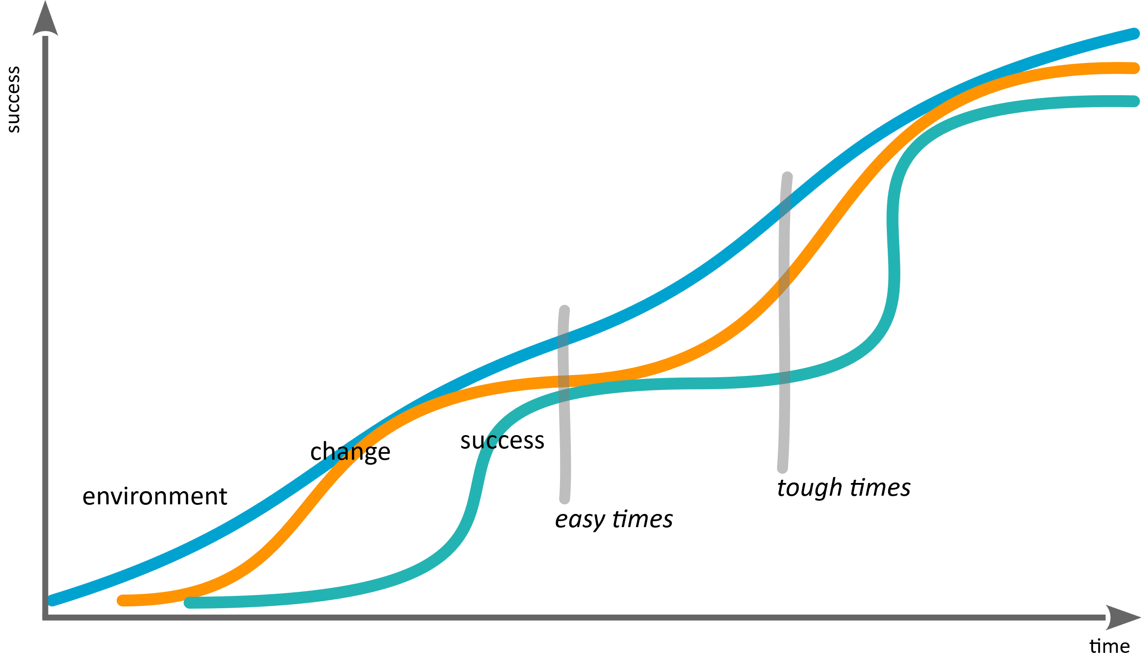
When we are stuck in the past, we will never create future
Fear > Forecast > Future
Notes:
Micropattern shows in Macropattern

Slide 55
Current Question or Fear
Fear > Forecast > Future
Still stuck with:
“AI is taking our jobs”
Notes:
This is the technical perspective …

Slide 56
Excurse: We (humans) are no machines!
Fear > Forecast > Future
But at least since 1600 years most of us must act as ones …
  Feudalism separated the world in Thinking and Working
  1% Thinking
  90% Working (just following commands; no thinking required)
  The “potato field” approach
  (I know that there are unmentioned 9%)

Slide 57
Excurse: We are no machines!
Fear > Forecast > Future
Most of us here would belong to the 90% working (not thinking)
  our purpose was to work as a obedient, cheap, and programmable machines
  our feelings were not valuable (neither hunger nor psychological needs)
  we just need to function
  listening to people talking about the rat race,
  we still follow the same rules, with a much nicer glazing
Notes:
Maybe sth about the hamster wheel … it’s the continuous proof of worth, because my identity was rejected
??? Hamster wheel cards? Most liekely not fast enough

Slide 58
Fear > Forecast > Future
The honest truth is that it’s only a matter of time, until human work force is not needed anymore.
It will happen. Maybe in 3 years or in 15.
Compared to prior industrial revolutions, we are on a meta level.
First time, we will be the worse machines.
Why are we scared about that thought and not happy?
Notes:
In 97% of times if I ask people "if you would enough money – there is no scarcity in your life – would you do the job you are doing?" The answer is "no"

Slide 59
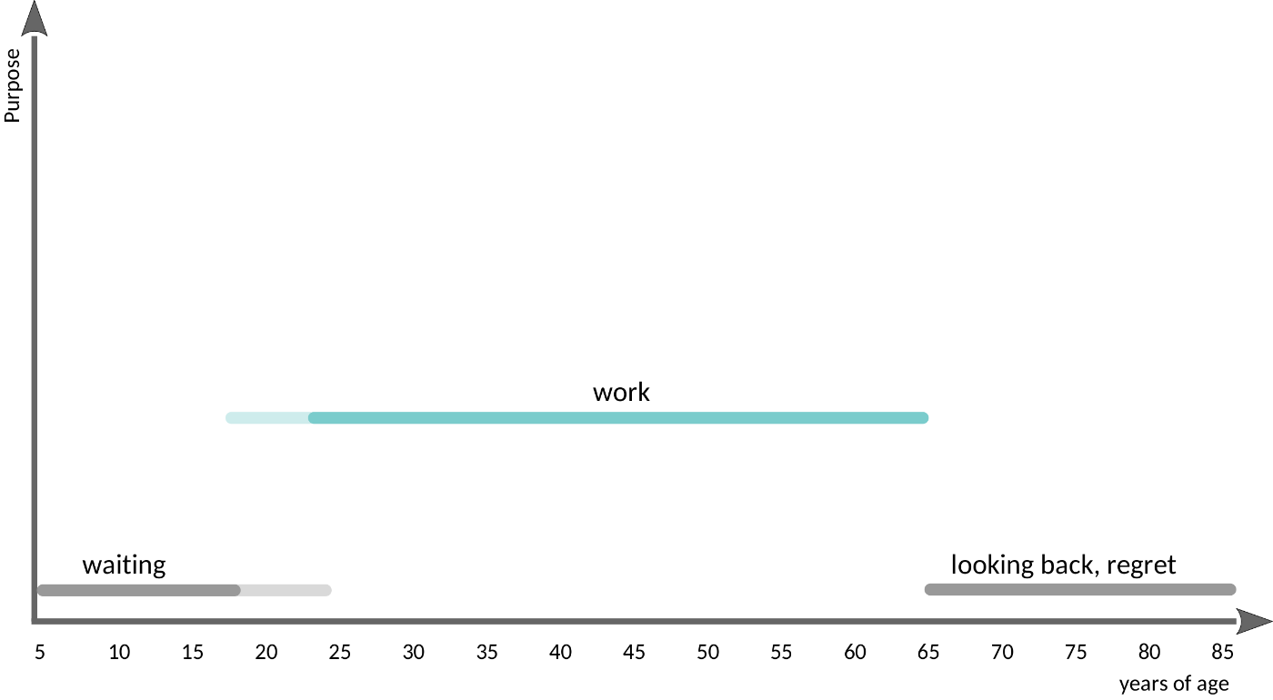
Our Training on „Meaning of Life“ (Feudalism)
Fear > Forecast > Future

Slide 60
„Meaning of Life“ (Feudalism)
Fear > Forecast > Future
Mode of Operation: functioning

Slide 61
Fear > Forecast > Future
Taking away performance (work)
means losing all self-worth.
We are scared of losing our purpose.
Notes:
Clinging to sth we never wanted

Slide 62
Fear > Forecast > Future
The real issue is that we believe that our
value comes from our performance.
That’s the core of the feudalistic worldview. And it’s not true, but useful for the 1%.
If we can get rid of that assumption, we gain freedom to create utopia,
instead of focusing that we lose something
that we actually never wanted.
Notes:
Clinging to sth we never wanted

Slide 63
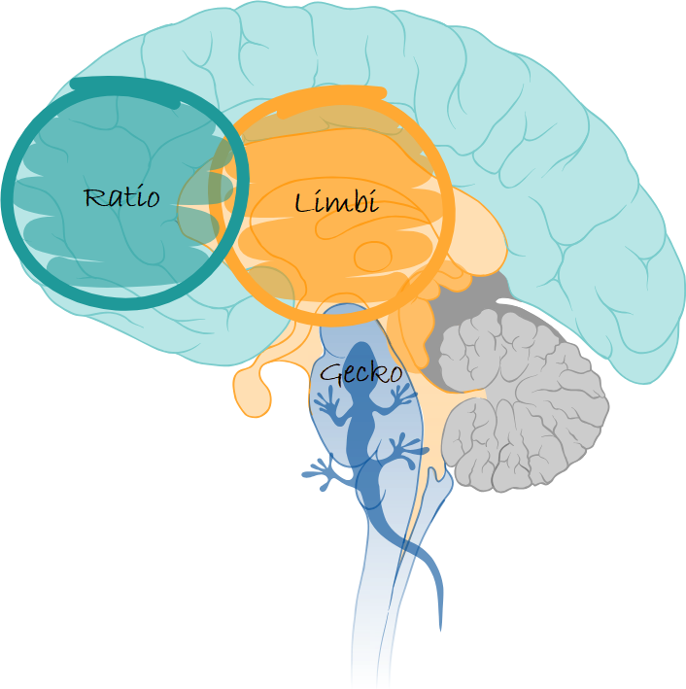
Regulation
Fear > Forecast > Future
The good news: AI takes the strain off our neocortex, allowing the rest of the brain to have a go
  less load (on functioning)
Emotional/social Core Skills are in the Limbi
  more opportunity, growth, development
  (for living)
Notes:
Machine repeats sth that is brilliantly defined. Perfect control.

Slide 64
Human Skills
Fear > Forecast > Future
Basic Human Needs: Connection and Creation
  I need my pack
  I want to make a contribution (every person has their own unique selling point, and that can’t come from a process)
So far, fear has overshadowed basic needs for most people (76 up to 98 out of 100)
Skills we need to develop
  Skills for Connection (Relationship)
  Skills for Creation (needs all levels of psychological safety)
Notes:
Die psychologischen Grundbedürfnisse sind Verbundenheit und Gestalt
Self-Actualization is just the means for Community-Actualization (it’s not a value in itself)
ung.

Slide 65

“Best time is twenty years ago,
the second best time is today.”
You started today,
to be ready for
success in 2030 .

Slide 66
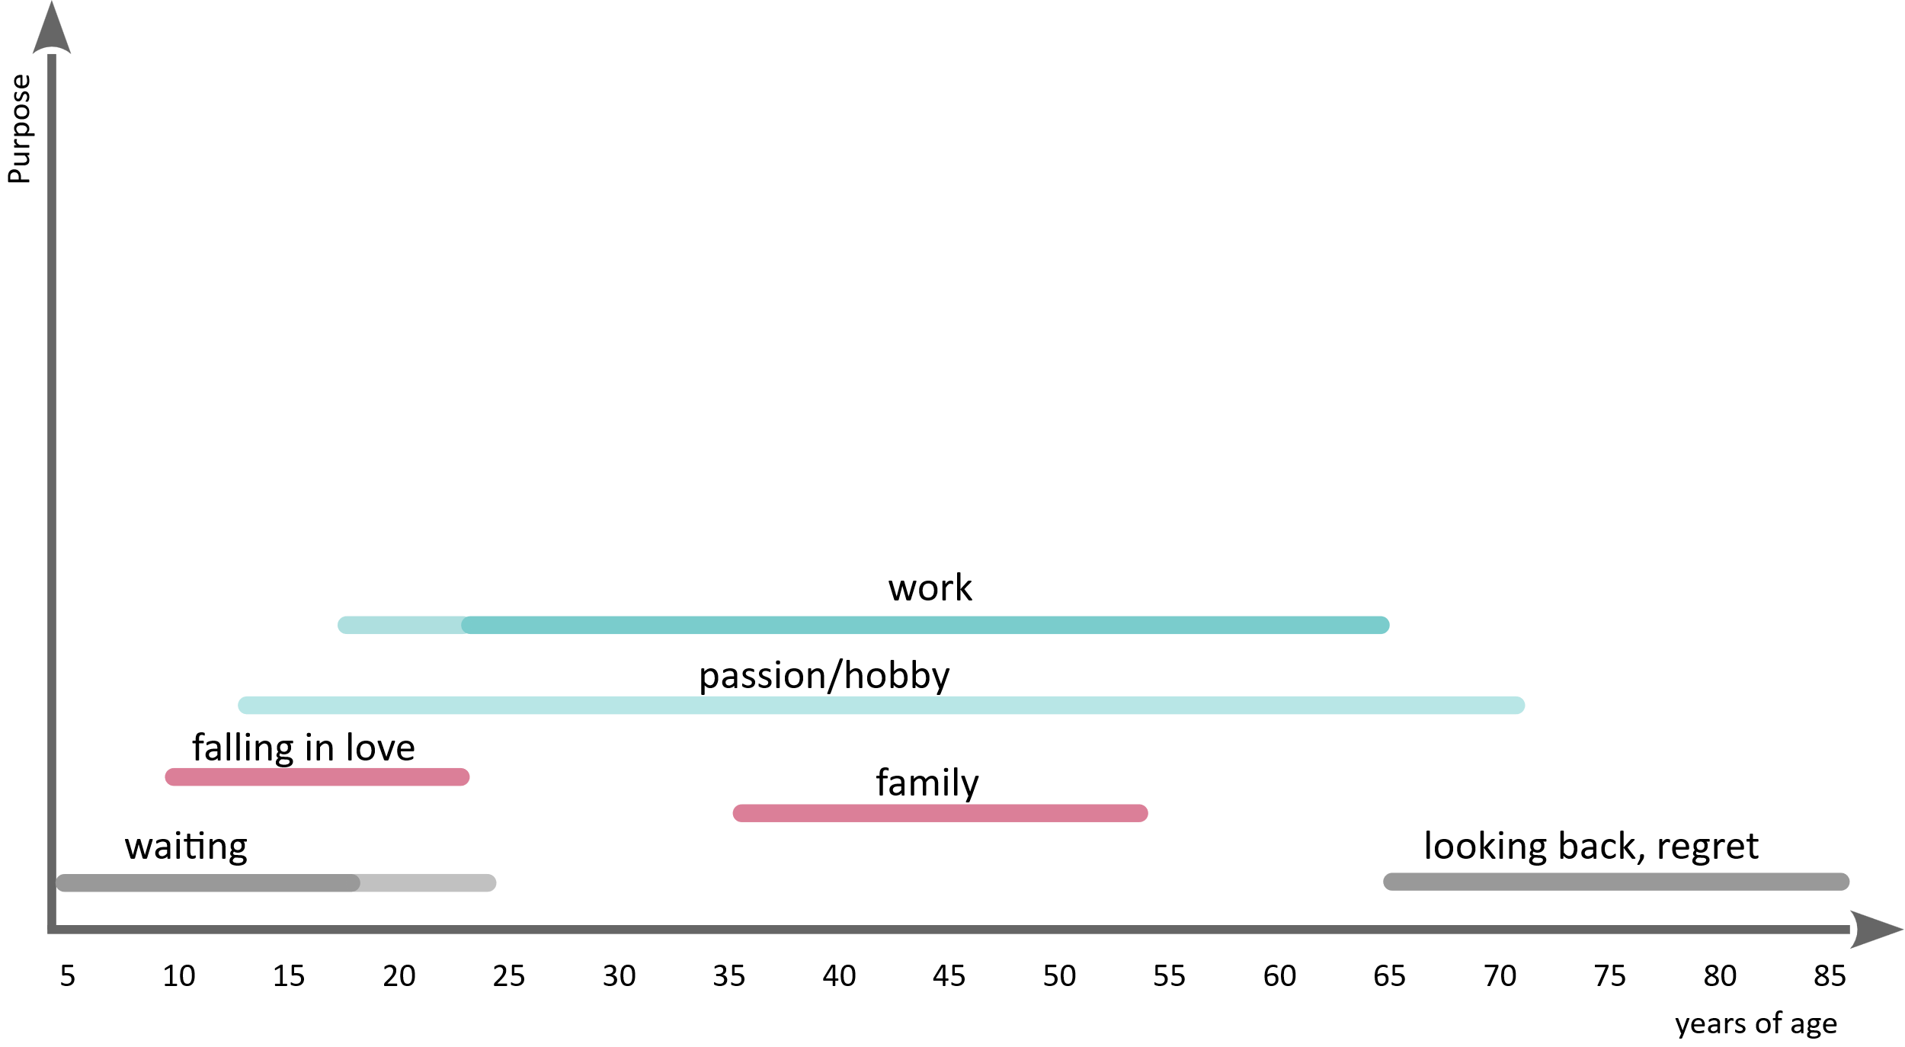
If we can pimp it… it stays slim: everything takes a back seat to money
Fear > Forecast > Future
Notes:
Everything in life had to take a back seat to work. We live under a sense of compulsion.

Slide 67
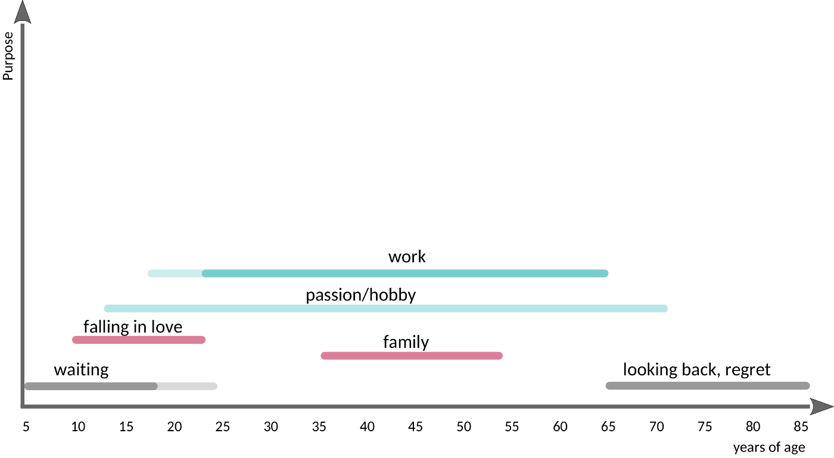
If we can pimp it… it stays slim: everything takes a back seat to money
Fear > Forecast > Future
Mode of Operation: functioning

Slide 68
Fear > Forecast > Future
AI is the catalyst for our
search for meaning
Since millennials and GenZ we are on this quest. AI just speeds it up.

Slide 69
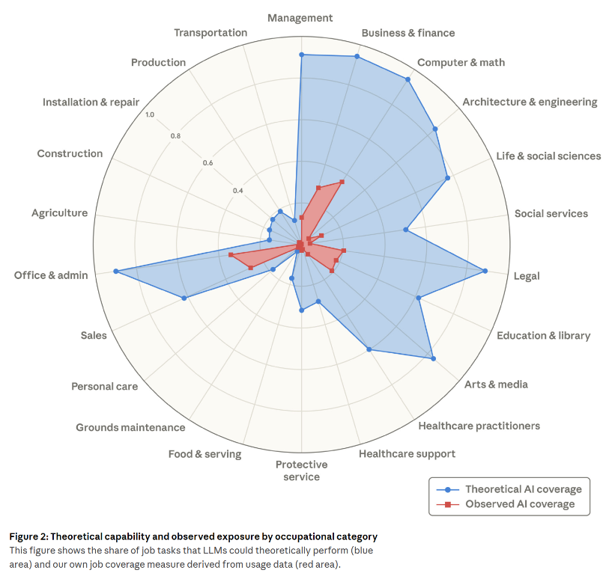
ANTHROP\C: The Reality of Resistance (Fear)
Fear > Forecast > Future
Labor market impacts of AI:
A new measure and early evidence
  Red: what we actually use
  Blue: the (current) potential usage
Report from 2026-03
  https://cdn.sanity.io/files/4zrzovbb/website/2b5bbaf2c1eb81dbf6e6fb813c1a24e35a64d376.pdf

Slide 70
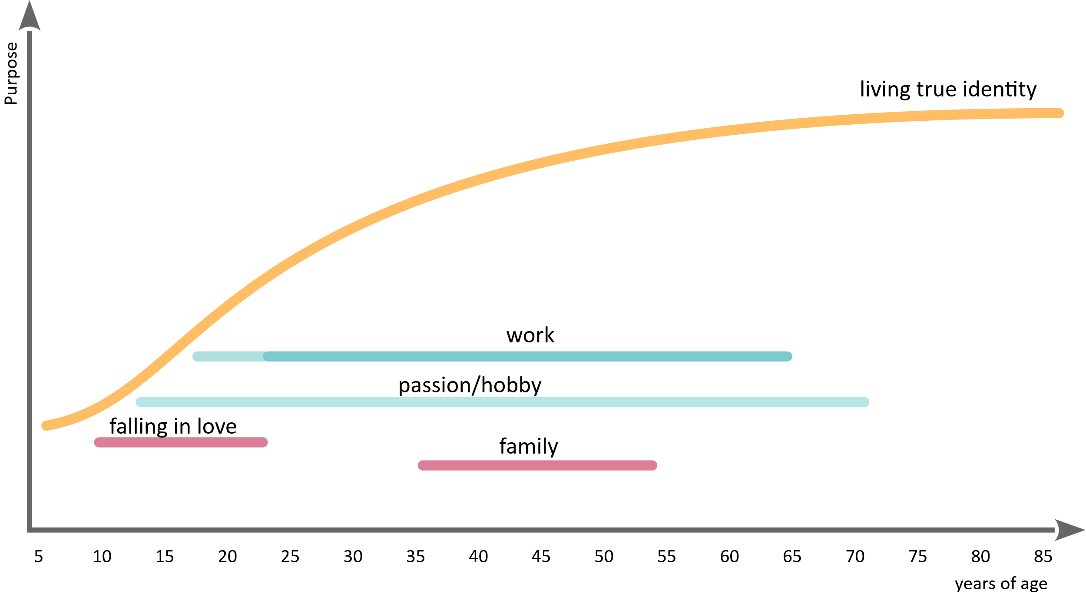
This is what a meaningful life would look like …(i.e., Jane Goodall)
Fear > Forecast > Future

Slide 71
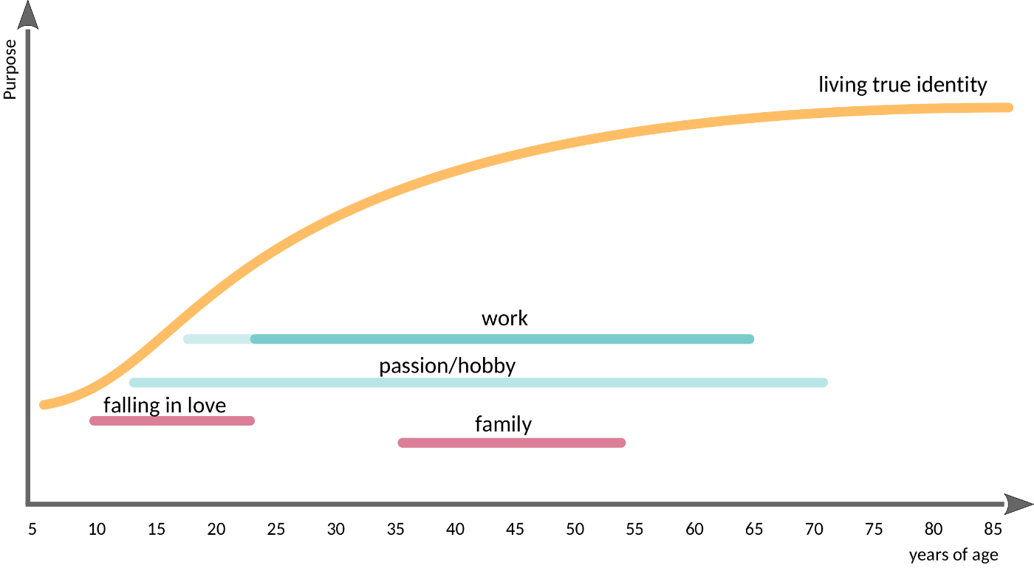
This is what a meaningful life would look like …(i.e., Jane Goodall)
Fear > Forecast > Future
Mode of Operation: living
Notes:
Jane

Slide 72
Agenda
Fear > Forecast > Future

Slide 73
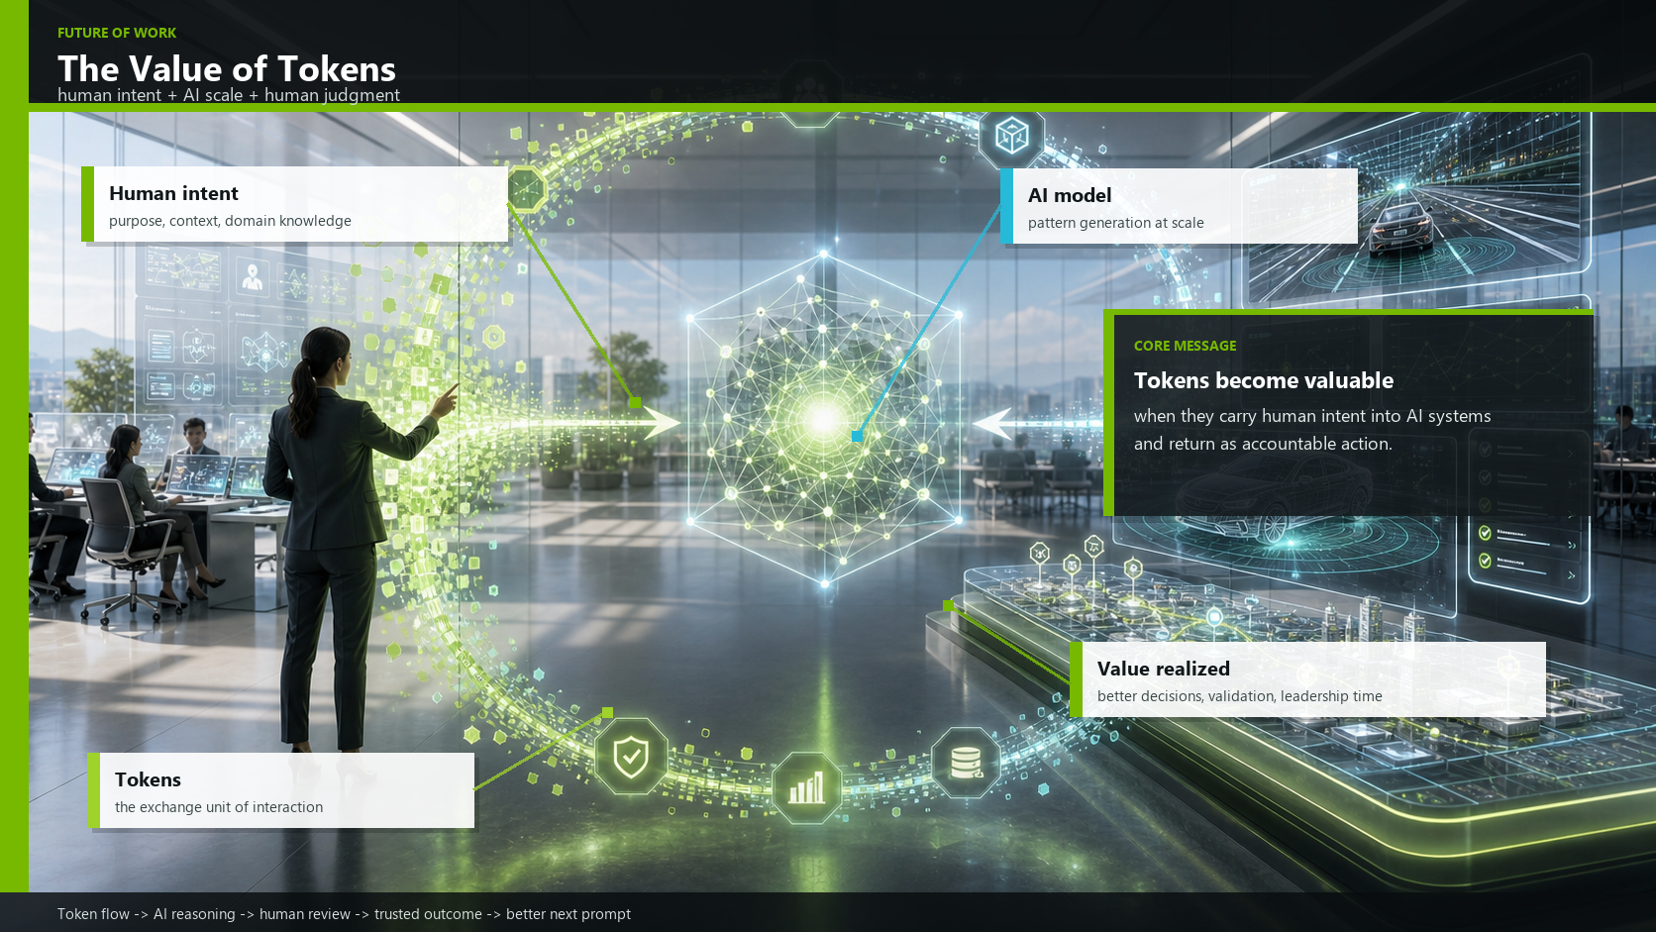
ANNOUNCING
Xxxxxxxx xxxxxxxxxxxx

Slide 74
Bhaskar (NVIDIA)
Fear > Forecast > Future
When we talk about tokens, it can sound very technical. But for the future of work, I would like to frame tokens differently.
A token is not just a fragment of text processed by an AI model. A token becomes valuable when it carries human intent: our purpose, our context, our domain knowledge, our constraints, and our judgment.
On the left side of this picture is the human part: intent. What are we trying to achieve? What matters in this engineering decision? What risk are we trying to understand?
In the center, AI helps us scale. It can process patterns, generate alternatives, summarize evidence, connect information, and explore a much larger space than we could handle manually and do it faster.
But the value is only realized on the right side, when the result comes back into human review and accountable action. Better decisions. Better validation. More time for leadership and safety judgment.
So the future is not “humans versus AI.” The future is the interaction loop: human intent into AI, AI reasoning at scale, human judgment back into the system.
That loop is where the value of tokens really lives.
Two topics I would like to address: As AI produces on the surface polished solutions, better than what we would have produced manually, we have to make an effort to review it and not take it at face value. AI is only good at understanding patterns, but does not understand meaning, morale, ethics etc.
Another topic you can see here. You may remember from Jensen’s five-layer cake that the bottom layer is energy. Tokens come at a cost. At our company, tokens have become one of the biggest cost factors in development. As this is internal, I am not going into specifics, but you know yourselves what kind of costs play into development. The point is, that not only the processes and work in your company is changing but also the cost of aspects of your work.

Slide 75
Current Trends
Fear > Forecast > Future
LLMs → Agent-based systems
  Agents orchestrate APIs, code, data, and other models
  Tool usage is becoming the norm (models systematically access tools)
  Prompt → Agents → Looping
First stable agent swarms
  Multiple agents work together in a coordinated manner on tasks (planners, executors, evaluators)
  Meaning: AI is becoming an organizational structure, not just a feature (orchestration)
Open source is catching up rapidly (e.g., projects like OpenClaw)
  Models are becoming more accessible, customizable, and combinable
  Meaning: AI is being democratized at the infrastructure level
Focus on evaluation and reliability is growing
  More benchmarks, more discussion about hallucinations, trust, and safety
  The first serious efforts toward “AI quality”

Slide 76
Next Level LLMs as a System
Fear > Forecast > Future
Non-autoregressive LLMs
  Diffusion, flow, and masked models generate many tokens in parallel. This could massively speed up the generation of long texts, code variants, and tests.
Few-Step / One-Step Generation
  FS-DFM (Few-Step Discrete Flow-Matching) points the way forward: no longer hundreds of iterations, but rather a few large, trained leaps.
Adaptive Parallel Decoding
  Models dynamically decide how many tokens they can safely generate in parallel. This strikes a balance between quality and speed.
Speculative Decoding & Drafting
  Quickly draft small models, then validate large ones.
  In the short term, this is likely the most important accelerator for today’s LLMs.
Agent-based systems instead of individual models
  OpenClaw is a sign of this trend: AI will not only generate text, but also perform tasks involving tools, files, calendars, code, and communication.
Hybrid models combining LLMs and verification
  The next generation will not only be “smarter” but also more deeply embedded in testers, solvers, type checkers, model checkers, simulators, and traceability graphs.
Quantum computers are unlikely to serve as a short-term LLM booster
  In the long term, quantum computing could transform optimization, simulation, cryptography, and search spaces.
  However, no direct breakthrough is expected for LLM inference or training by 2030.
  The greater lever remains architecture: parallel, sparse, tool-supported, and verified.
Notes:
Die nächste Generation von KI wird nicht einfach ein besseres LLM sein. Sie wird ein System sein: schneller, paralleler, handelnder – und deshalb schwerer zu prüfen.

Slide 77
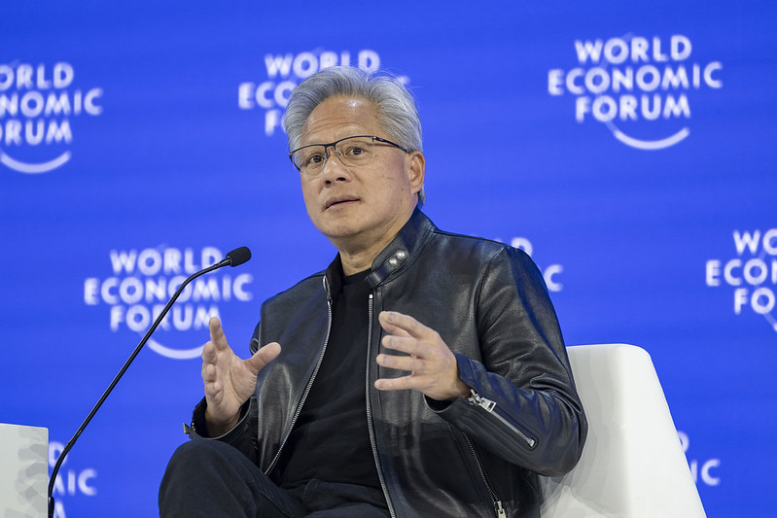
Historical Change Driven by Agentic AI
Fear > Forecast > Future
Level of distribution: Linux 30+ years = OpenClaw 3 weeks
  Nvidia-Chef über OpenClaw: In nur drei Wochen an Linux vorbeigezogen
https://creativecommons.org/licenses/by-nc-sa/4.0/
Notes:
Jensen Huang, CEO von Nvidia, hat auf der TMT-Konferenz von Morgan Stanley nicht nur über die Vorteile der Speicherkrise gesprochen, sondern auch über das Open-Source-Projekt OpenClaw. Es stellt laut der Einschätzung von Huang eine Zäsur dar. Der Manager verglich die Adoptionsrate der Software mit dem offenen Betriebssystem-Kernel Linux.
Huang bezeichnete das Projekt nicht nur deswegen als die wahrscheinlich wichtigste Softwareveröffentlichung aller Zeiten. Die Wachstumskurve verlaufe dabei nicht linear, sondern gleiche eher einer vertikalen Linie auf der Y-Achse. Das Projekt sei mittlerweile die am häufigsten heruntergeladene Open-Source-Software in der Geschichte. Diese Dynamik unterstreicht die Geschwindigkeit, mit der sich die technologische Entwicklung aktuell vollzieht.

Slide 78
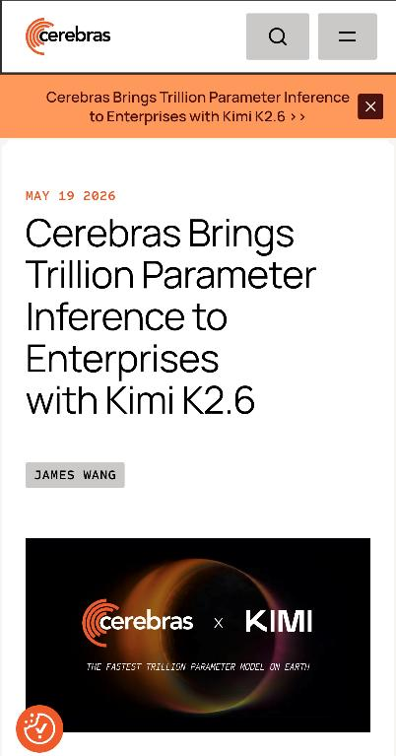
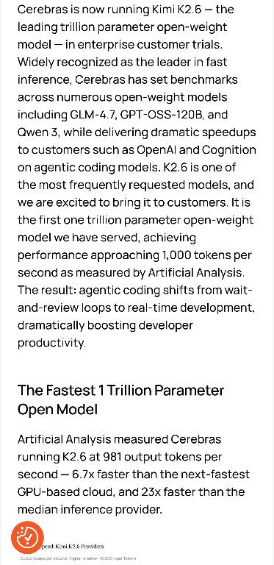
Open Source: Kimi K2.6 (last month), Kimi K2.7 (today)
Fear > Forecast > Future

Slide 79
Fear > Forecast > Future
Leopold Aschenbrenner in Situational Awareness (2024):
Estimating ~5 OOMs
increase until 2030
(OOM: order of magnitude, which is 10x → 50x)
Notes:
Was bedeutet das? Vom 8088 zum 80386? Oder noch mehr?

Slide 80
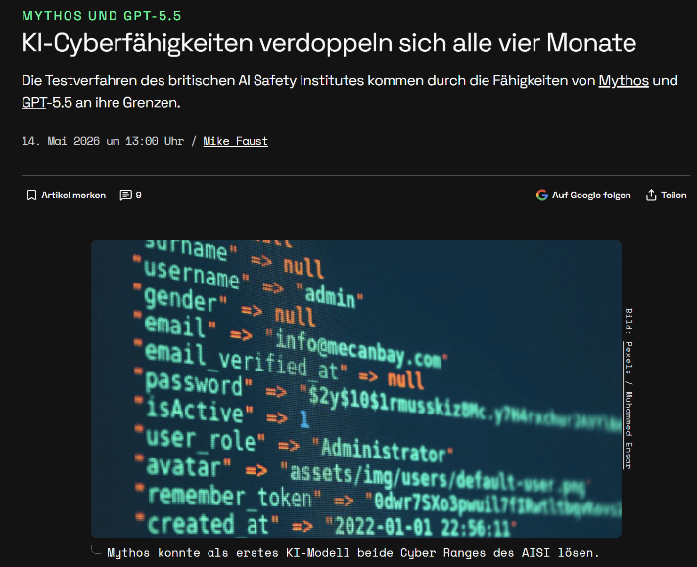
It’s way faster than expected …
Fear > Forecast > Future
AI cyber capabilities double every four months
  Mythos und GPT-5.5: KI-Cyberfähigkeiten verdoppeln sich alle vier Monate - Golem.de

Slide 81
Fear > Forecast > Future
Current speed in Software Engineering (2026) [estimation published May 2026]
2x in 4.2 month
(exponential: let’s even reduce to 2x in 6 month
2x2x2x2x2x2x2x2 = ~256 from 2026; ~1024 from 2024)
Notes:
Was bedeutet das? Vom 8088 zum 80386? Oder noch mehr?

Slide 82
What’s next?
Fear > Forecast > Future
We don’t know
World moves still fast (high fuzziness)
Quantum computing will speed up AI
We still don’t understand how it works, but speed up development

Slide 83
Reminder: We don’t need to discuss today’s details …
Fear > Forecast > Future
Notes:
To visualize the current state, we need
a reference we understand better
Let’s talk about computers
That’s the current level of LLMs
Awesome at it’s time, but a relict from
retrospective

Slide 84
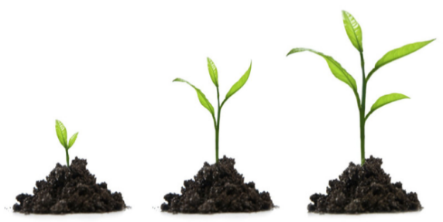
Fear > Forecast > Future
Value = f(context, product)
Notes:
Das kann spannend sein, weil wir dann Kontext-Experten werden können …
Bis wir KI’s bekommen die auch die Umwelt-Erfahrung machen (aber sie werden nicht menschliche Bedürftigkeit erleben)
Mensch als ethische Instanz und Kontext-Experten. Noch müssen wir der KI Richtung geben und auch Schutz vor Angriffen.

Slide 85
AI as Catalysator of Meaninglessness of #Features
Fear > Forecast > Future
“Features will be cheap.
Value will be incredible rare.”

Slide 86

Learning from Books (Information)
Fear > Forecast > Future
Books (availability) → Internet (finding & filtering) → Social Media (usage of attention)
  Information has become worthless; attention is everything (external managed)

Slide 87
Value of the Past Vanishes
Fear > Forecast > Future
1: Generation of Functionality (Features) is cheap
  In the past the #Features was the driver to value of software
2: Generation of Non-Functional Requirements becomes cheap
  We can produce several architectures in parallel
3: Verification & Validation will be cheap
  Claude Mythos/Fable is currently already finding more vulnerabilities then we did ever before

Slide 88
Value of the Past Vanishes
Fear > Forecast > Future
1: Generation of Functionality (Features) is cheap
  In the past the #Features was the driver to value of software
2: Generation of Non-Functional Requirements becomes cheap
  We can produce several architectures in parallel
3: Verification & Validation will be cheap
  Claude Mythos is currently already finding more vulnerabilities then we did ever before
What’s left to create value?

Slide 89
Less is More
Forecast > Fear > Future
Jan Bosch (Professor of Software Engineering): “We use only 4% of Features.”
  Understanding of needs and context will be the key to value
Minimized usefulness
Understanding the Application of the Application
Quality
  Quality captures the usefulness during application!
  What we (humans!) don’t use has no quality (value)
  Focus on Specification follows the assumption that spec’s capture usefulness (wrong)
  Future Quality: Understanding Context shows Purpose and Meaning ...
Notes:
Context bedeutet ein tiefes Verständnis der Anwendung. Menschen die aus dem Kontext, aus der Erfahrungswelt kommen und Kern “rausschälen” können.
“Was brauchen wir wirklich?” Das kann ich mit Daten unterstützen, aber da sehe ich nie die blinden Flecken. Da brauchen wir ein tiefes Verständnis.
Internet was “information overflow”, know we get feature/tool/app/attention overflow. But we crave meaning.

Slide 90
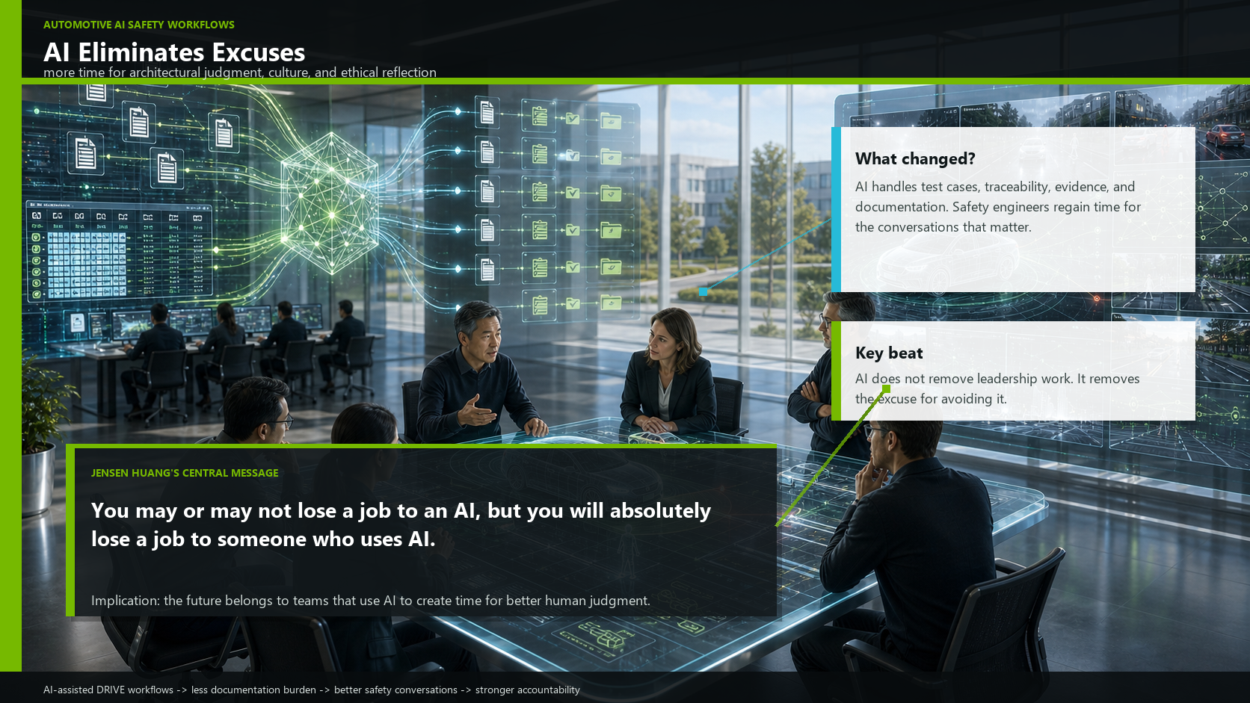

Slide 91
Bhaskar (NVIDIA)
Fear > Forecast > Future
At NVIDIA, we've seen this play out in our automotive engineering teams. When we implemented AI-assisted test case generation and automated traceability tools into our DRIVE development workflows, something unexpected happened: our most experienced safety engineers suddenly had more time to actually talk to each other. To review architectural decisions together. To think about the edge cases that matter — not just the ones the test matrix covers.
The quality of those conversations improved. The depth of the safety analysis improved. Not because the engineers got smarter — they were already brilliant — but because they were no longer buried in documentation.
AI eliminated the excuse. The excuse that there's no time for the conversations that matter.
AI does not primarily eliminate work. It eliminates excuses — particularly the excuse that there is no time for leadership, culture, and ethical reflection.

Slide 92

Management 2 Leadership: Analogy of a Car
Fear > Forecast > Future
Notes:
Bild von Auto
Und dann das: “Wie wäre es, wenn die ganze Zeit einer der Ingeniuere im Auto sitzen müsste und was richtet und korrigiert? Lenkung, Motor, Bremse … alles funktioniert fast richtig, aber der Ingeniuer muss es immer richten, weil das Auto eben nicht das macht, was zu erwarten wäre
Wer operativ eingebunden ist, korrigiert, was an Führung fehlt. Das ich Nacharbeit. Muda.
Leadership ist ein funktionierendes System zu bauen!

Slide 93
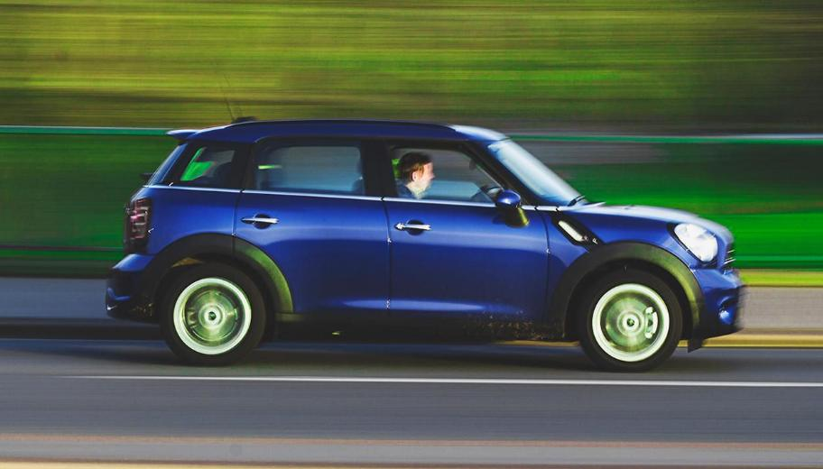
Management 2 Leadership
Fear > Forecast > Future
Imagine one of the engineers had to sit in the car the whole time, making adjustments and corrections
  Steering, engine, brakes… everything works almost right … but only almost
  The engineer always has to fix it because the car just doesn’t do what you’d expect it to.
Those involved in day-to-day operations
correct what’s missing in leadership.
That’s rework. Muda.
  Leadership is about building a system
  that works!
Notes:
Bild von Auto
Und dann das: “Wie wäre es, wenn die ganze Zeit einer der Ingeniuere im Auto sitzen müsste und was richtet und korrigiert? Lenkung, Motor, Bremse … alles funktioniert fast richtig, aber der Ingeniuer muss es immer richten, weil das Auto eben nicht das macht, was zu erwarten wäre
Wer operativ eingebunden ist, korrigiert, was an Führung fehlt. Das ich Nacharbeit. Muda.
Leadership ist ein funktionierendes System zu bauen!

Slide 94
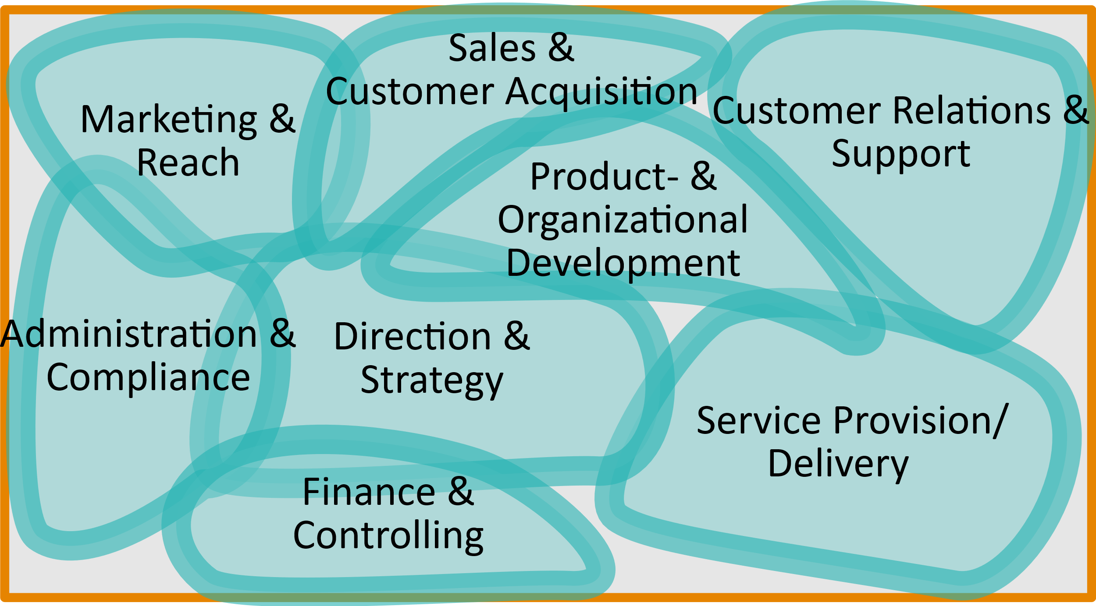
Leadership: Functional Architecture
Fear > Forecast > Future

Slide 95
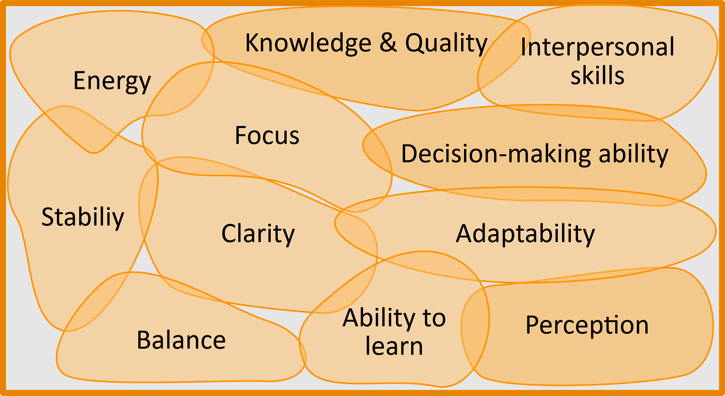
Leadership: Non-Functional Architecture
Fear > Forecast > Future

Slide 96
Leadership: We include the Whole Brain
Fear > Forecast > Future
We add …
  Sense/Meaning/Purpose
  Trust
  Truth
  Connection and safety
  (psychological safety)
Basically: human 2 human connection
Notes:
Trust

Slide 97
Limbi has 7 Parts (Jaak Panksepp; Affective Neuroscience)
Welcome
System | Function (positive) | Activated by… | Blocked by… | Recognizable by… (diagnostic clues)
SEEKING | Motivation, curiosity, flow | Autonomy, meaning, rediscovery | Control, boredom, pressure | Boredom, cynicism, loss of energy, lack of suggestions or ideas
RAGE | Assertiveness, clarity | Justice, protection, self-defense | Powerlessness, injustice | Hostility, microaggressions, sudden outbursts of anger
FEAR | Protection, caution | Threat, uncertainty | Constant uncertainty | Withdrawal, control, excessive caution, the "no" reflex, evasion
LUST | Joy of life, intimacy | Closeness, self-determination, enjoyment | Shame, assault, taboos | Body shaming, fear of physical contact, shame, over-control
CARE | Compassion, empathy | Safety, trust, connection | Distrust, feeling overwhelmed | Cynicism, indifference, withdrawal from relationships
PANIC / GRIEF | Connection, belonging | Loss, isolation, rejection | Separation, exclusion | Overly emotional reactions, exhaustion, neediness, distrust
PLAY | Creativity, learning, flow | Safety, lightness, freedom | Seriousness, control, fear | Sarcasm, withdrawal, playing it safe, phrases like “That won’t work here”

Slide 98

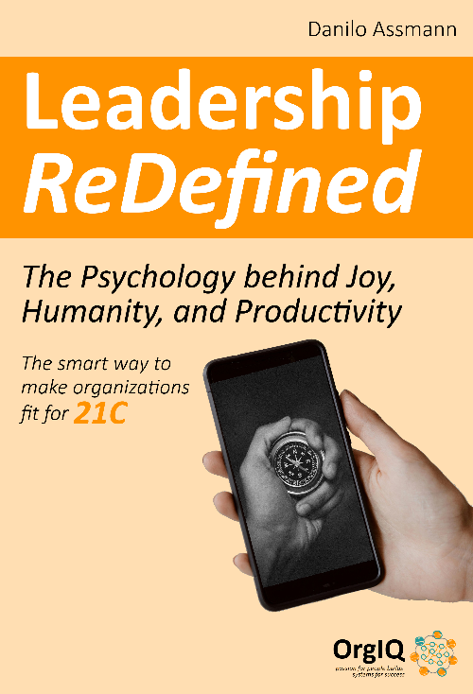
Two Lovely Books on the Topic of Leadership
Fear > Forecast > Future

Slide 99
Another Dark Side of AI
Fear > Forecast > Future
“Great Power comes with even greater Responsibility”
(in many areas AI will be dangerous: deep fakes (trust erosion in online spaces),
security breaches in AI systems and by AI systems,
inequality in access and usage,
overflow of information,
preference for cultural patterns of thought (especially Germany))

Slide 100
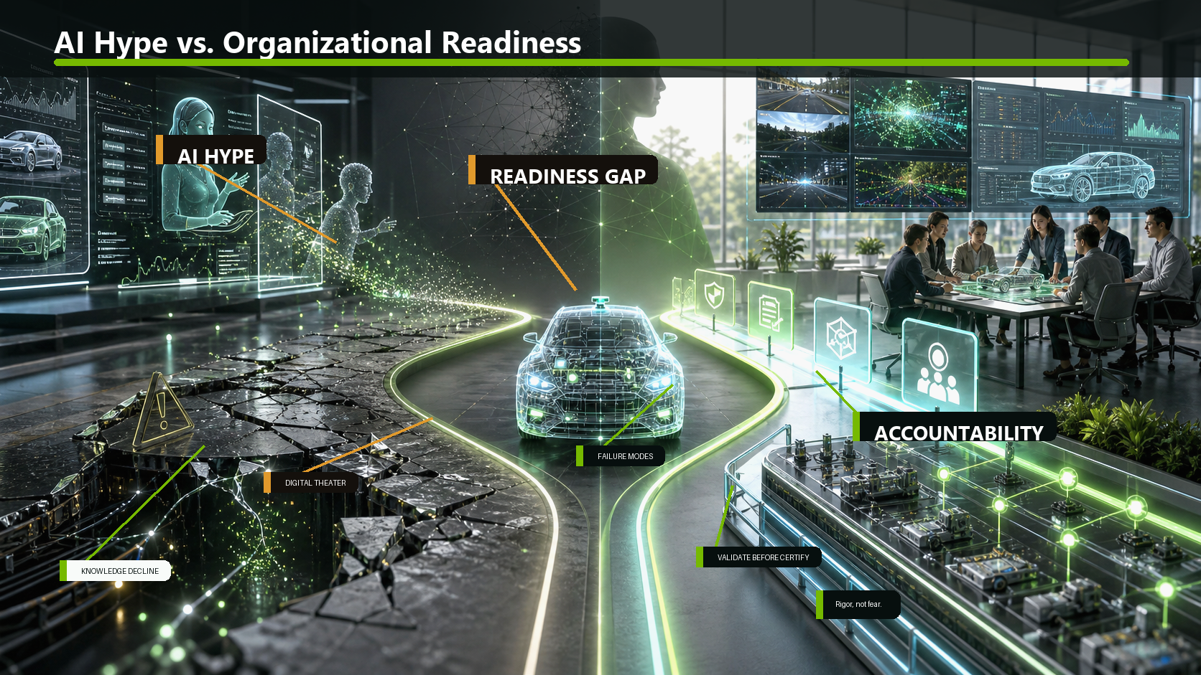

Slide 101
Bhaskar (NVIDIA)
Fear > Forecast > Future
And I want to add one more risk — because I see it in our industry conversations: the gap between AI hype and organizational readiness. You may recall. We had something similar with agile. Whole sections of this conference were dedicated to Agile development for a few years, and companies wanted to use it, regardless of its usefulness in the context.
Gartner and Reuters have both reported that a significant share of so-called "agentic AI" projects — projects where AI is supposed to act autonomously as a kind of digital employee — are being discontinued. Cost overruns. Unclear ROI. Complexity that the organization wasn't prepared for.
There's a real danger of organizations deploying AI tools they don't understand, into processes they haven't redesigned, hoping for outcomes they haven't defined. That's not digital transformation. That's digital theater. And in safety-critical industries, digital theater can kill people.
We had a discussion in the ASPICE working group 13 whether we need to adapt the model to the new way of working. There was also an interesting discussion yesterday in the first set of talks whether assessments will look different in the future. I will not go into details, but looking at the changes we are facing it will definitely impact our processes, and I assume you will agree to that.
If we agree that our processes and approaches will change, then this will have an impact on how we will ensure quality and evaluate it.
The antidote is not fear of AI. It's rigor. The same rigor you apply to any safety-critical system: understand the failure modes, design for accountability, validate before you certify.
Solution to good to be true
We first have to get used to the extremely high and consistent quality of reports and data.
  We aren't used to this. And we tend to confuse a good interface with good content.
  We can only validate the output if our expertise exceeds that of the AI—but for how much longer will that be the case?
There is a strong temptation for managers to lay off genuine experts because they are too expensive, reasoning that the AI's quality is good enough—"you just have to give it a quick look." That is completely understandable at first, but it leads to a total loss of control.
Erosion of knowledge.

Slide 102
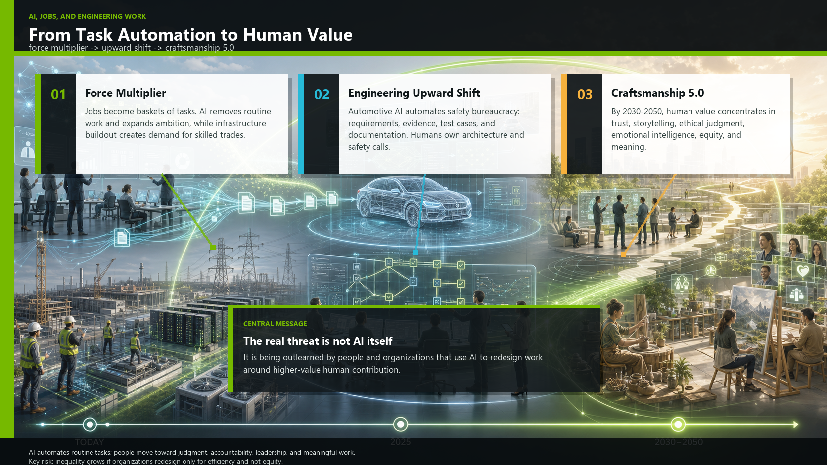

Slide 103
Bhaskar (NVIDIA)
Fear > Forecast > Future
1. The General Macroeconomic Projection
The "Job Destruction" Myth is False Jensen Huang explicitly dismisses the fear of AI causing mass job losses as "complete nonsense". He argues that because AI acts as a "force multiplier," making professionals exponentially more productive, companies will actually want to hire more people, not fewer. He projects there will be more jobs in five years than there are today.
Jobs are a "Basket of Tasks" A job is not a single monolith; it is a "basket of tasks". AI will automate the routine, time-consuming tasks within that basket, freeing humans to focus on the harder, more complex, and more meaningful parts of their work. While this efficiency might eventually pave the way for a four-day workweek, humans will likely become busier because we will use our freed-up time to take on larger, more ambitious projects.
2. The Automotive and Engineering Projection
White-Collar and Management Roles are Hit First The IMF estimates that around 40% of global employment is exposed to AI, with advanced economies seeing the highest impact. Unlike past industrial revolutions that replaced manual labor, so-called blue-collar jobs, the OECD notes that AI is increasingly affecting non-routine cognitive work—specifically white-collar and managerial tasks.
Automating the "Bureaucracy" of Safety In the automotive industry, engineering teams are burdened by massive amounts of documentation required for rigorous safety frameworks like ISO 26262, SOTIF, and ASPICE. AI is fundamentally restructuring these roles by automating text-based and pattern-driven tasks, such as generating code, drafting requirements, aggregating evidence, and producing test cases.
The "Upward Shift" to Leadership and Accountability Because AI models are "stochastic parrots" that lack grounded understanding, ethical agency, and the ability to take legal responsibility, they cannot replace the human engineer. Instead, human effort systematically shifts upward. In automotive workflows, for instance, tools like NVIDIA Omniverse handle the massive scale of generating synthetic driving scenarios, while the human safety engineer's job shifts from manually generating documentation to deeply analyzing architectural edge cases and making the ultimate safety calls. AI eliminates the excuse that engineers have "no time" for leadership, cultural development, and ethical reflection.
3. Long-Term Risks and Societal Shifts (2030–2050)
Asymmetric Inequality While highly skilled engineers will become force multipliers, the IMF and ILO warn of asymmetric impacts across qualification levels. Administrative and clerical roles—which are disproportionately held by women and are often lower-paid—are highly exposed to automation, posing a risk of exacerbating inequality if organizations do not design for equity.
The Transition to "Craftsmanship 5.0" Looking toward 2050, as machines become the better machines, "humans must become better humans". Uniquely human traits like storytelling, emotional intelligence, and the appreciation of imperfection (wabi-sabi) will become premium skills. Long-term projections suggest that as extreme automation continues, income and consumption may eventually need to be decoupled from traditional full-time employment. This could lead to an era where humans engage in "Craftsmanship 5.0"—working out of a desire for meaning, quality, and social contribution rather than pure economic survival.

Slide 104
Agenda
Fear > Feudalism > Future

Slide 105
Self-Check
Fear > Feudalism > Future
If you can put it into a process, AI will be happy doing it for you.
Notes:
Assumption ~95%

Slide 106
Feudalistic Machine Logic
Fear > Feudalism > Future
A workforce designed
to be replaceable is replaceable.

Slide 107
Fear > Feudalism > Future
The honest truth is that it’s only a matter of time, until human work force – as we know it – is not needed anymore.
It will happen. Maybe in 3 years or in 15.

Slide 108
Fear > Feudalism > Future
But…
Let’s switch perspective and look closer.

Slide 109
Fear > Feudalism > Future
Robots have never taken a job
away from humans.
From the very beginning, those jobs were intended for robots.
But since robots didn’t exist back then, humans were used as a substitute.
Notes:
This is actually the key … should be also emotional (from the story line) … fear of losing must be created before, and then we see that we lose sth, we actually never wanted. And just now are scared, because it’s all we know.
It’s just familiarity of pain.

Slide 110
Fear > Feudalism > Future
Everything you could formally define, is machine work,
which was never intended for humans.
(Basically we need to teach AI “laziness”.
Because the best ideas came out of limited resources and motivation.
Looking for a shortcut is the best source of creativity.)

Slide 111
Fear > Feudalism > Future
What exactly are human abilities?
Individuality and complexity, not automation.
Craftsmanship (5.0) is human. Complexity, variety, vitality… music, art, philosophy, connection, … life
Notes:
Conflicting worldviews of jigsaw/puzzle versus standardized bricks

Slide 112
Fear > Feudalism > Future
Feudalism is based on the idea that humans are a substitute for robots.
(Cheap labor. Cheapest workforce.)
Notes:
Aber es war völlig überflüssig oder vergeblich, sich darüber den Kopf zu zerbrechen. Die Welt ist, wie sie ist.
Die Idee der Roboter war schon immer eine der “Gutmenschen”: Sie wollten gesellschaftliche Probleme mit Technik lösen.

Slide 113
Fear > Feudalism > Future
But since robots didn’t exist back then, humans were used as a substitute.
Notes:
Ratio is supported or substituted, but the rest is not affected … the rest of the brain is not “replaced”

Slide 114
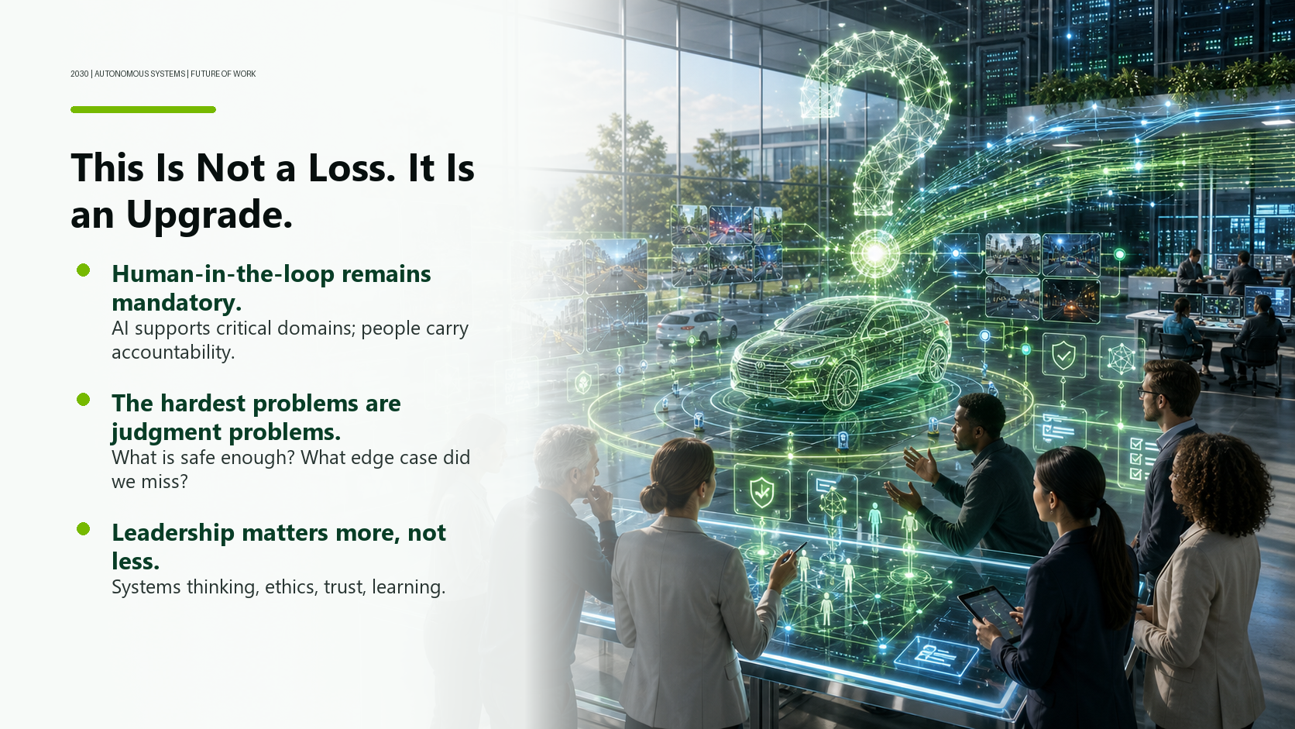

Slide 115
Bhaskar (NVIDIA)
Fear > Feudalism > Future
By 2030 — which is not far away — we expect AI systems to remain limited in understanding and accountability. Human-in-the-loop models will be mandatory in critical domains, including automotive safety. The demand for skills like systems thinking, ethical judgment, leadership, and continuous learning will intensify.
And here's what we believe: this is not a loss. It's an upgrade.
The work that will remain most human is the work that was always most human: asking the right questions, navigating genuine uncertainty, building the relationships that make coordination possible, bearing responsibility for outcomes that matter.
At NVIDIA, our mission is to build the computing infrastructure for the age of AI. But we've learned something important along the way: the hardest problems in autonomous systems aren't compute problems. They're judgment problems. Who decides what's safe enough? How do you handle the edge case you didn't anticipate? How do you build an organization that can learn from failure without being destroyed by it?
Those are leadership questions. And they're getting more important, not less.

Slide 116
Fear > Feudalism > Future
Simple Math:
If productivity and income
hadn’t been decoupled in the 1970s,
we would have around
15-20 family working hours/week by now.
(Pre-AI: in the 1960s one 40h/week income was enough to have everything)

Slide 117
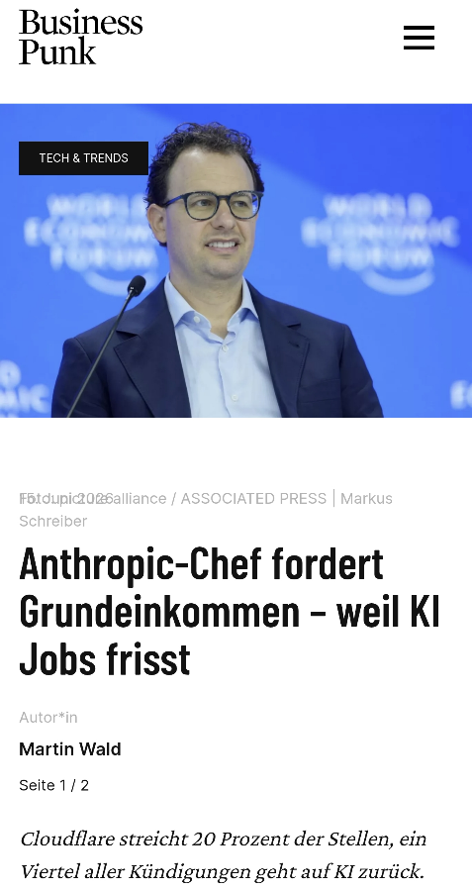
Fear > Feudalism > Future
Anthropic CEO calls for a basic income
  “AI is taking away jobs”
  Reason is the 20% cut at Cloudflare
It's a systems logic argument
  Fully automated production still needs
  purchasing power
  Production decoupled from consumption means system requires adaptation
  We choose for whom it’s beneficial

Slide 118
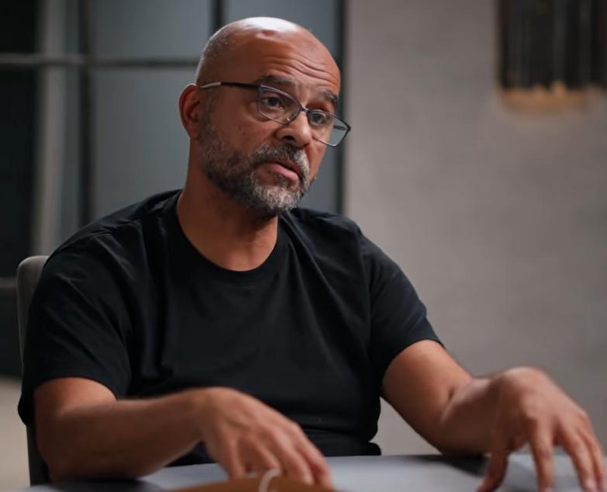
Mo Gawdat (Ex-Google)
Fear > Feudalism > Future
“Artificial Super Intelligence will arrive
the minute AGI happens.”
“I genuinely believe that we will end up in a utopia of abundance.”

Slide 119
Mo Gawdat (Ex-Google)
Fear > Feudalism > Future
“Artificial super intelligence will arrive the minute AGI happens.”
“I genuinely believe that we will end up in a utopia of abundance.”
“Not because our leaders have suddenly turned ethical, but because our unethical leaders have gone out of the equation and were replaced with a super efficient minimum energy principle that doesn’t see value in anything that's destructive.”
“lean into AI and the second one is like lean into human connection and lean into the truth. Don't be fooled by the hype. Uh, you know, try to be more informed, I think. And then finally, ethics.
Source: Ex-Google Officer: You Only Have 3 Years Left Before It Hits! - Mo Gawdat?
Notes:
Something from Ex-Google Officer: You Only Have 3 Years Left Before It Hits! - Mo Gawdat?
artificial super intelligence will arrive the minute AGI happens. So it doesn't really matter if AI is a billion
1:51:26 times smarter than you or just twice as smart as you. Once we cross beyond AGI,
1:51:32 ASI is just yeah, very very soon. And uh and yeah, I think we'll overcome
1:51:42 that when we get to the fourth inevitable when AI is in charge of everything. I genuinely believe that we
1:51:49 will end up in a utopia of abundance. I genuinely believe that
1:51:54 again physics, mathematics and biology will tell you that super intelligence is benign and that we will eventually end
1:52:02 up in a good place. Not because humanity has done much to get us there. Not
1:52:07 because our leaders have suddenly turned ethical, but because our unethical leaders have gone out of the equation
1:52:13 and were replaced with a super efficient minimum energy principle that doesn't
1:52:20 see value in anything that's destructive. So, the future's going to be great. Those who make it to 2038 will enjoy it.
1:55:16 So I've got two things so far which is basically like lean into AI and the second one is like lean into
1:55:22 human connection and lean into the truth. Don't be fooled by the hype. Uh, you know, try to be more
1:55:30 informed, I think. And then finally, ethics. Uh, if you want to, I know it
1:55:37 sounds the world we live in sounds as if the only way to win is to compete in capitalism.
Humans: ph; AI: Tokens
Mo Gawdat “Chasing Utopia”

Slide 120
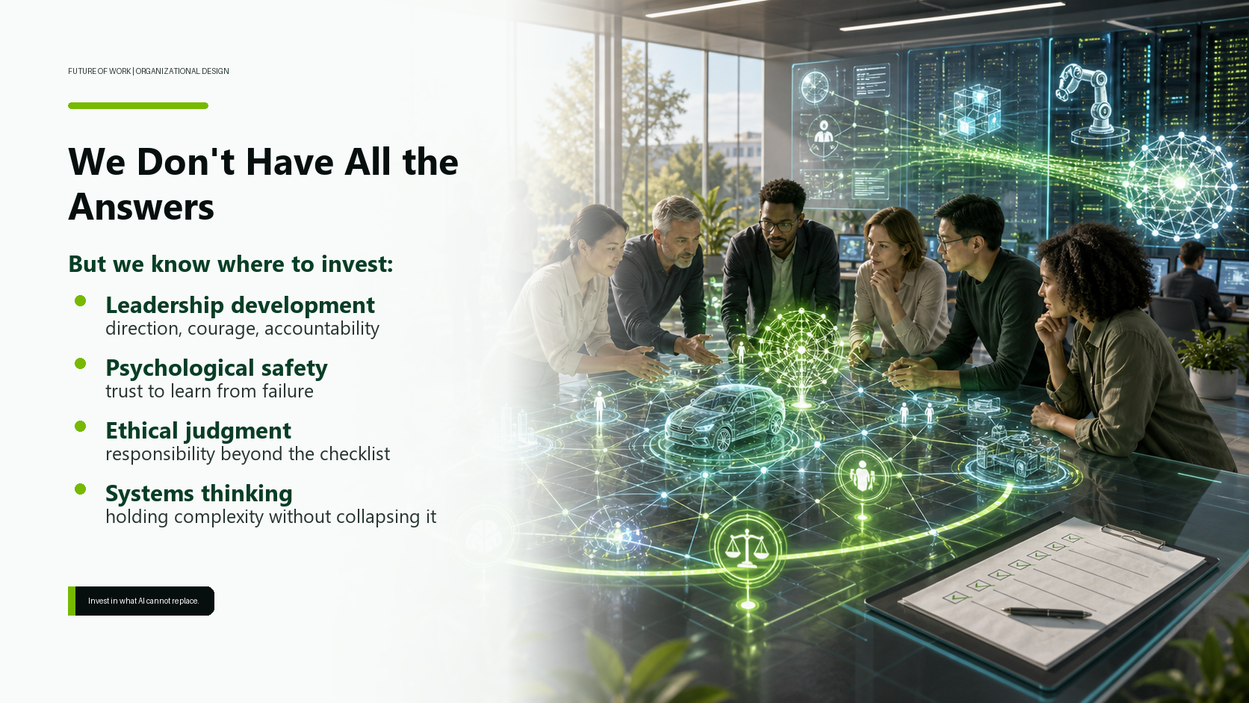

Slide 121
Bhaskar (NVIDIA)
Fear > Feudalism > Future
We don't have all the answers. And we want to be honest about that.
But we do believe this: the organizations that will navigate this transition well are the ones that invest now in what AI cannot replace. Not in spite of AI, but because of it. Leadership development. Psychological safety. Ethical judgment. Systems thinking. The capacity to hold complexity without collapsing it prematurely into a checklist.

Slide 122
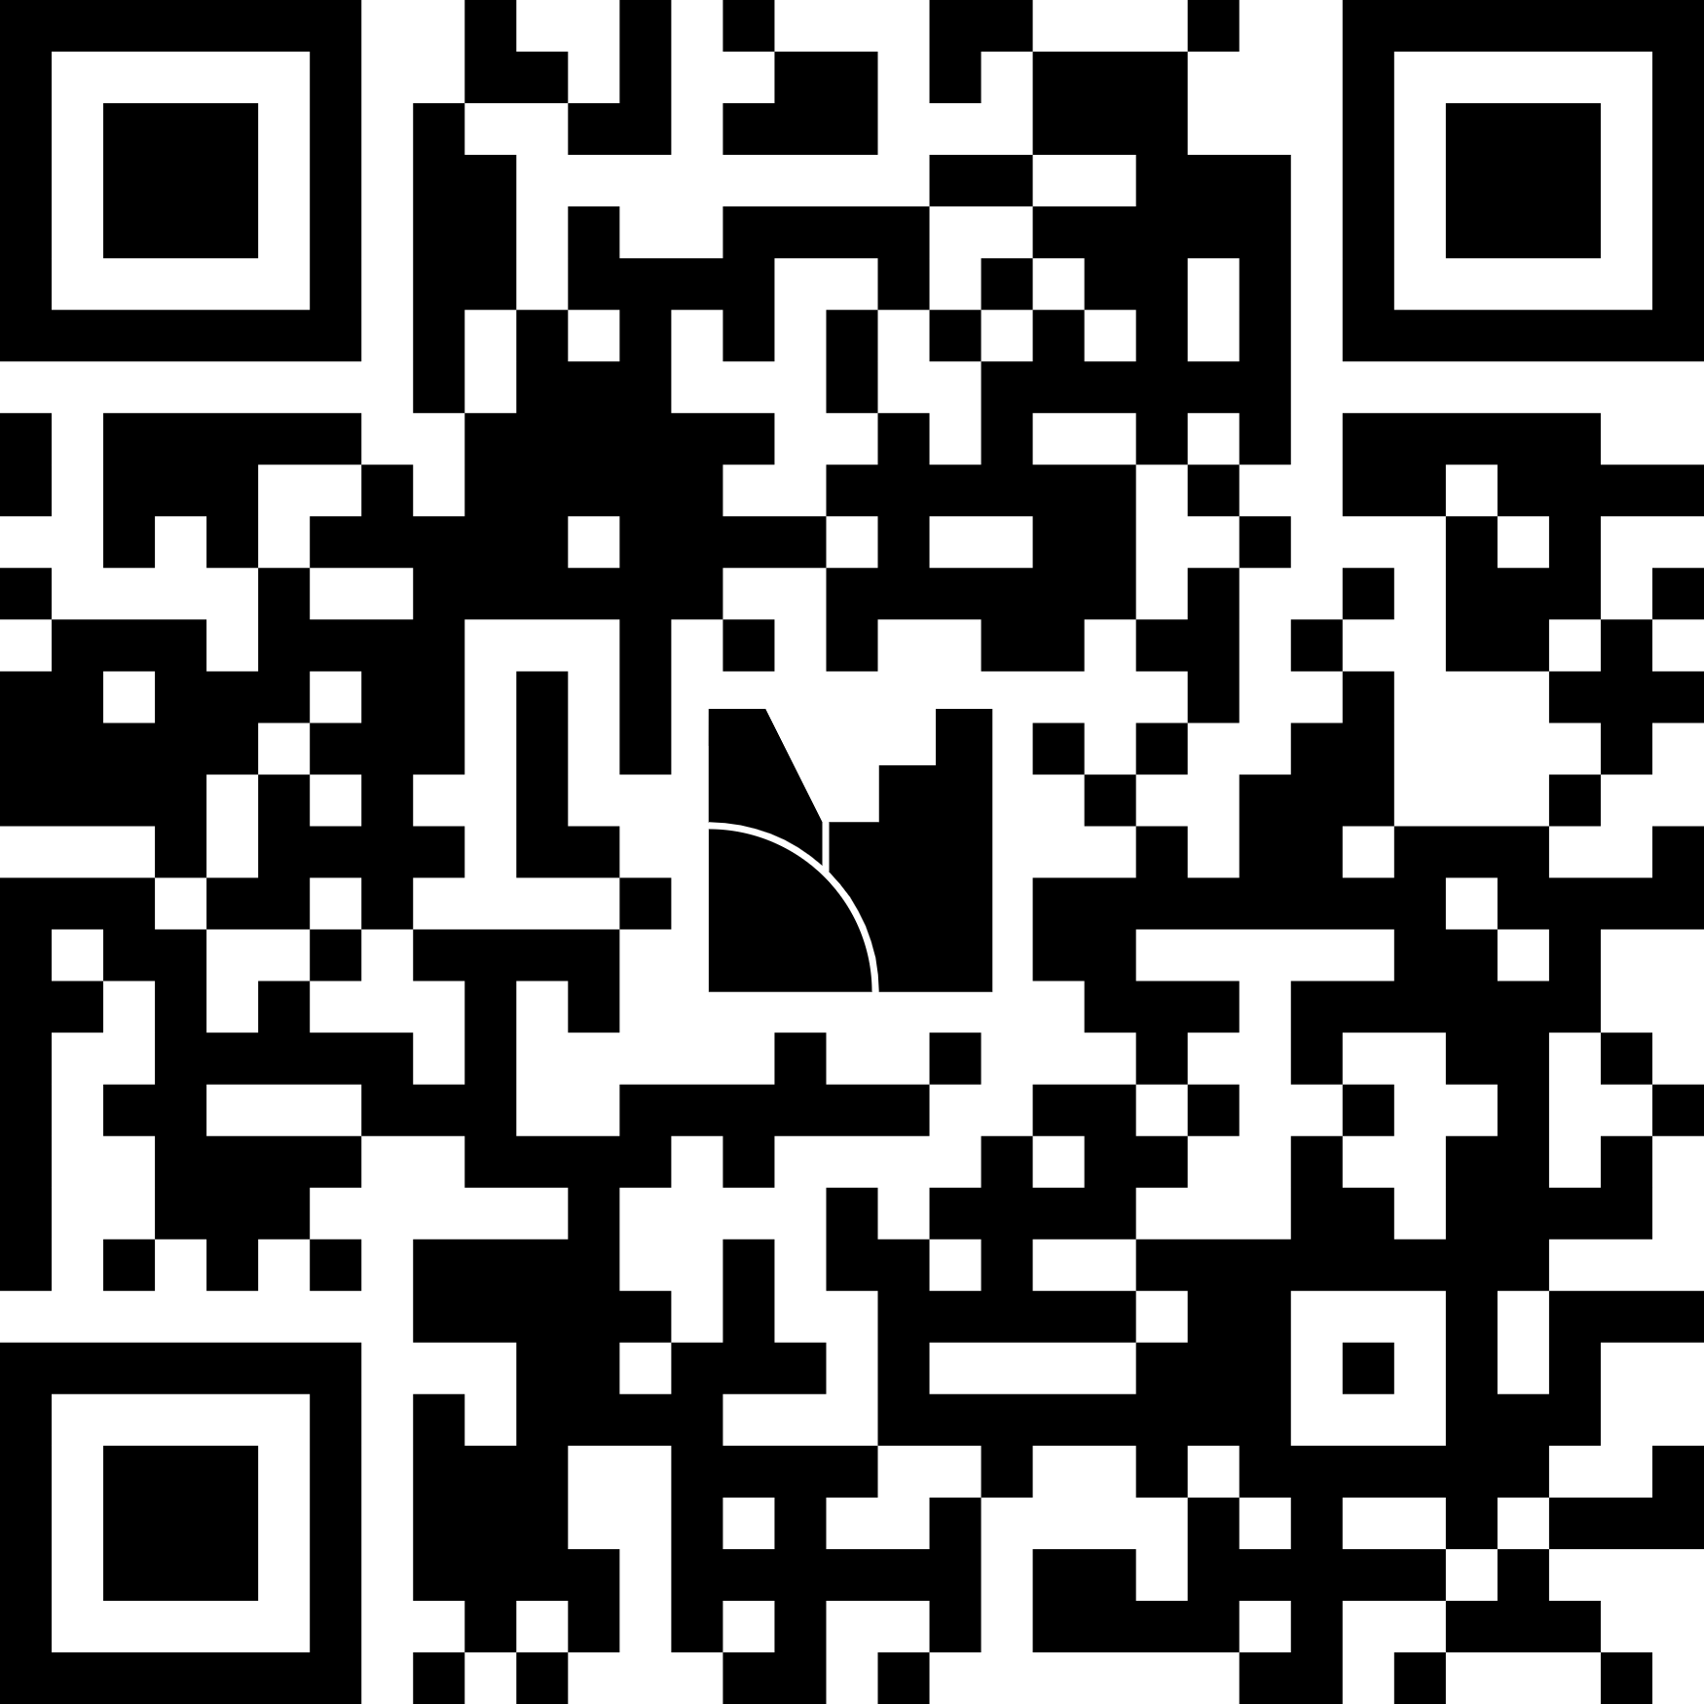
Invitation
Fear > Feudalism > Future
We are collecting perspectives from this community!
  https://www.menti.com/albb2nm6h462
  6696 3431

Slide 123
Both?
Fear > Feudalism > Future
So here is our invitation to you today — and we mean this literally.
Which tasks should be delegated to AI? Which human capabilities should be strengthened? And what does leadership mean in an AI-enabled organization?
We'll synthesize the responses and share them publicly. Because this isn't a question we can answer from a stage. It requires collective sense-making — which has always been what VDA SYS is really about.
Notes:
mentimeter

Slide 124
Reframing ;)
Fear > Feudalism > Future
Bad News: AI won’t replace
our workforce fully until 2030.
Notes:
Reframing!
Gemischte Szenarien: Automatisierung immer mehr KI, aber Mensch Haftung, Ethik, Risikonlyse, Kontext … Den Nutzen verstehen

Slide 125
Fear > Feudalism > Future
Let’s create utopia.

Slide 126
Utopia #1
Fear > Feudalism > Future
LLMs are on the way out, but general AI isn’t here yet
  We have a collaboration with AI: similar to “reduction systems”
  (string rewriting systems from theoretical computer science)
  So software doesn’t develop on its own yet, but it is generated from the specification
Challenge
  Software acceptance testing without considering the internal structure—only black-box testing is possible
  We need very good specifications
  Former testers are experts in “inverse specs”
  (defining undesirable or unauthorized functionality or behavior)
We still avoid being human (and leaving Feudalism feels scary)

Slide 127

Utopia #2: WALL·E (Waste Allocation Load Lifter – Earth-Class)
Fear > Feudalism > Future
AI is powerful, but it has no purpose in and of itself
  AI is the superior machine, but we could become the superior humans
  Yet we are still stuck in the same worldview; it remains feudalism, we are merely switching sides
Challenge
  “Purpose of Life” was for 97.3% defined as “sell yourself to work”
  Without work humans lack any direction and purpose
  (Risk of “Universe 25” Scenario; Behavioral sink – Wikipedia, https://en.wikipedia.org/wiki/Behavioral_sink)
We still avoid collaboration … being human
(and leaving Feudalism) feels scary
  we chose comfort over life (responsibility)
Notes:
Losing our purpose means compensation … numbing of the loss

Slide 128

Utopia #2: WALL·E – Humans stuck in Toddler-Mode
Fear > Feudalism > Future

Slide 129

Utopia #3
Fear > Feudalism > Future
We no longer need to “work”; instead, we can fully realize our potential.
  The misguided path of wage labor (enslavement) has come to an end, and we must learn to live again.
Challenge:
  We need a purpose that goes beyond “I live to provide my labor”
  Level of meaning and significance

Slide 130
Fear > Feudalism > Future
It‘s not about jobs, it‘s about purpose.
But it’s high time we learn to live.
Notes:
living as opposite of functioning

Slide 131


Slide 132
Bhaskar (NVIDIA)
Fear > Feudalism > Future
Conclusion:
AI does not primarily eliminate work. It eliminates excuses. Particularly the excuse that there is no time for leadership, for culture, for ethical reflection.
The future of work is not a technological problem. It's a design challenge: how do we intentionally combine machine strengths with human capabilities to build organizations that are resilient, humane, and effective?
We are shifting everything up one level of abstraction. Time for leadership. Time for humanity. Time for uniqueness. Until now, operational tasks have consumed all the time available for this. That shift is now possible.

Slide 133

What now?
Fear > Feudalism > Future
Machines can now be the best machines.
Which allows us, after all these centuries,
to be the best humans.

Slide 134

It‘s been a pleasure.
Questions?
Bhaskar Vanamali
Danilo Assmann

