Slide 1
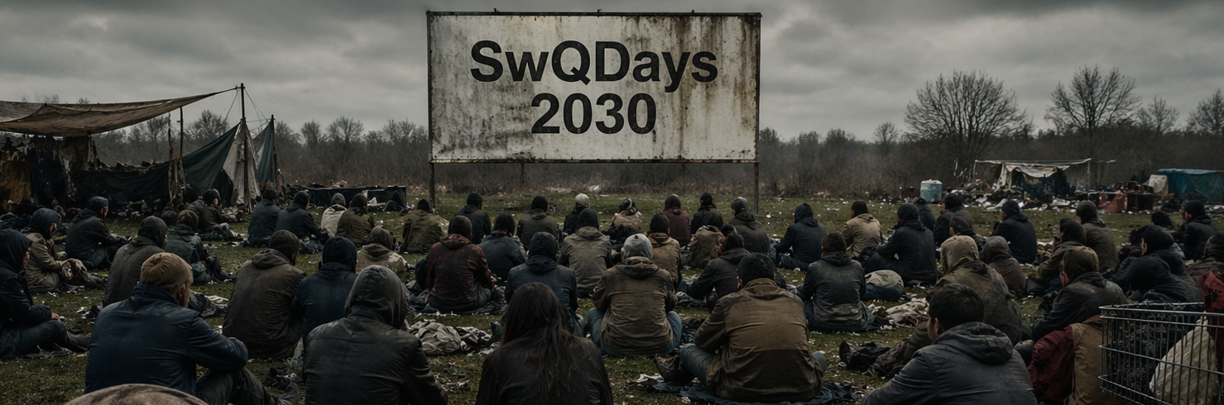
Ready for 2030
Software Quality between AI and Limbi –
thinking in cooperation instead of competition

Slide 2
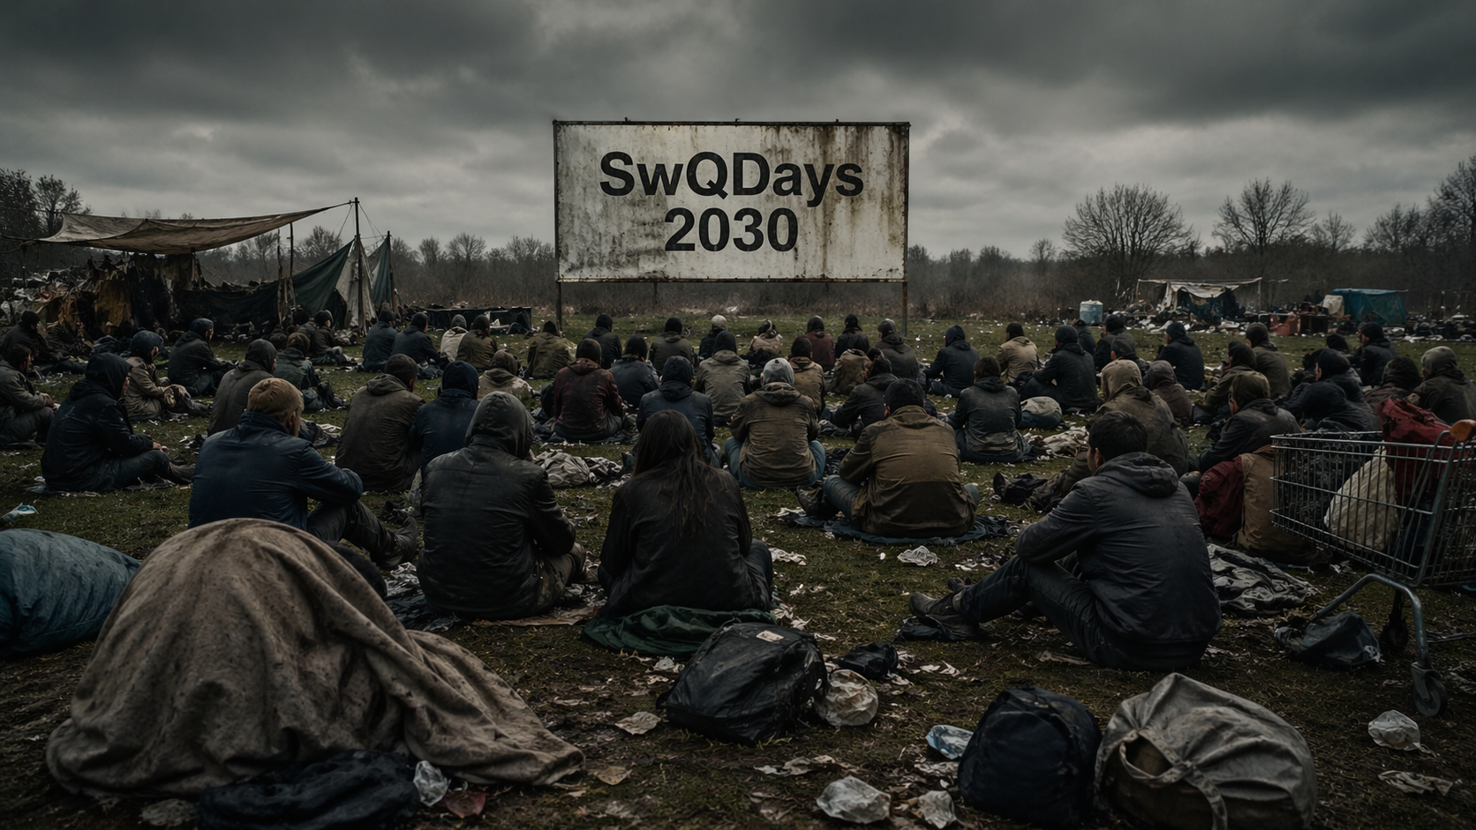
if we are scared,,
we tend to see dystopia
Notes:
Kleine Abfrage wie “scared” die Leute sind?
Handzeichen ein bisschen. Aufstehen sehr.

Slide 3
Warm-up
“I don’t know what to say.”
The initial idea was so simple …
1) prediction AI
2) prediction effect
3) choose the scenario
But everything changes unbelievable fast … if you prepare slides 1 week in advance, they are outdated
I feel overwhelmed
Notes:
Now that I am standing here, I don’t know what to say. Even for me, everything is changing too fast. Every week 30 new tools.

Slide 4
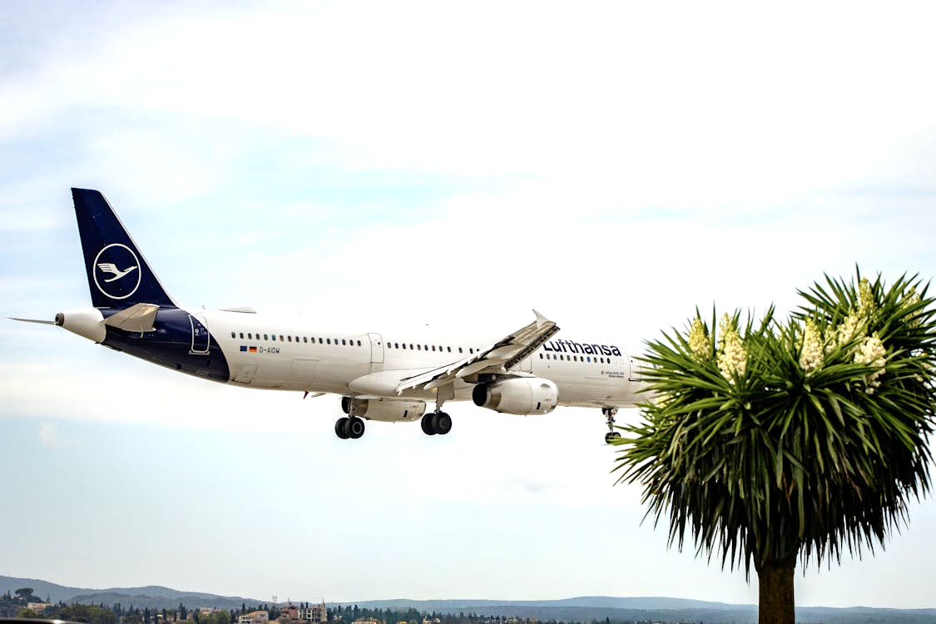
Let’s explore :)
Notes:
Disclaimer: It will be emotional challenging. And I know it’s been a long day. But just flow with the story. It’s not a presentation, it’s doomscrolling ;)
And every time you feel resistance, write it down. What was the trigger and what was your reaction. We can talk about this later.
And after valuing your resistance as your inner truth, switch back to exploration mode … curiosity. I need your curiosity for the next minutes.

Slide 5
Let’s explore :)
in doomscrolling mode
Notes:
Disclaimer: It will be emotional challenging. And I know it’s been a long day. But just flow with the story. It’s not a presentation, it’s doomscrolling ;)
And every time you feel resistance, write it down. What was the trigger and what was your reaction. We can talk about this later.
And after valuing your resistance as your inner truth, switch back to exploration mode … curiosity. I need your curiosity for the next minutes.

Slide 6
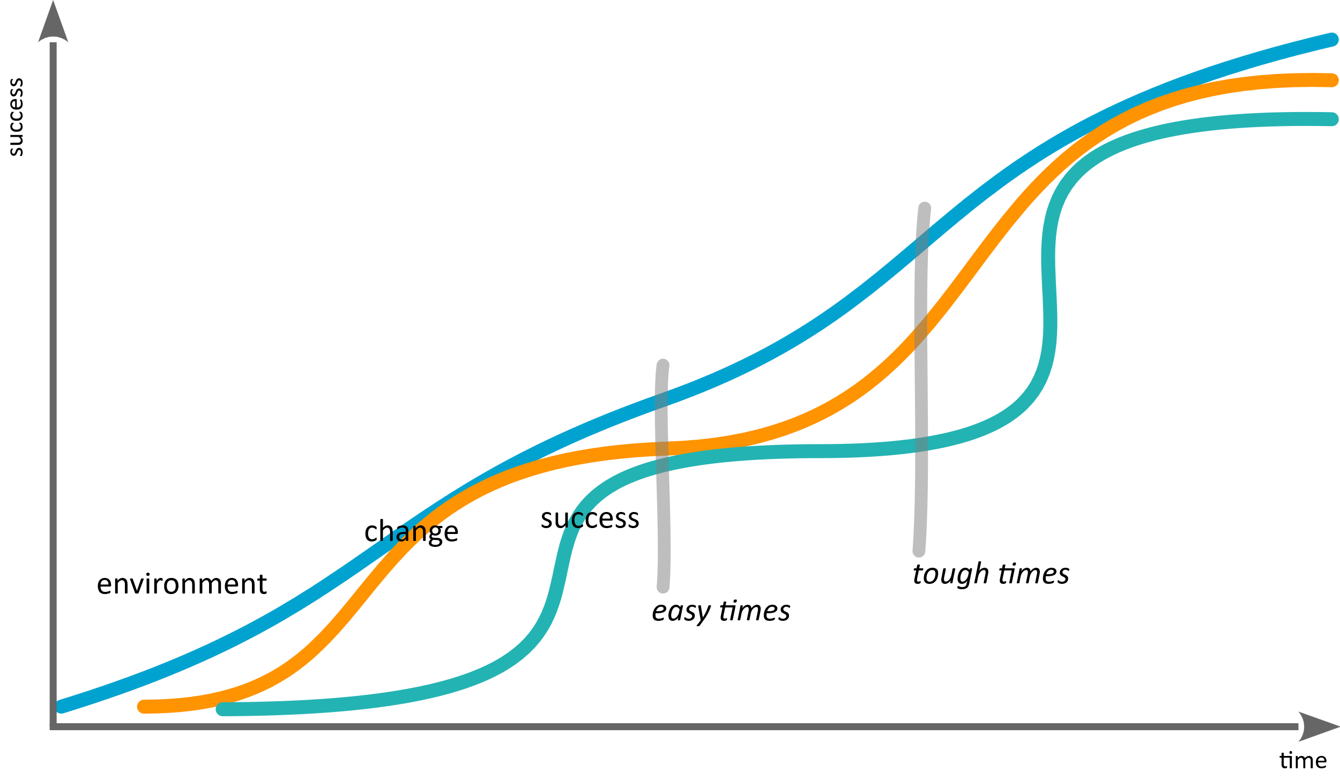
Why predictions are so difficult … and easy ...
Warm-up
Notes:
Technology often changes fast, but worldviews take more time. Constant pace…
Outside vs. inside
Lagging because of Cohesive forces (fear)

Slide 7
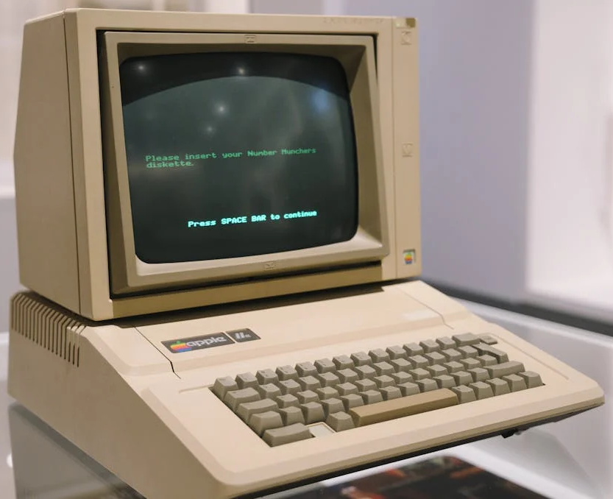
Reminder: Current State of AI (and the difficulty with predictions)
Warm-up
Notes:
To visualize the current state, we need
a reference we understand better
Let’s talk about computers
That’s the current level of LLMs
Awesome at it’s time, but a relict from
retrospective

Slide 8
AI Context
Warm-up
My background: Processes in Automotive
Over the last 20 years most algorithms moved to neural networks – and nobody cared
  in Hardware and Backends
  nobody knew or noticed
From 2023 LLMs (Chat-Bots) took over and spread fast
  1-2 years until reached mainstream
OpenClaw (as one version of personal agents) spread even faster
  2 months until mass market
Notes:
Not a single presentation without AI today … we see the difference to last year …

Slide 9
AI Context
Warm-up
LLMs are only one variant of neural networks
  when I talk about “AI” I mean all possible technologies
    no restriction to LLMs
  with LLMs we still see improvements, but we see also the pareto principle
    We still have high speed, the improvements are unbelievable, but way smaller incremental steps
    The limit of LLMs is imaginable

Slide 10
Two Interwoven Topics
Warm-up
1) What will AI do?
2) How will we react?

Slide 11
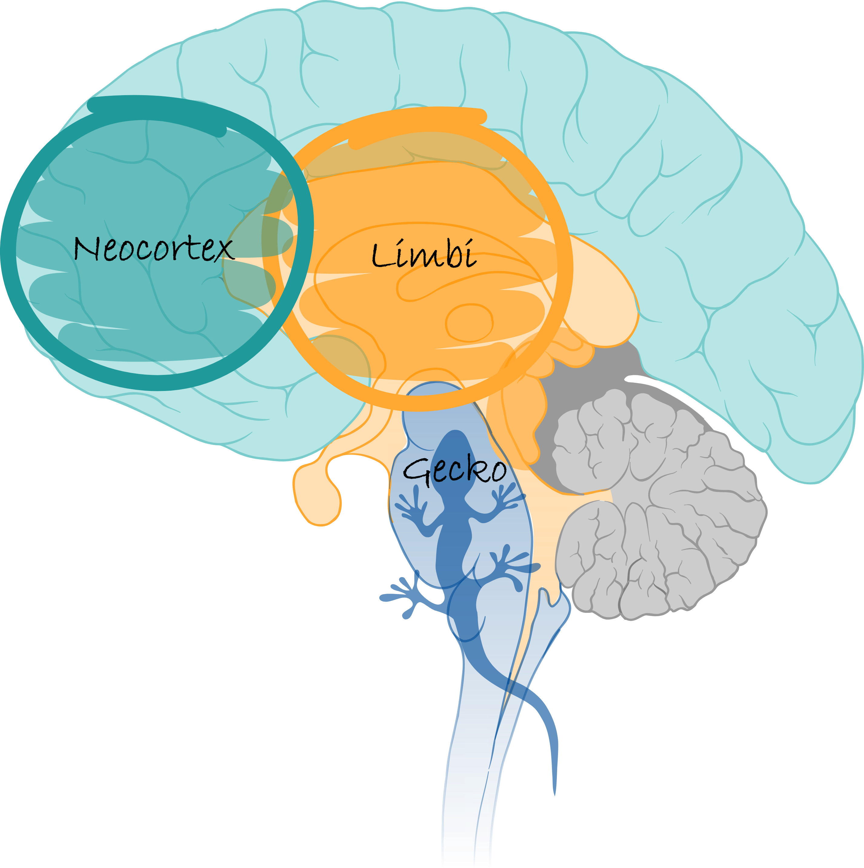
Ready for 2030

Slide 12
Agenda
Forecast > Fear > Future

Slide 13
Agenda
Forecast > Fear > Future

Slide 14
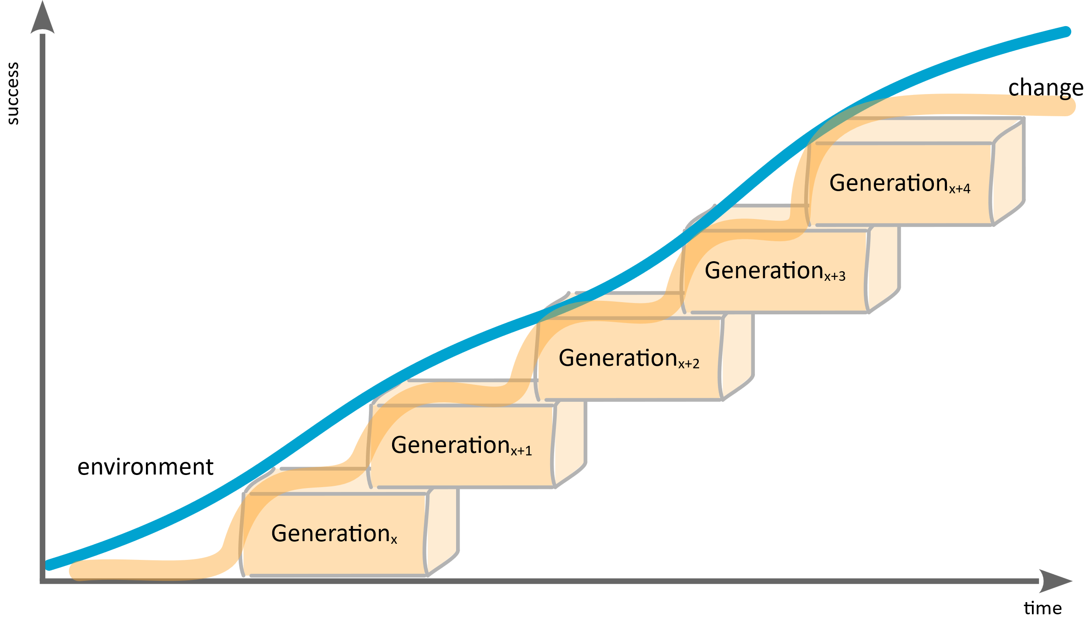
How Populations Should Learn
Forecast > Fear > Future

Slide 15
What we did the last 1000 years …
Forecast > Fear > Future
“I’m right and you’re not”
Notes:
Natürlich haben wir nicht in allen Bereichen Stillstand, aber in dem, auf den es jetzt ankommt ;)
Das ist dann schon die Hinführung zum Limbi; den Defensiveness ist Angst.

Slide 16

Forecast > Fear > Future
“Resistance is
just fear.”

Slide 17
How Populations Should Learn
Forecast > Fear > Future
“The willingness to learn,
is called intelligence.”
Notes:
Humble and open …
Little defensiveness, and a lot of trust.
And maybe we all experience currently a bit defensiveness, because we are affected

Slide 18
Forecast > Fear > Future
Leopold Aschenbrenner in Situational Awareness (2024):
Estimating ~5 OOMs
increase until 2030
(OOM: order of magnitude, which is 10x → 50x)
Notes:
Was bedeutet das? Vom 8088 zum 80386? Oder noch mehr?

Slide 19
Forecast > Fear > Future
Current speed in SE (2026) [estimation published las week]
2x in 4.2 month
(exponential: let’s even reduce to 2x in 6 month
2x2x2x2x2x2x2x2 = ~256 from 2026; ~1024 from 2024)
Notes:
Was bedeutet das? Vom 8088 zum 80386? Oder noch mehr?

Slide 20
What’s next?
Forecast > Fear > Future
I don’t know
World moves still fast (high fuzziness)
Quantum computing will speed up AI
We still don’t understand how it works, but speed up development

Slide 21
Current Trends
Forecast > Fear > Future
LLMs → Agent-based systems
  Agents orchestrate APIs, code, data, and other models
Tool usage is becoming the norm
  Models no longer operate in isolation, but systematically access tools
First stable agent swarms
  Multiple agents work together in a coordinated manner on tasks (planners, executors, evaluators)
  Meaning: AI is becoming an organizational structure, not just a feature
Open source is catching up rapidly (e.g., projects like OpenClaw)
  Models are becoming more accessible, customizable, and combinable
  Meaning: AI is being democratized at the infrastructure level
Focus on evaluation and reliability is growing
  More benchmarks, more discussion about hallucinations, trust, and safety
  The first serious efforts toward “AI quality”

Slide 22
Next Level LLMs as a System
Forecast > Fear > Future
Non-autoregressive LLMs
  Diffusion, flow, and masked models generate many tokens in parallel. This could massively speed up the generation of long texts, code variants, and tests.
Few-Step / One-Step Generation
  FS-DFM (Few-Step Discrete Flow-Matching) points the way forward: no longer hundreds of iterations, but rather a few large, trained leaps.
Adaptive Parallel Decoding
  Models dynamically decide how many tokens they can safely generate in parallel. This strikes a balance between quality and speed.
Speculative Decoding & Drafting
  Quickly draft small models, then validate large ones.
  In the short term, this is likely the most important accelerator for today’s LLMs.
Agent-based systems instead of individual models
  OpenClaw is a sign of this trend: AI will not only generate text, but also perform tasks involving tools, files, calendars, code, and communication.
Hybrid models combining LLMs and verification
  The next generation will not only be “smarter” but also more deeply embedded in testers, solvers, type checkers, model checkers, simulators, and traceability graphs.
Quantum computers are unlikely to serve as a short-term LLM booster
  In the long term, quantum computing could transform optimization, simulation, cryptography, and search spaces.
  However, no direct breakthrough is expected for LLM inference or training by 2030.
  The greater lever remains architecture: parallel, sparse, tool-supported, and verified.
Notes:
Die nächste Generation von KI wird nicht einfach ein besseres LLM sein. Sie wird ein System sein: schneller, paralleler, handelnder – und deshalb schwerer zu prüfen.

Slide 23
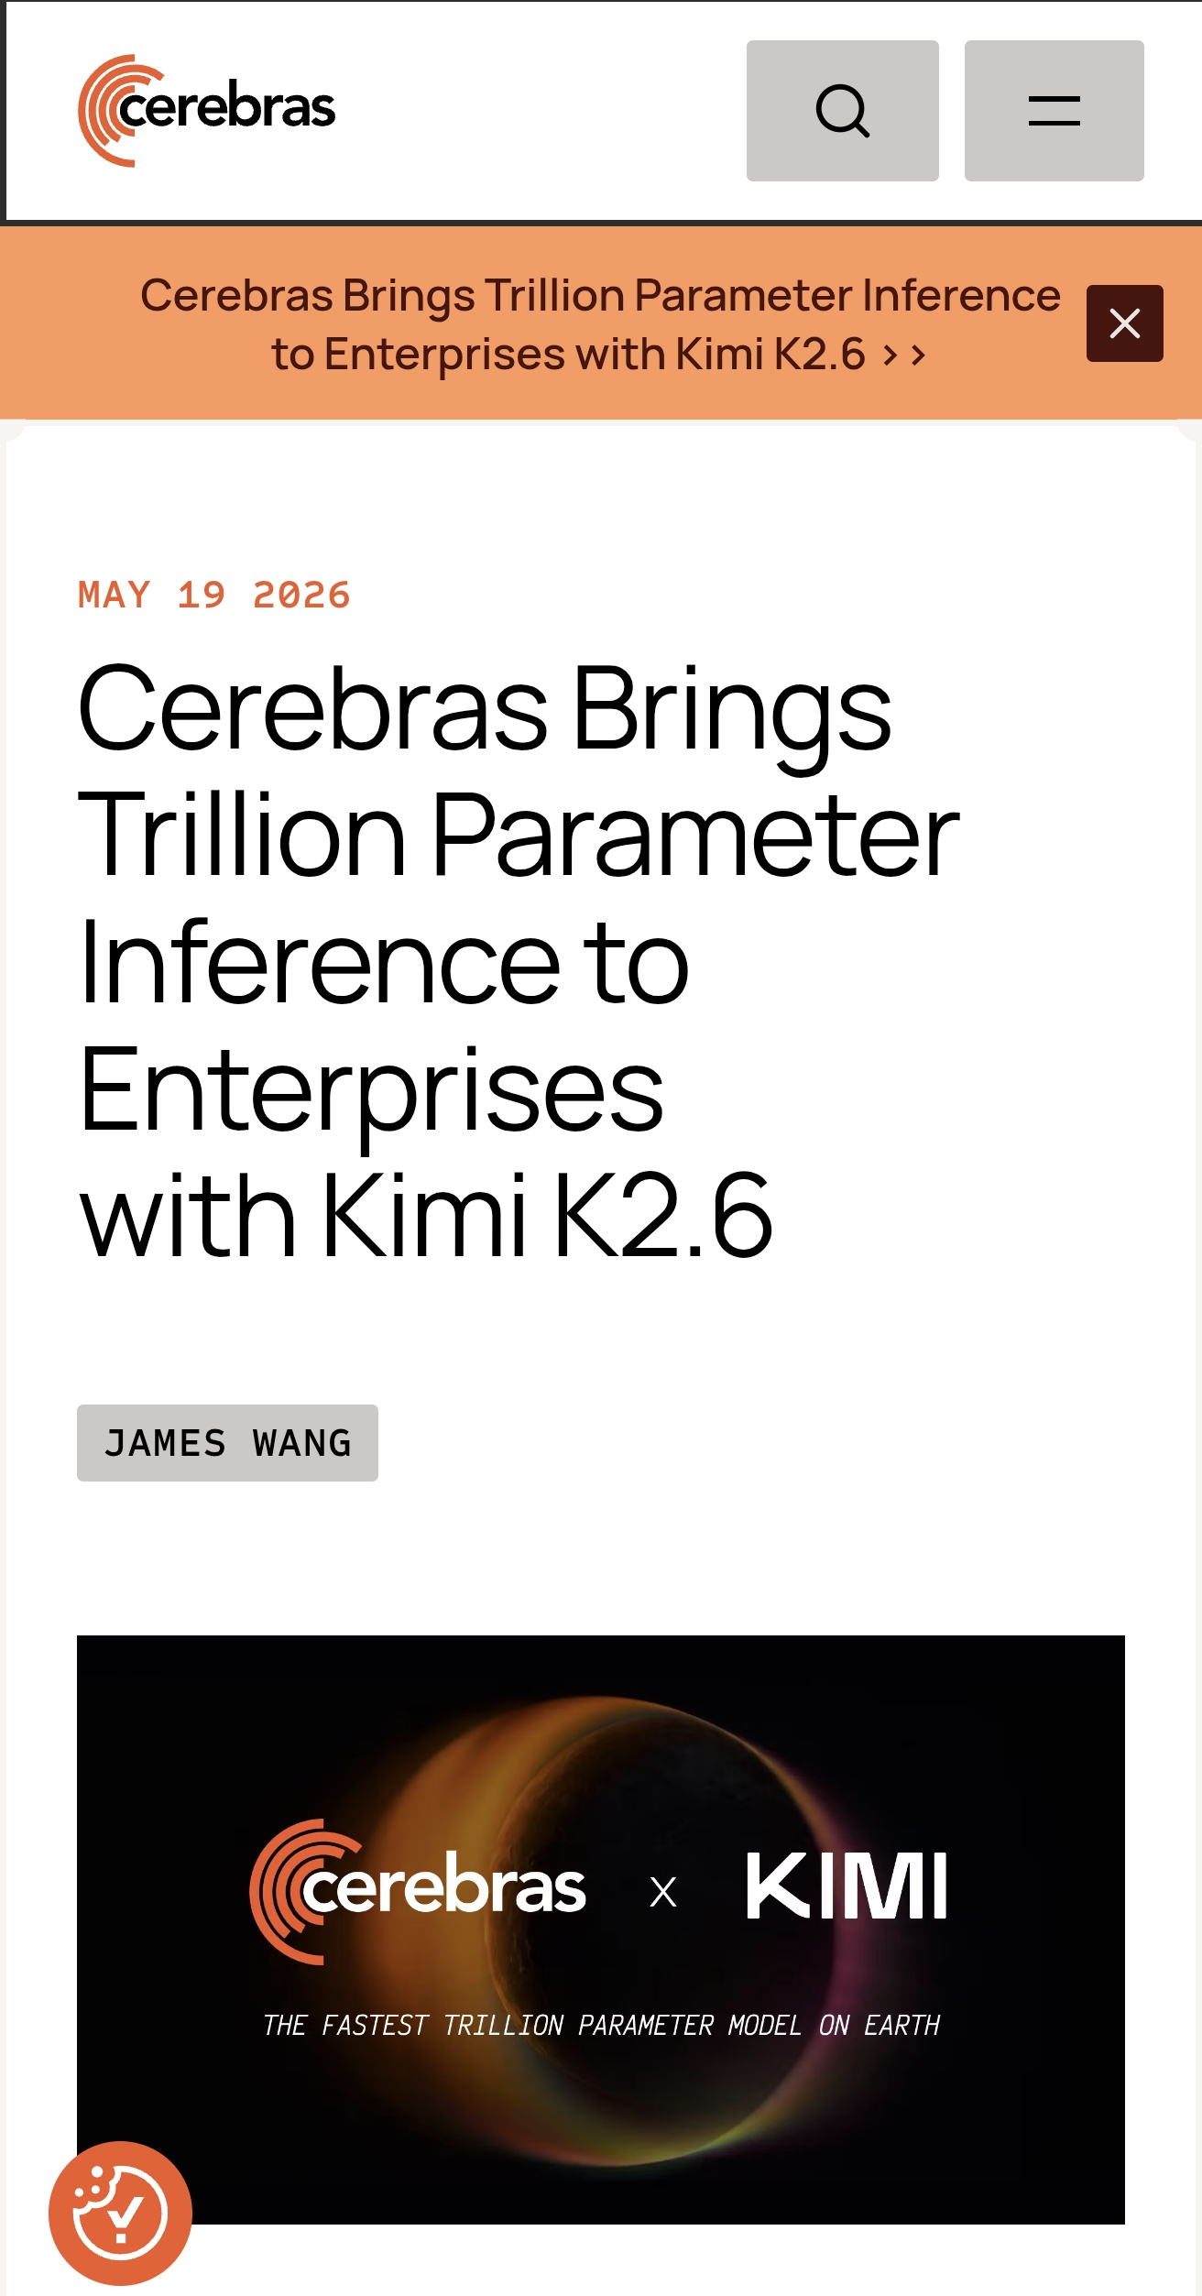
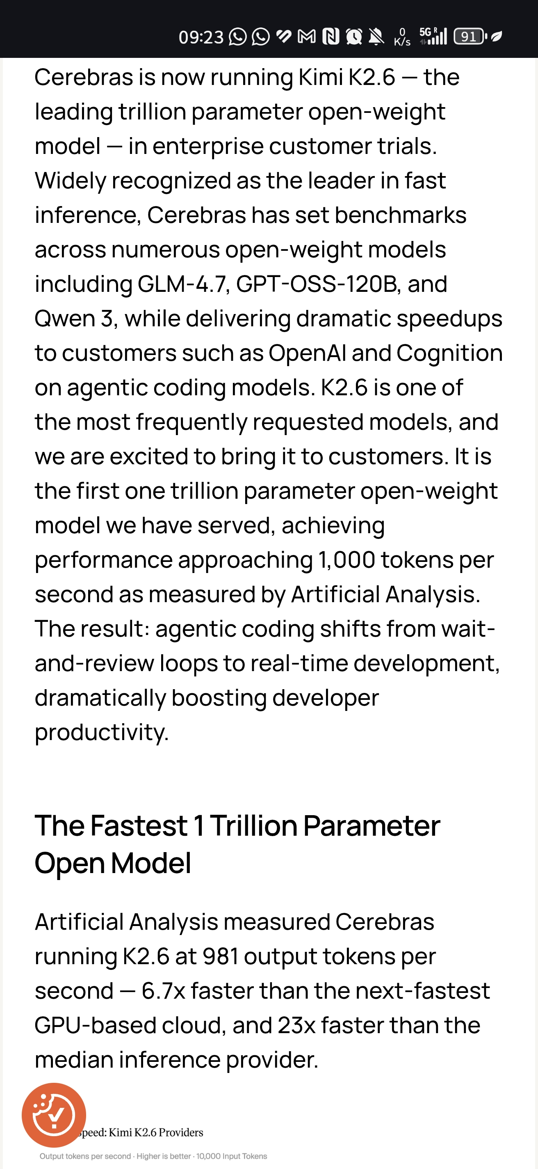
Kimi K2.6 (today)
Forecast > Fear > Future

Slide 24
Huge Area 4 Us
Forecast > Fear > Future
How to deal with Software generated by AI?
  As in reduction systems (string rewriting systems), we can produce fast different variants of the same system based on the specification
    WhiteBox-Coverage can be co-created by AI
  How can we avoid that AI produces defects? Something like Cleanroom-Engineering with AI?
How to deal with the AI-Software (neuronal networks) itself?
  Validation and verification?
  Coverage?
Q will be once again just a statistical means, if the product is fit for it’s purpose
  We don’t test in quality
  We just check, which quality was built in (and rebuild it …)

Slide 25
Reminder: We don’t need to discuss today’s details …
Forecast > Fear > Future
Notes:
To visualize the current state, we need
a reference we understand better
Let’s talk about computers
That’s the current level of LLMs
Awesome at it’s time, but a relict from
retrospective

Slide 26
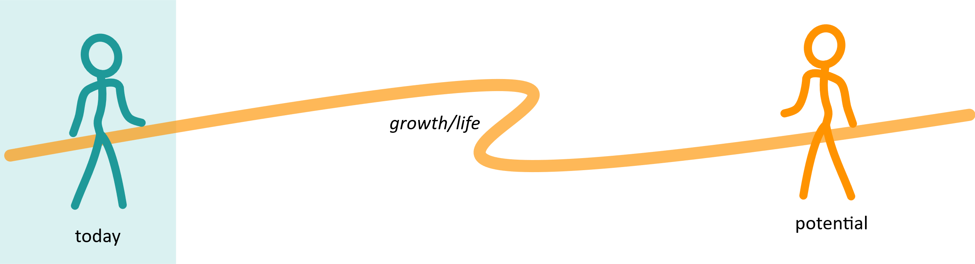
Soft Resistance – Sounds so logical
Forecast > Fear > Future
The need to feel safe keeps us stuck in the past (current).
This is the reason we miss the opportunity to design our future.
Notes:
Looking at the talks and arguments, you can easily identify, if they are stuck in “today”-box out of fear. But if we are stuck, we miss the chance to create future.
Wir stecken im heute fest und machen Annahmen basierend auf jetzt. Wir verlassen die Box nicht. Das gibt uns das Gefühl von Sicherheit, aber so verpassen wir die Chance Zukunft zu gestalten

Slide 27
When we are stuck in the past, we will never create future
Warm-up
Notes:
Technology often changes fast, but worldviews take more time. Constant pace…
Outside vs. inside

Slide 28
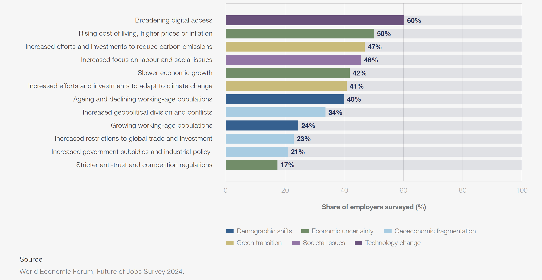
WEF: Macrotrends driving business transformation until 2030
Forecast > Fear > Future

Slide 29
WEF: Macrotrends driving business transformation until 2030
Forecast > Fear > Future
Everything Digital
Cost of Living
Survival (Sustainability)
Social Issues (+ age)
Economical Issues (growth)
Note: Data was pre Trump
Notes:
Das ist die Überleitung zu dem, was uns Sorgen macht …

Slide 30
Agenda
Forecast > Fear > Future

Slide 31
Forecast > Fear > Future
Okay, first quality, then fear …
(we use Quality as the frame or a shell model)
Notes:
This is the technical perspective …

Slide 32
Forecast > Fear > Future
From the
Value of Quality
to the
Quality of Value.
Notes:
This is the technical perspective …

Slide 33
My Truth
Forecast > Fear > Future
“I was a software quality manager for 10 years
and built up two departments, and only then did
I learn what quality really is.”
Have you ever been so
oblivious for such a long time?
(which is totally embarrassing by the way)
Notes:
Da bin ich immer noch nicht so rund mit …

Slide 34
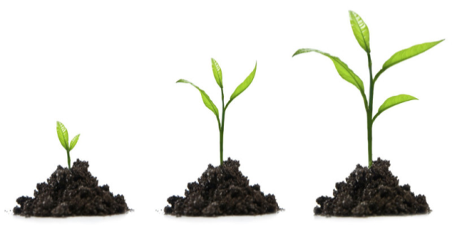
O.k., so what is quality exactly?
Forecast > Fear > Future
Gerald M. Weinberg
Notes:
Quality is not in the product, but in the application. It’s in the use
Value is not fix; it is personal and it can constantly change …

Slide 35
The Secret Behind the Value
Forecast > Fear > Future
Value = f(context, product)
Notes:
We will need this later … Das kann spannend sein, weil wir dann Kontext-Experten werden können …
Bis wir KI’s bekommen die auch die Umwelt-Erfahrung machen (aber sie warden nicht menschliche Bedürftigkeit erleben)

Slide 36
Back to my Shame and why it doesn’t help
Forecast > Fear > Future
We always do the best we know/believe
I was driven by the standards
(ISO 16949, ISO 9001, ISO 15504/330xx, ISO 61508, ISO 26262, …)
I needed an “accident” to see better.

Slide 37
Forecast > Fear > Future
“I’ve never seen a single technical issue, without an underlying human issue.”
I learned that late …
Notes:
Von meiner Erfahrung hierhin, ist der Weg noch nicht so ganz klar. Das noch schärfen.

Slide 38
Current Question or Fear
Forecast > Fear > Future
Here we go again:
“AI is taking our jobs”
A) Unfortunately, it won’t happen that quickly
B) It’s great, because we’re doing things that aren’t a good fit anyway
Notes:
This is the technical perspective …

Slide 39
Excurse: We (humans) are no machines!
Forecast > Fear > Future
But at least since 1600 years most of us must act as ones …
  Feudalism separated the world in Thinking and Working
  1% Thinking
  90% Working (just following commands; no thinking required)
  The “potato field” approach
  (I know that there are unmentioned 9%)

Slide 40
Excurse: We are no machines!
Forecast > Fear > Future
Most of us here would belong to the 90% working (not thinking)
  our purpose was to work as a obedient, cheap, and programmable machines
  our feelings were not valuable (neither hunger nor psychological needs)
  we just need to function
  listening to people talking about the hamster wheel,
  we still follow the same rules, with a much nicer glazing
Notes:
Maybe sth about the hamster wheel … it’s the continuous proof of worth, because my identity was rejected
??? Hamster wheel cards? Most liekely not fast enough

Slide 41
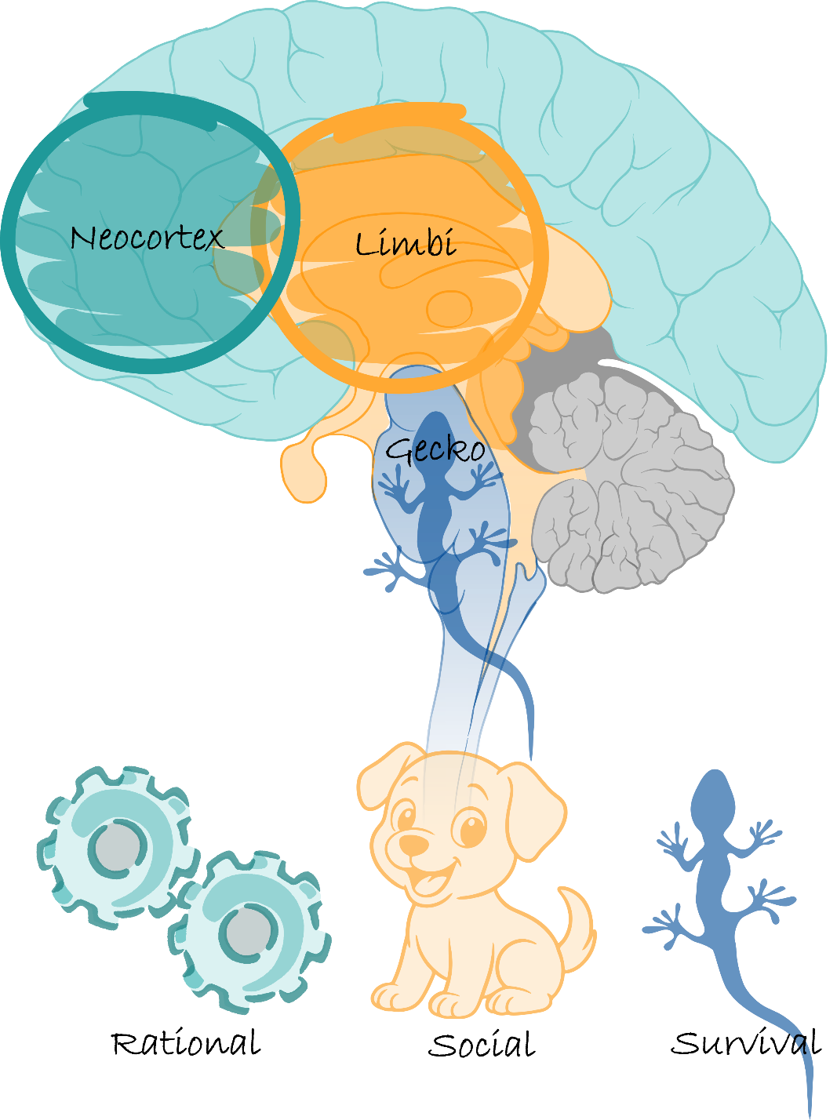
Let‘s look into fear…
Forecast > Fear > Future
Notes:
Gecko aktiv, bedeutet dass der Rest runtergeregelt ist. Wir denken dann an die Momente, in denen unser Adrenalin hoch ist, aber das kann auch ein Dauerzustand sein. Also Angst-Modus, nicht nur Moment.

Slide 42
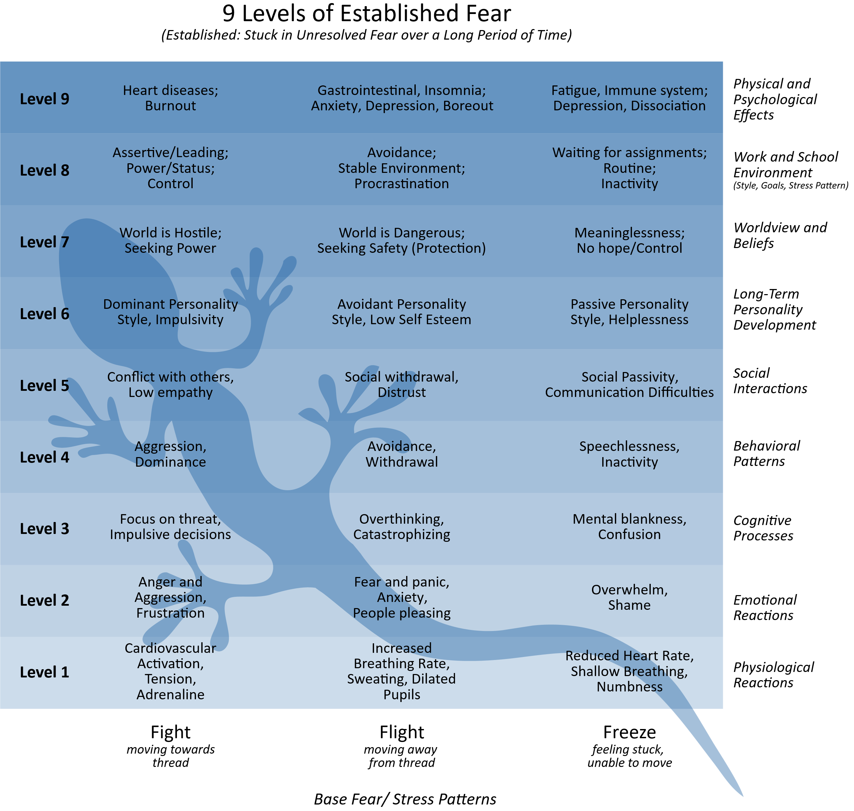
Some interesting marker for fear mode
Forecast > Fear > Future
Fear-Mode vs Fear-Moment
Fear can be a permanent state
  survival mode
  hamster wheel
  autopilot
Often we find “fawn” mechanisms for
the underlying fight, flight, freeze
  “fawn” is just social accepted disguise
Notes:
verkleiden

Slide 43
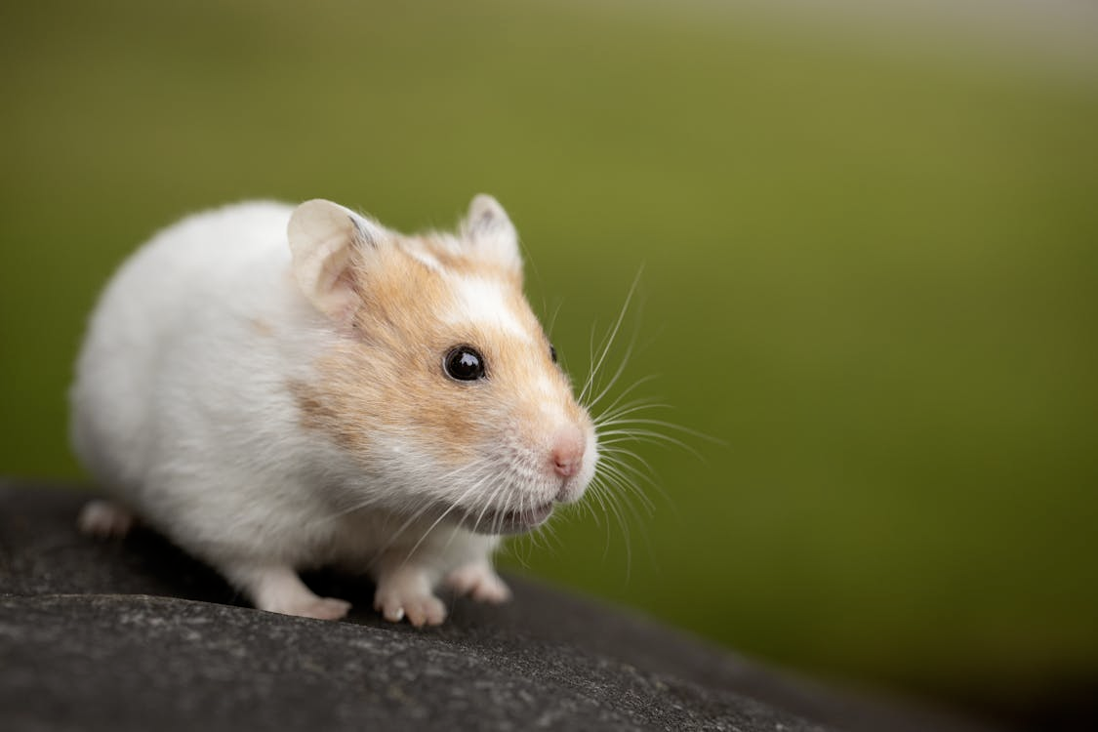
Naturally, we are sweet and relaxed.
Is this your
daily reality?
Notes:
Basically, we are naturally sweet and relaxed.
Hamsters don’t belong into a wheel, but in their natural habitat.

Slide 44
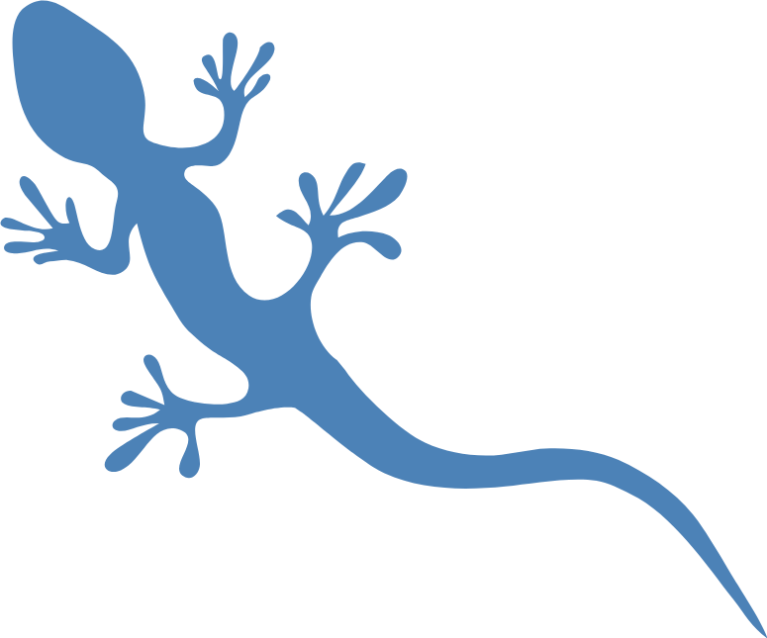
Forecast > Fear > Future
“Culture is the set of implicit shared tools and patterns for dealing with emotional uncertainty.”
Notes:
Fear-Mode is always disconnected and therefore uncertainty …
Because we are not in our habitat.

Slide 45
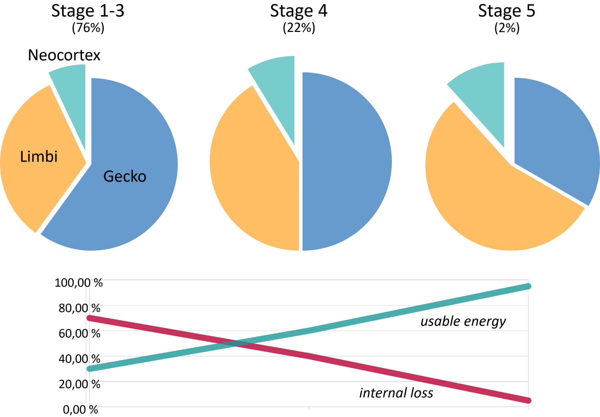
How do we work in “fear mode”?
Forecast > Fear > Future

Slide 46
Forecast > Fear > Future
The honest truth is that it’s only a matter of time, until human work force is not needed anymore.
It will happen. Maybe in 3 years or in 15.
Compared to prior industrial revolutions, we are on a meta level.
First time, we will be the worse machines.
Notes:
Until now, machines were tools used by us. Now this turns.
Machines will ourperform us on machine jobs. And that’s okay.

Slide 47
Probabilities for AI ASPICE-Process until 2030
Forecast > Fear > Future
Artifact creation & maintenance: very likely
  Requirements proposals, test cases, traceability, safety/security work products
  Probability: 70%
Context-sensitive HARA/FTA/FMEA with full autonomy
  Probability : 30–40 %
  Note: Domain-specific details & exceptions are difficult
Formally verified safety cases from start to finish
  Probability : 40–50 %
  Note: Partially formal, with a human signature
“Solely responsible” without human approval
  Probability : 10–15 %
Notes:
HARA (Hazard Analysis and Risk Assessment) is a structured process to identify potential hazards, assess associated risks, and define safety requirements to ensure functional safety in automotive and other safety-critical systems.

Slide 48
Probabilities what might be possible 2030
Forecast > Fear > Future
“Autonomous Compliance Assistant” is a realistic possibility
  Risk: People just click through
Current example: Claude’s own evaluation regarding the school bombing in Iran
  So what's the recommendation, ultimately?
  Give it more time?
  Make sure not to cause any harm?

Slide 49
Future of Work for …
Forecast > Fear > Future
Testers / QA Professionals
Reviewers / Developers with a focus on QA
Quality Managers / Process Owners
DevOps / Architects with an interest in QA
Organizational / Management Level
What is today, what will AI take over, future need, skills, reasoning
We don’t have the time to go through all of them, but you find it in the slides
Notes:
By dem Expert-Table: Aktuell ist die größte Einschränkung, dass jemand alles was AI macht gereviewed warden muss. Wir haben also einen Engpass beim Lesen.
Das ist aktuell verständlich, aber alles Übergangs-Themen

Slide 50
Tester / QA Professionals
Forecast > Fear > Future
Today: Test scripts, regression testing, automation.
AI takes over: Test case generation, regression testing, test data, mutation testing.
Future tasks: Exploratory testing, scenarios, empathy for users.
Skills that are becoming more important:
  Empathy: Adopting the user’s perspective (“How does the product feel?”).
  Creativity: Designing unexpected scenarios, “thinking outside the box.”
  Communication: Conveying results in a way that developers/managers truly understand.
Why it makes sense: Testers become domain translators—they bring the human user experience into the pipeline.

Slide 51
Reviewer / Developer with a focus on QA
Forecast > Fear > Future
Today: Code review, clean code, design feedback.
AI takes over: Syntax, style, common bugs, performance suggestions.
Future tasks: Contextual architecture decisions, ethical evaluation, long-term maintainability.
Skills that are becoming more important:
  Systemic thinking: Connections between architecture, teams, and organization.
  Storytelling: Justifying decisions, getting stakeholders on board.
  Reflective ability: Evaluating AI suggestions, recognizing bias and “blind spots.”
Why it makes sense: Reviewers become architects for decisions, not for syntax details.

Slide 52
Quality Managers / Process Owners (as example)
Forecast > Fear > Future
Today: Norms, standards (ASPICE, ISO), audit checklists, maturity levels.
AI takes over: Evidence generation, compliance documentation, traceability.
Future task: Defining purpose & governance – What risks are we willing to accept?
What level of quality do we want?
Skills that are becoming more important:
  Ethics & values: Quality definition = not just “bug-free,” but also “fair, explainable, sustainable.”
  Moderation & facilitation: Guiding teams through conflicting goals.
  Sense of responsibility: Making decisions that AI cannot standardize.
Why it makes sense: You become curators of AI processes and
give quality meaning within its context.
Notes:
Go only for the last sentence …

Slide 53
DevOps / Architects with an interest in QA
Forecast > Fear > Future
Today: CI/CD, pipeline development, test integration, toolchains.
AI takes over: Automated CI/CD pipelines, test integration, monitoring.
Future challenge: Building resilience and adaptability—how do systems respond to failures, conflicts, and value-based decisions?
Skills that are becoming more important:
  Collaboration & empathy: Aligning the requirements of different stakeholders.
  Resilience-oriented thinking: Building systems and teams to withstand disruptions.
  Adaptive communication: Explaining technical complexity in a way that managers and users can understand.
Why it makes sense: DevOps is becoming the integration role between humans and machines.

Slide 54
Organizational / Management Level
Forecast > Fear > Future
Today: Cost-benefit decisions, enforcing standards, cultural issues.
AI takes over: Reporting, dashboards, KPI tracking.
Future challenge: Driving cultural change—from machine logic to human logic.
Skills that are becoming more important:
  Leadership by Purpose: Formulating purpose and vision.
  Building trust: Aligning AI results with human decisions.
  Conflict resolution: Making trade-offs transparent (speed vs. safety, cost vs. sustainability).
Why it makes sense: Management becomes the architect of the human-machine system.

Slide 55
Application to Roles in Software Quality
Forecast > Fear > Future
Role | What AI Takes Over | What “Limbi” enhances | A New Form of Quality
Tester | Tests, Data, Automation | Intuition for User Experience | Emotional Quality: “feels right”
Reviewer | Code verification, pattern matching | Meaning & Context: What is the code intended to achieve? | Semantic Quality: “makes sense as a whole”
Quality Manager | Compliance, Audit-Trails | Connecting people, learning processes | Systemic Quality: “We learn as a system”
Developer | Coding, generate variants | Creative problem-solving, responsibility | Quality of Intention: “We create with intention”
Management | Monitoring, KPIs | Trust, Guidance, Culture | Quality of Coherence: “People and AI work together”
Notes:
Focus on the new forms of quality … new levels.

Slide 56
Challenge: Quality of Training and Test Data
Forecast > Fear > Future
Learning is harder for new LLMs because the internet has become “polluted” by now
  We can really only trust books published before 2024/2025
  Everything else could already be AI-generated text, which means there are sources of error
  (especially texts from very early systems …)
Well, you can already tell the generations and individual chatbots apart, but we still have data pollution on a massive scale
  We also acted first and thought later

Slide 57
Self-Check
Forecast > Fear > Future
Try teaching an AI everything you do: We have an “intelligence” here that can access everything, has agents (roles/perspectives), and can cooperate with one another.
  For this thought experiment, let’s assume we have perfect AI
  The ultimate process executer! Even with fuzziness.
  Requirements agents, architecture agents, design agents, development agents, verification agents,
  validation agents, …
Approach:
  “Write the Code according to specification/test cases.”
  “Make sure you have an xyz-Coverage of x%.”
  “Create test cases for specification/requirements, with a full functional coverage. (Find all objects, states, relations.)”
  ...
You have someone who is not lazy, but will do everything it's told! Again and again.
When you have done all that, how much of your work is covered?
(in % or ph/day)
Notes:
Assumption ~95%

Slide 58
Self-Check
Forecast > Fear > Future
If you can put it into a process, AI will be happy doing it for you.
Notes:
Assumption ~95%

Slide 59
Forecast > Fear > Future
The honest truth is that it’s only a matter of time, until human work force – as we know it – is not needed anymore.
It will happen. Maybe in 3 years or in 15.
Compared to prior industrial revolutions, we are on a meta level.

Slide 60
Forecast > Fear > Future
But…
Let’s switch perspective and look closer.

Slide 61
Forecast > Fear > Future
Robots have never taken a job
away from humans.
From the very beginning, those jobs were intended for robots.
But since robots didn’t exist back then, humans were used as a substitute.
Notes:
This is actually the key … should be also emotional (from the story line) … fear of losing must be created before, and then we see that we lose sth, we actually never wanted. And just now are scared, because it’s all we know.
It’s just familiarity of pain.

Slide 62
Self-Check
Forecast > Fear > Future
Remember: How much of your work is covered? (in % or ph/day)
Everything you could formally define, is machine work,
which was never intended for humans.
(Basically we need to teach AI “laziness”.
Because the best ideas came out of limited resources and motivation.
Looking for a shortcut is the best source of creativity.)

Slide 63
Forecast > Fear > Future
What exactly are human abilities?
Individuality and complexity, not automation.
Craftsmanship is human. Complexity, variety, vitality… music, art, philosophy, connection, … life
Notes:
Conflicting worldviews of jigsaw/puzzle versus standardized bricks

Slide 64
Forecast > Fear > Future
Feudalism is based on the idea that humans are a substitute for robots.
(Cheap labor. Cheapest workforce.)
Notes:
Aber es war völlig überflüssig oder vergeblich, sich darüber den Kopf zu zerbrechen. Die Welt ist, wie sie ist.
Die Idee der Roboter war schon immer eine der “Gutmenschen”: Sie wollten gesellschaftliche Probleme mit Technik lösen.

Slide 65
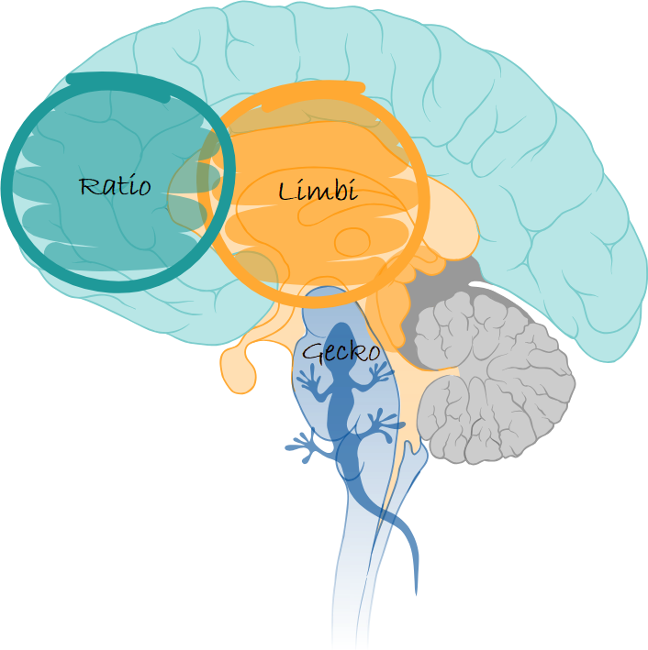
Forecast > Fear > Future
But since robots didn’t exist back then, humans were used as a substitute.
Notes:
Ratio is supported or substituted, but the rest is not affected … the rest of the brain is not “replaced”

Slide 66
Forecast > Fear > Future
Value = f(context, product)
Notes:
Das kann spannend sein, weil wir dann Kontext-Experten werden können …
Bis wir KI’s bekommen die auch die Umwelt-Erfahrung machen (aber sie werden nicht menschliche Bedürftigkeit erleben)
Mensch als ethische Instanz und Kontext-Experten. Noch müssen wir der KI Richtung geben und auch Schutz vor Angriffen.

Slide 67
AI as Catalysator of Meaninglessness of #Features
Forecast > Fear > Future
“Features will be cheap.
Value will be incredible rare.”
Notes:
To visualize the current state, we need
a reference we understand better
Let’s talk about computers
That’s the current level of LLMs
Awesome at it’s time, but a relict from
retrospective

Slide 68
Value of the Past Vanishes
Forecast > Fear > Future
1: Generation of Functionality (Features) is cheap
  In the past the #Features was the driver to value of software
2: Generation of Non-Functional Requirements becomes cheap
  We can produce several architectures in parallel
3: Verification & Validation will be cheap
  Claude Mythos is currently already finding more vulnerabilities then we did ever before
Notes:
To visualize the current state, we need
a reference we understand better
Let’s talk about computers
That’s the current level of LLMs
Awesome at it’s time, but a relict from
retrospective

Slide 69
Value of the Past Vanishes
Forecast > Fear > Future
1: Generation of Functionality (Features) is cheap
  In the past the #Features was the driver to value of software
2: Generation of Non-Functional Requirements becomes cheap
  We can produce several architectures in parallel
3: Verification & Validation will be cheap
  Claude Mythos is currently already finding more vulnerabilities then we did ever before
What’s left to create value?
Notes:
To visualize the current state, we need
a reference we understand better
Let’s talk about computers
That’s the current level of LLMs
Awesome at it’s time, but a relict from
retrospective

Slide 70
Less is More
Forecast > Fear > Future
Jan Bosch (last years Keynote): “We use only 4% of Features.”
  Understanding of needs and context will be the key to value
Minimized usefulness
Quality
  Quality captures the usefulness during application!
  What we (humans!) don’t use has no quality (value)
  Focus on Specification follows the assumption that spec’s capture usefulness (wrong)
  Future Quality: Understanding Context shows Purpose and Meaning ...
  Understanding the Application of the Application
Notes:
Context bedeutet ein tiefes Verständnis der Anwendung. Menschen die aus dem Kontext, aus der Erfahrungswelt kommen und Kern “rausschälen” können.
“Was brauchen wir wirklich?” Das kann ich mit Daten unterstützen, aber da sehe ich nie die blinden Flecken. Da brauchen wir ein tiefes Verständnis.
Internet was “information overflow”, know we get feature/tool/app/attention overflow. But we crave meaning.

Slide 71
Agenda
Forecast > Fear > Future

Slide 72
Forecast > Fear > Future
Let’s talk about competence.
“Do you see yourself as competent?”
Notes:
Kurze Abfrage mit Handzeichen …/Aufstehen

Slide 73
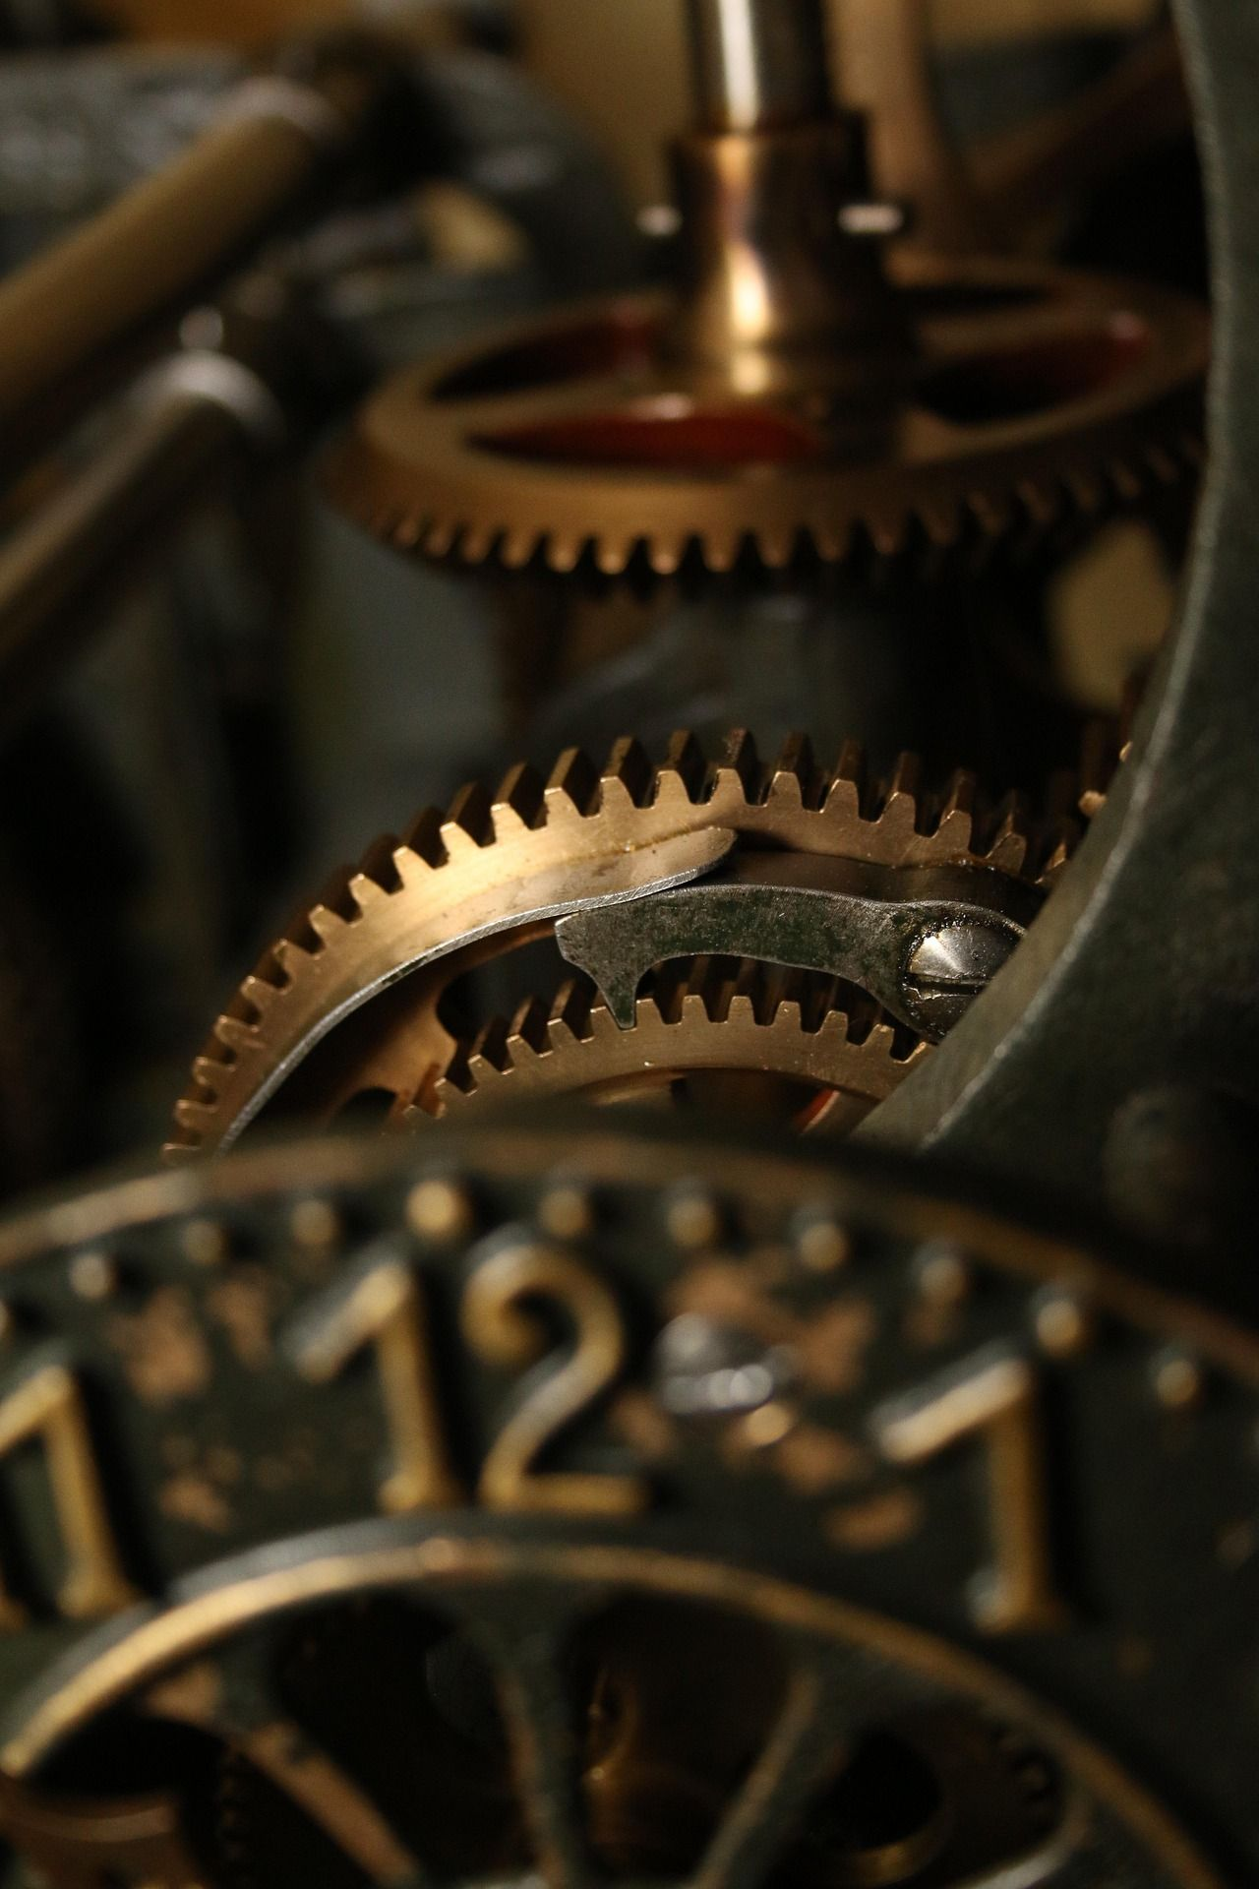
Forecast > Fear > Future
Machine competence
vs
Human competence
Notes:
Machine repeats sth that is brilliantly defined. Perfect control.

Slide 74

“Competence is the ability to act creatively and independently in open-ended, unexpected situations.”(John Erpenbeck )
Notes:
Competence is the ability to apply intelligence

Slide 75
Forecast > Fear > Future
Feudalism
vs
Regulation
Notes:
Machine repeats sth that is brilliantly defined. Perfect control. No “competence”, because it’s fixed or frozen
Regulation is the mechanism for competence

Slide 76
Let’s explore :)

Slide 77
Reframing ;)
Forecast > Fear > Future
Bad News: AI won’t replace
our workforce fully until 2030.
Notes:
Reframing!
Gemischte Szenarien: Automatisierung immer mehr KI, aber Mensch Haftung, Ethik, Risikonlyse, Kontext … Den Nutzen verstehen

Slide 78
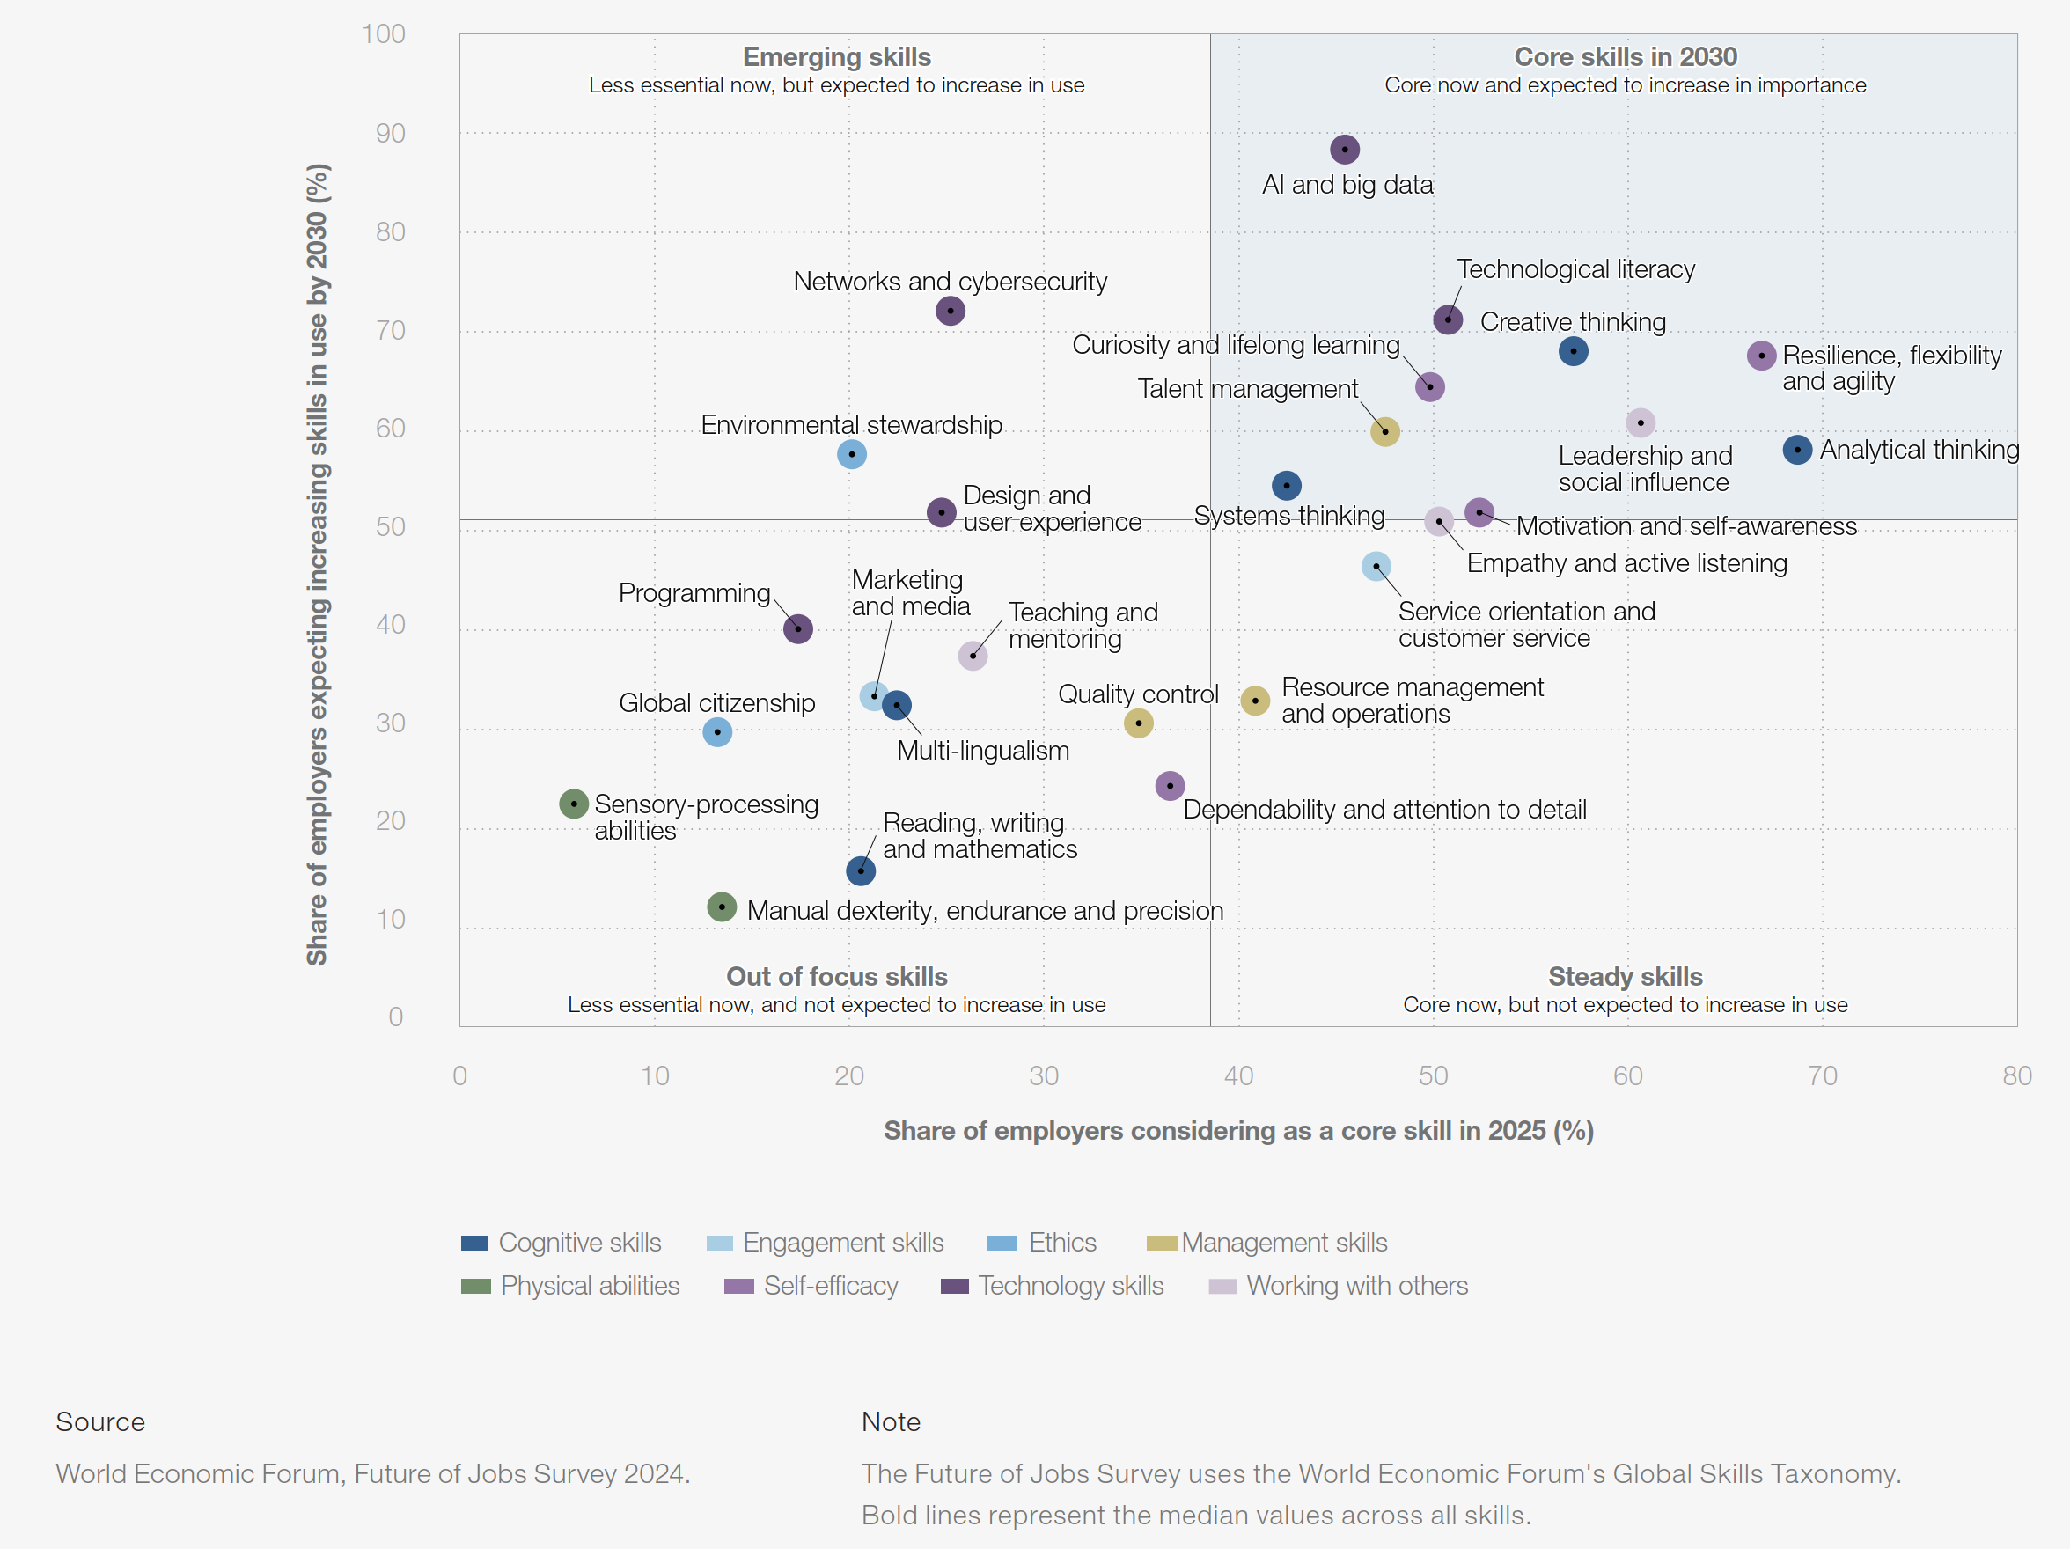
WEF: Future Skills
Forecast > Fear > Future
Systems thinking
Empathy and active listening
Motivation and self-awareness
Curiosity and lifelong learning
Leadership and social influence
Creative thinking
(Technological literacy)
Analytical thinking
Resilience, flexibility, and agility
Notes:
Technological literacy is the ability to effectively use, manage, evaluate, and understand technology to accomplish tasks and solve problems.

Slide 79
Future Skills
Forecast > Fear > Future
Systems thinking
Empathy and active listening
Motivation and self-awareness
Curiosity and lifelong learning
Leadership and social influence
Creative thinking
(Technological literacy)
Analytical thinking
Resilience, flexibility, and agility
What does this actually mean?
Notes:
Technological literacy is the ability to effectively use, manage, evaluate, and understand technology to accomplish tasks and solve problems.

Slide 80
Forecast > Fear > Future
Collaboration
Capability

Slide 81
Collaboration Capability
Forecast > Fear > Future
Collaborative models optimize for the best-performing system
  “Community-Actualization”
  The focus is on the system as a whole.

Slide 82
Competitive Agents
Forecast > Fear > Future
AI is based on training data: They also copy “collaborative models”.
  And 97.3% of the time, that’s undesirable – the vast majority of data is competitive, not collaborative
  We see (our) dysfunctional behavior in fast motion
  Observations:
    Building a hierarchy, and the most “suited” individual will rise to the top
    Survival of the fittest within the system
    Which often means the most “morally flexible” person, not necessarily the smartest.
Cost of competition
  This individual defines the upper limit of the system’s intelligence
  And will most likely focus on personal benefits rather than system benefits
  And if I believe my solution is better, I have to become this person.
Notes:
But in slow motion. What we usually don’t notice, because it happens slowly and subtly, is presented here in a condensed form.
Suddenly, the dysfunction becomes visible.
So what is the internal optimization of competitive models?

Slide 83
WEF: Future Skills & Limbi
Forecast > Fear > Future
  Growing (Limbi) importance
    Systems thinking
      collaborative
    Empathy and active listening
      collaborative (Limbi!)
    Motivation and self-awareness
      collaborative (Limbi)
    Curiosity and lifelong learning
      collaborative (happy Limbi)
    Leadership and social influence
      collaborative (Limbi)
    Creative thinking
      Limbi
    (Technological literacy)
    Analytical thinking
    Resilience, flexibility, and agility
      collaborative (Limbi)
Notes:
Technological literacy is the ability to effectively use, manage, evaluate, and understand technology to accomplish tasks and solve problems.
Leadership is the opposite from Feudalism! Not power and obedience, but leading and following (the difference is cohesion; inside and outside are aligned)

Slide 84
Forecast > Fear > Future
Let’s create utopia.

Slide 85
Utopia #1
Forecast > Fear > Future
LLMs are on the way out, but general AI isn’t here yet
  We have a collaboration with AI: similar to “reduction systems”
  (string rewriting systems from theoretical computer science)
  So software doesn’t develop on its own yet, but it is generated from the specification
Challenge
  Software acceptance testing without considering the internal structure—only black-box testing is possible
  We need very good specifications
  Former testers are experts in “inverse specs”
  (defining undesirable or unauthorized functionality or behavior)
We still avoid collaboration … being human (and leaving Feudalism) feels scary

Slide 86
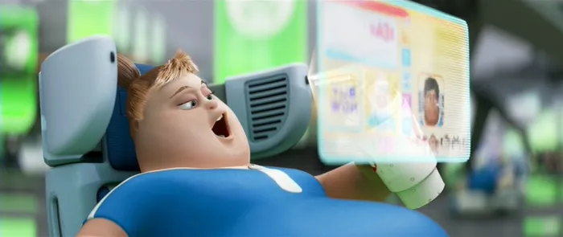
Utopia #2: WALL·E (Waste Allocation Load Lifter – Earth-Class)
Forecast > Fear > Future
AI is powerful, but it has no purpose in and of itself
  AI is the superior machine, but we could become the superior humans
  Yet we are still stuck in the same worldview; it remains feudalism, we are merely switching sides
Challenge
  “Purpose of Life” was for 97.3% defined as “sell yourself to work”
  Without work humans lack any direction and purpose
  (Risk of “Universe 25” Scenario; Behavioral sink – Wikipedia, https://en.wikipedia.org/wiki/Behavioral_sink)
We still avoid collaboration … being human
(and leaving Feudalism) feels scary
  we chose comfort over life (responsibility)
Notes:
Losing our purpose means compensation … numbing of the loss

Slide 87
Utopia #2: WALL·E – Humans stuck in Toddler-Mode
Forecast > Fear > Future

Slide 88
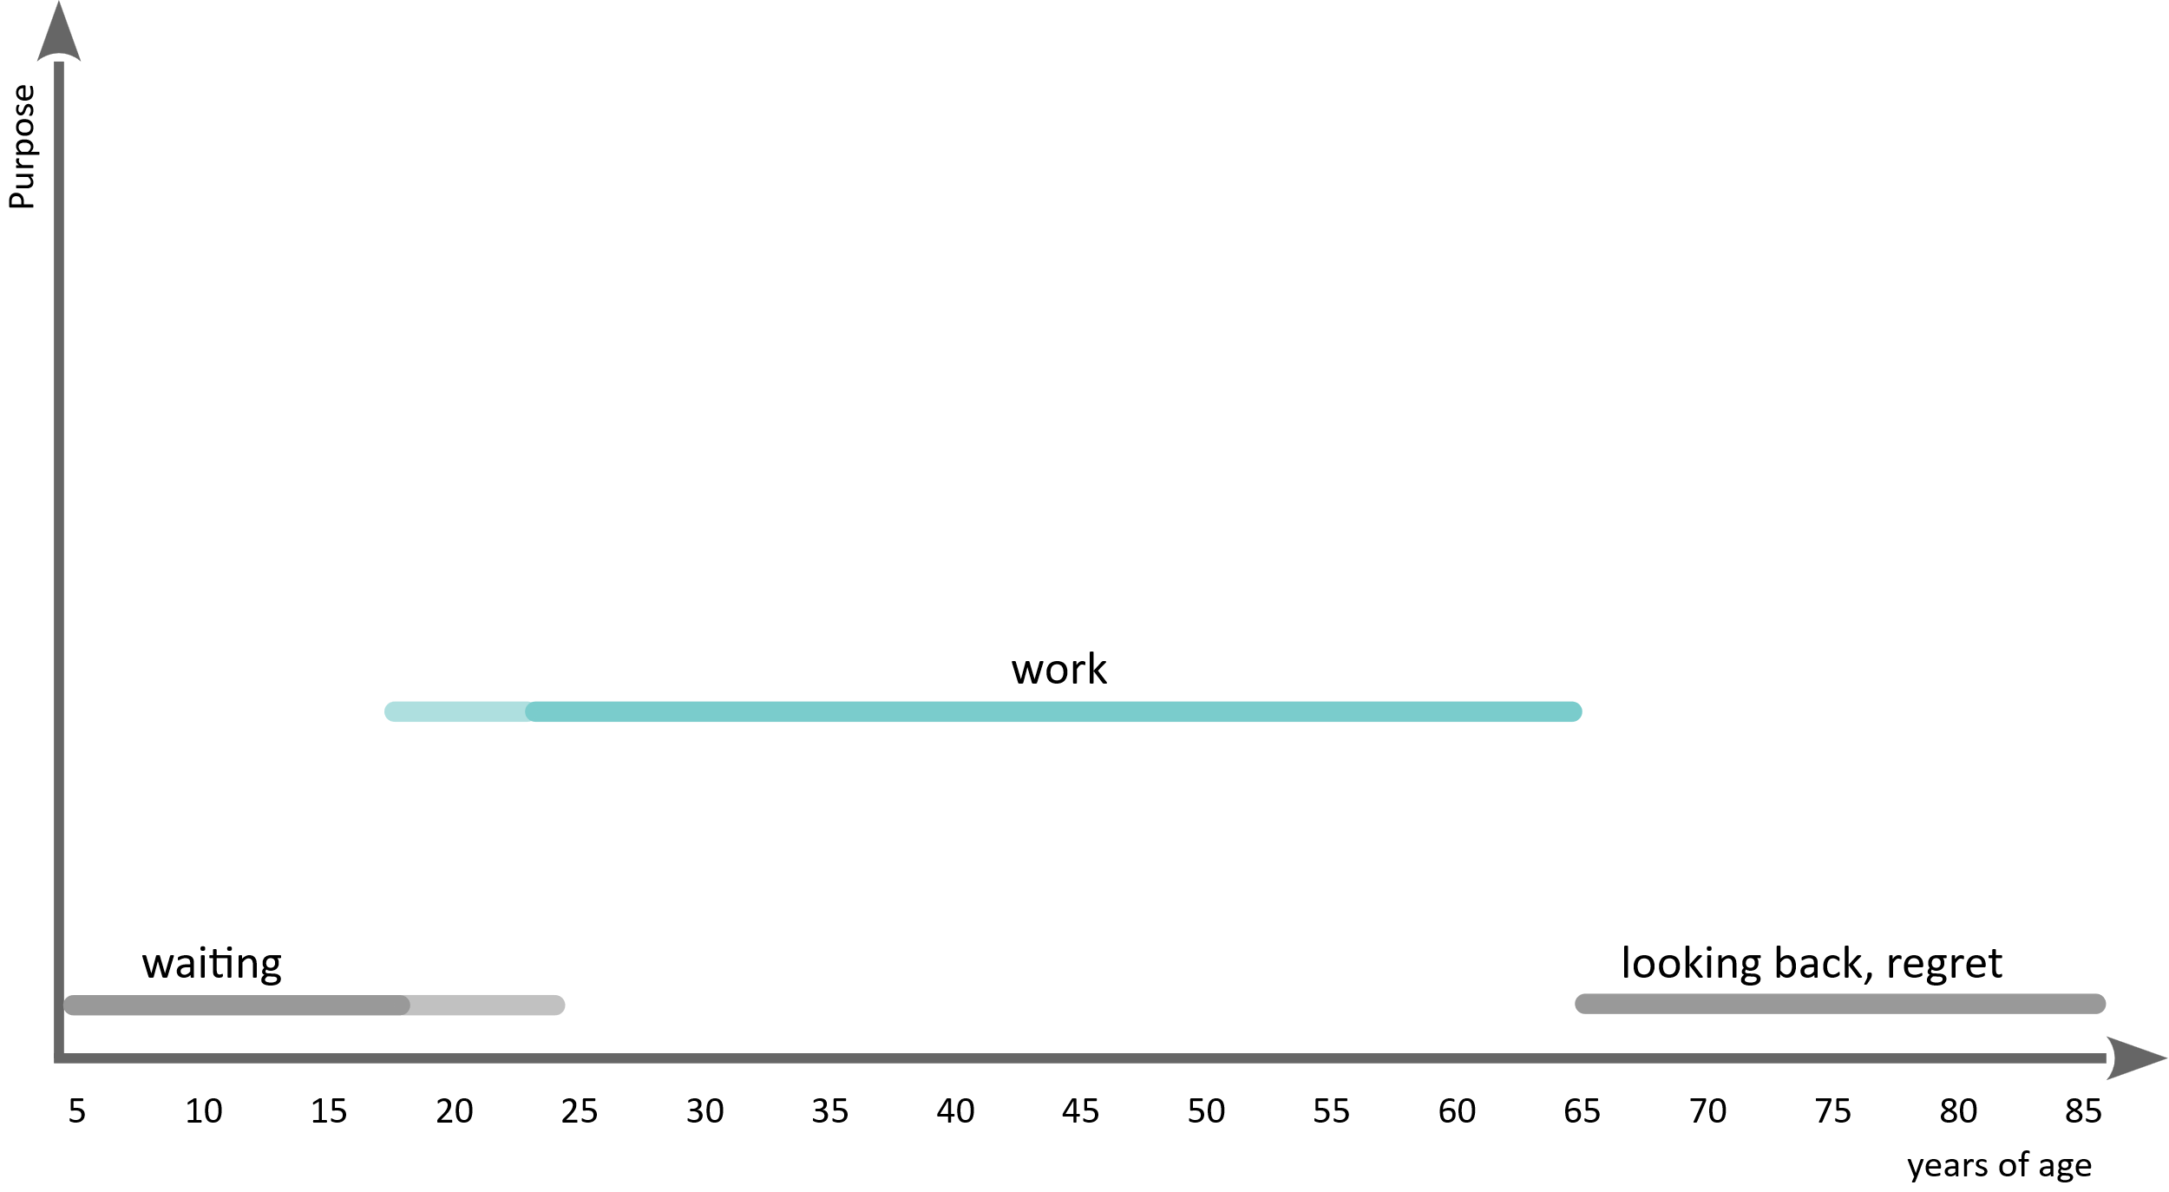
„Meaning of Life“ (Feudalism)
Forecast > Fear > Future

Slide 89
Forecast > Fear > Future
Taking away performance (work)
means losing all self-worth.
We are scared of losing our purpose.
Notes:
Clinging to sth we never wanted

Slide 90
Forecast > Fear > Future
The real issue is that we believe that our
value comes from our performance.
That’s the core of the feudalistic worldview. And it’s not true, but useful for the 1%.
If we can get rid of that assumption, we gain freedom to create utopia,
instead of focusing that we lose something
that we actually never wanted.
Notes:
Clinging to sth we never wanted

Slide 91
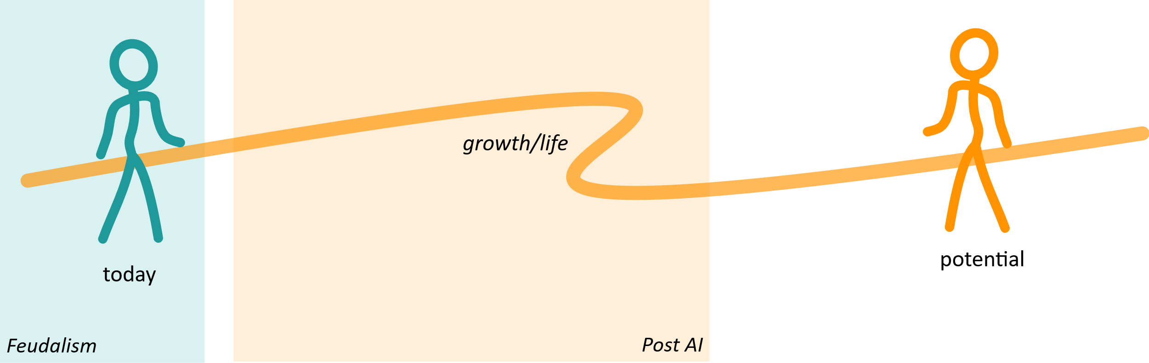
Utopia #3
Forecast > Fear > Future
We no longer need to “work”; instead, we can fully realize our potential.
  The misguided path of wage labor (enslavement) has come to an end, and we must learn to live again.
Challenge:
  We need a purpose that goes beyond “I live to provide my labor”
  Level of meaning and significance

Slide 92
Regulation
Forecast > Fear > Future
The good news: AI takes the strain off our neocortex, allowing the rest of the brain to have a go
  less load
Emotional/social Core Skills are in the Limbi
  more opportunity, growth, development
Notes:
Machine repeats sth that is brilliantly defined. Perfect control.

Slide 93
Human Skills
Forecast > Fear > Future
Basic Human Needs: Connection and Creation
  I need my pack
  I want to make a contribution (every person has their own unique selling point, and that can’t come from a process)
So far, fear has overshadowed basic needs for most people (76 up to 98 out of 100)
Skills we need to develop
  Skills for Connection (Relationship)
  Skills for Creation (needs all levels of psychological safety)
Notes:
Die psychologischen Grundbedürfnisse sind Verbundenheit und Gestalt
Self-Actualization is just the means for Community-Actualization (it’s not a value in itself)
ung.

Slide 94
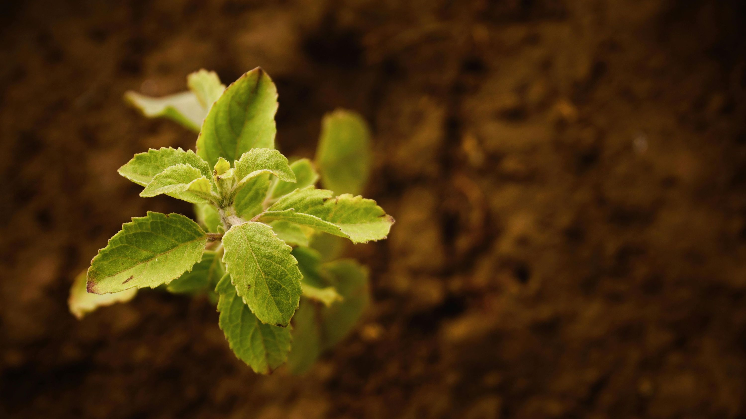
“Best time is twenty years ago,
the second best time is today.”
You started today,
to be ready for
success in 2030 .

Slide 95
Current Existential Crisis
Forecast > Fear > Future

Slide 96
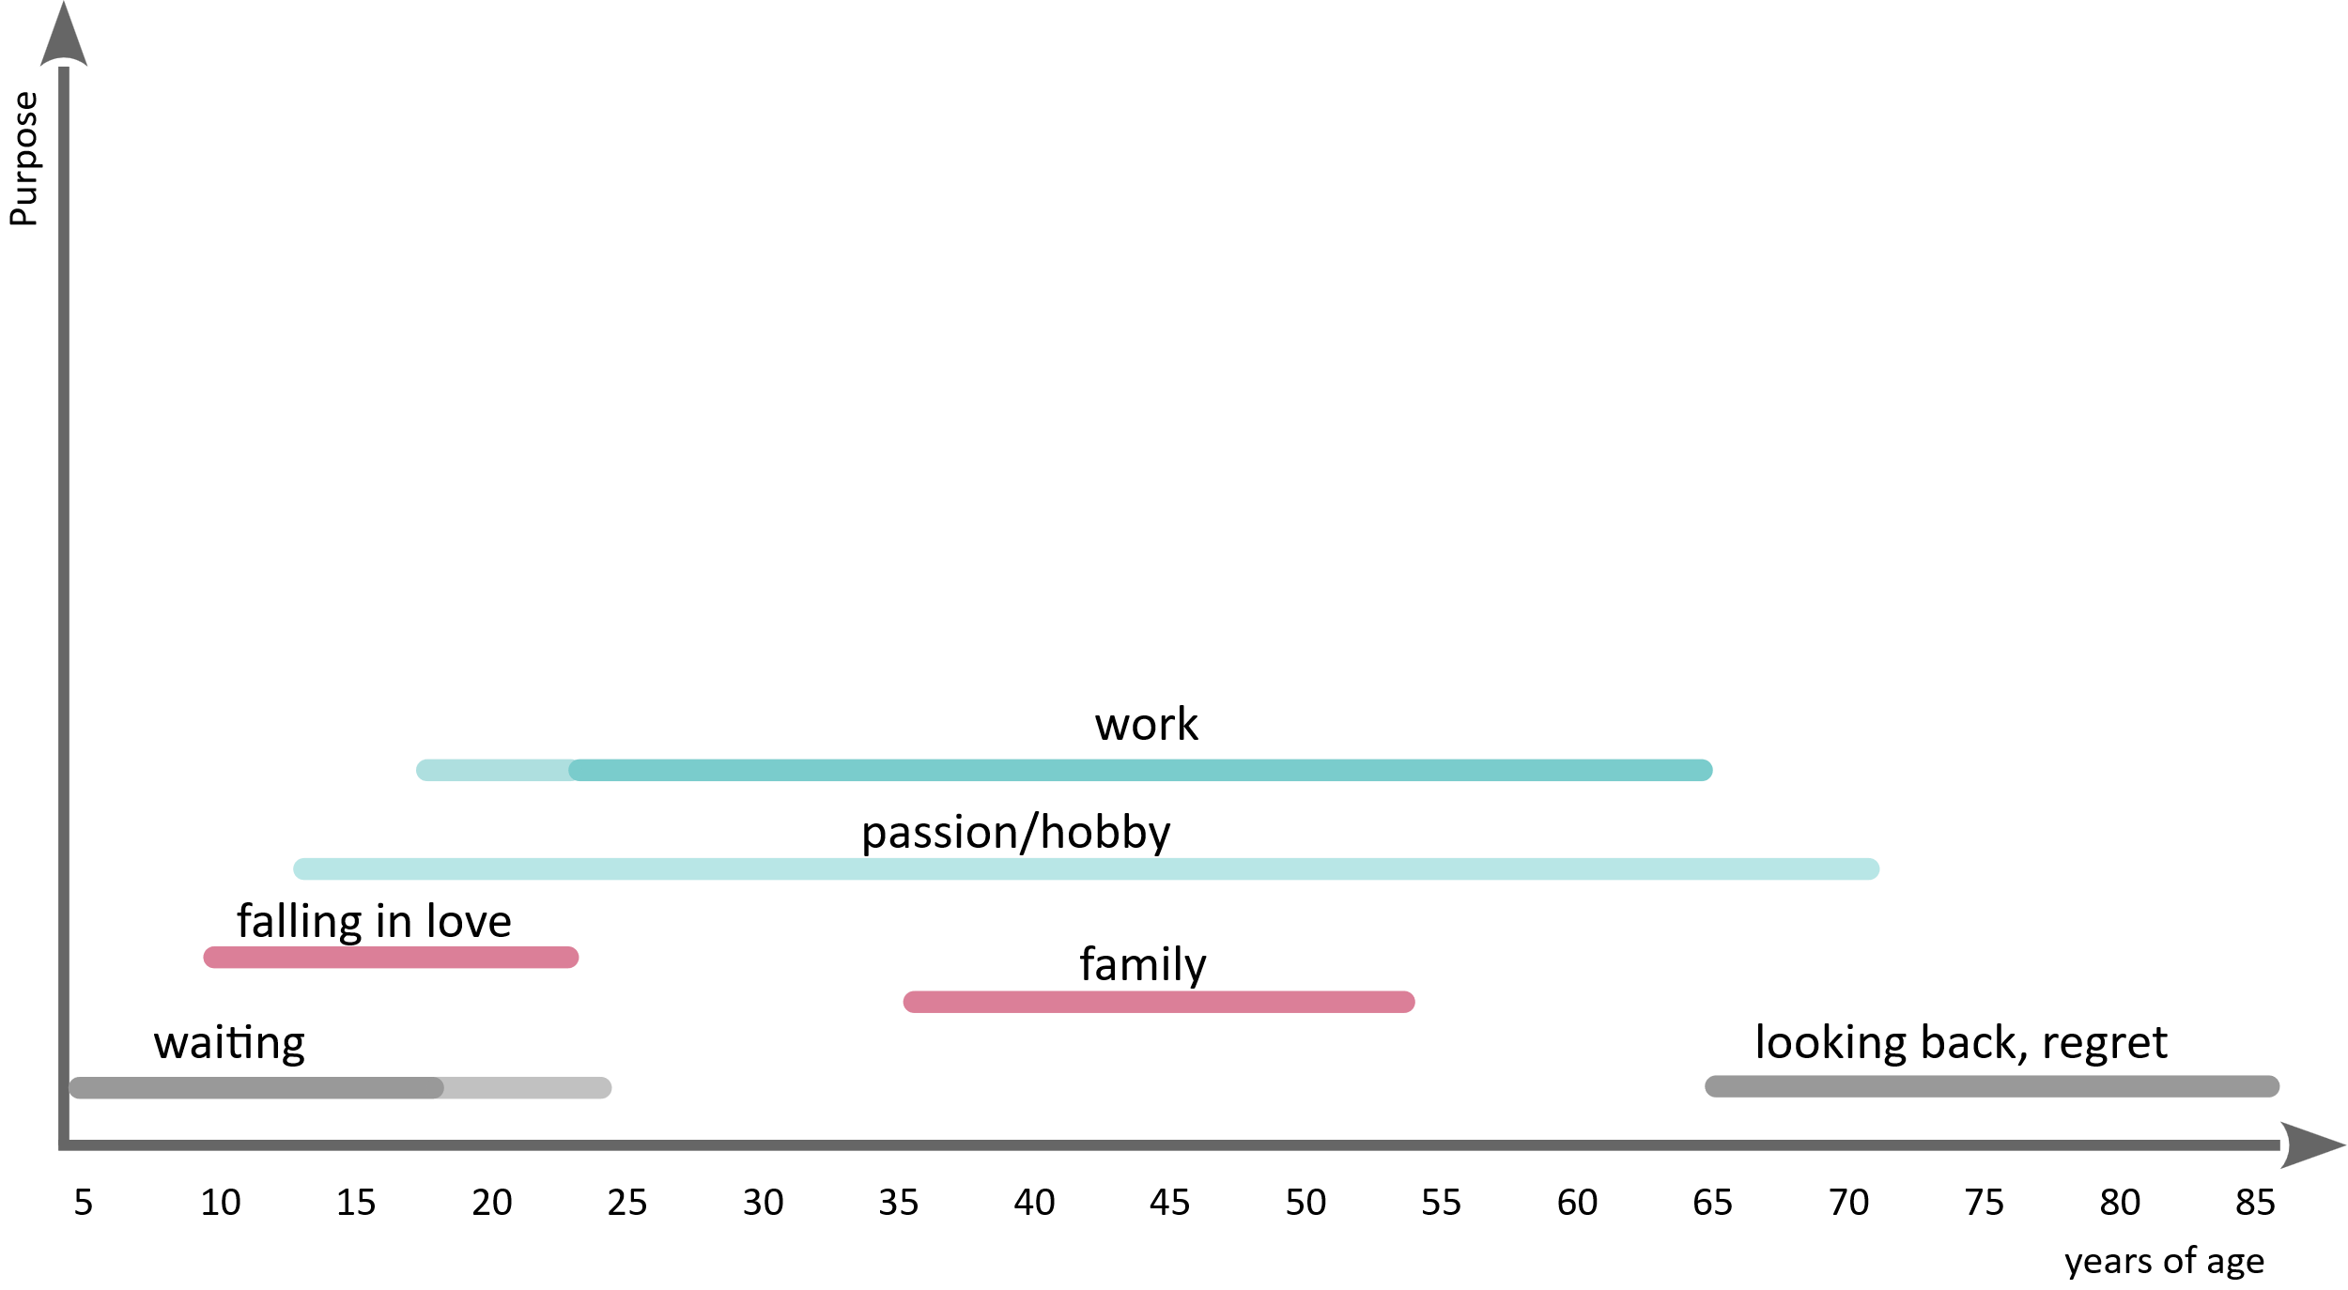
If we can pimp it… it stays slim: everything takes a back seat to money
Forecast > Fear > Future

Slide 97
Forecast > Fear > Future
AI is the catalyst for our
search for meaning
Since millennials and GenZ we are on this quest. AI just speeds it up.

Slide 98
Limbi has 7 Parts (Jaak Panksepp; Affective Neuroscience)
Forecast > Fear > Future
System | Function (positive) | Activated by… | Blocked by… | Recognizable by… (diagnostic clues)
SEEKING | Motivation, curiosity, flow | Autonomy, meaning, rediscovery | Control, boredom, pressure | Boredom, cynicism, loss of energy, lack of suggestions or ideas
RAGE | Assertiveness, clarity | Justice, protection, self-defense | Powerlessness, injustice | Hostility, microaggressions, sudden outbursts of anger
FEAR | Protection, caution | Threat, uncertainty | Constant uncertainty | Withdrawal, control, excessive caution, the "no" reflex, evasion
LUST | Joy of life, intimacy | Closeness, self-determination, enjoyment | Shame, assault, taboos | Body shaming, fear of physical contact, shame, over-control
CARE | Compassion, empathy | Security, trust, connection | Distrust, feeling overwhelmed | Cynicism, indifference, withdrawal from relationships
PANIC / GRIEF | Connection, belonging | Loss, isolation, rejection | Separation, exclusion | Overly emotional reactions, exhaustion, neediness, distrust
PLAY | Creativity, learning, flow | Safety, lightness, freedom | Seriousness, control, fear | Sarcasm, withdrawal, playing it safe, phrases like “That won’t work here”

Slide 99
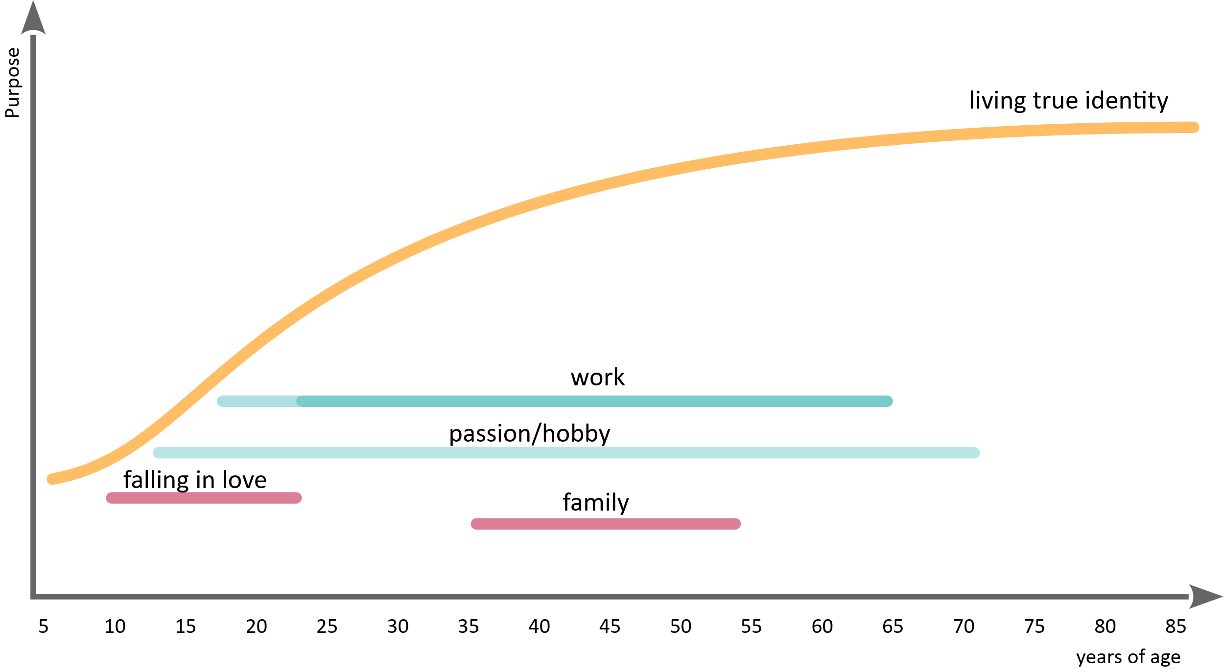
This is what a meaningful life would look like …(i.e., Jane Goodall)
Forecast > Fear > Future
Notes:
Jane

Slide 100
Forecast > Fear > Future
No, SwQ won't be out of a job by 2030.
But it's high time we learn to live.

Slide 101

Intelligence: Learning, Anticipating, and Adapting for System Survival and Success

Slide 102
only if we are scared,,
we tend to see dystopia

Slide 103
Forecast > Fear > Future
otherwise we see the 3-hours
work day
Notes:
Da noch ein Bild :)
Wir können jetzt nicht auf alle Daten eingehen, aber wir sollten aktuell bei 10-15h/Woche Familienarbeitszeit liegen, wenn es nicht die Entkopplung in den 70ern gegeben hätte

Slide 104
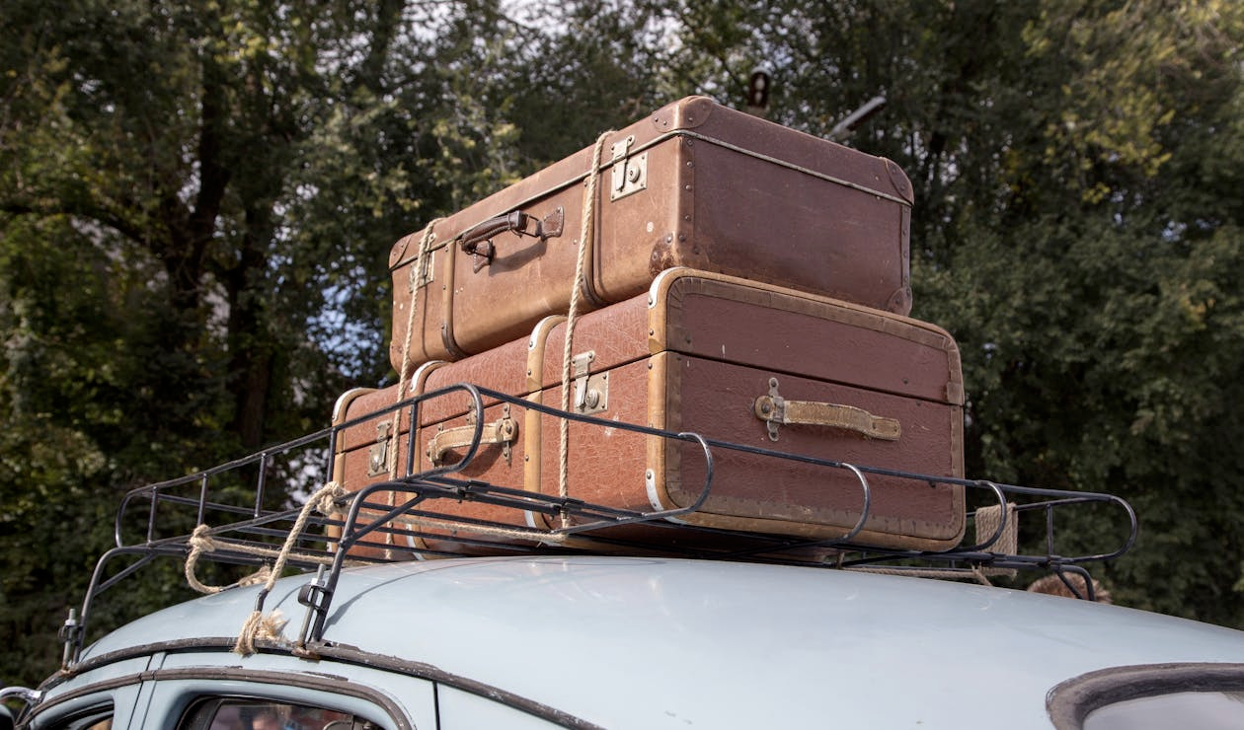
You are already on your way, because you are here

Slide 105
Forecast > Fear > Future
The probability of living instead
of just functioning improves.

Slide 106
Key Takeaway
Forecast > Fear > Future
Until now: People were treated like machines
→ Increased efficiency through discipline, control, and “programming.”
  AI will handle all “programming” better
We can cry about losing what broke us, or we can unleash their true strengths:
creativity, relationship-building, purpose, values, and conflict resolution
Organizations can move away from the “machine paradigm” (rhythm, standardization, control)
toward a human-centered paradigm (meaning, networking, co-creation)
  AI can live in the machine space
  humans in human mode
Notes:
OrgIQ.org passt hier perfekt, weil dein Ansatz genau diese Architektur für menschenzentrierte Organisationen liefert. KI wird sozusagen die Maschinenebene, die Menschen endlich davon entlastet, selbst Maschinen sein zu müssen.

Slide 107
Summary
Forecast > Fear > Future
Slavery
Slavery with fruit basket
Work with AI
Utopia: New Perspective

Slide 108
It‘s been a pleasure.
Questions?
Danilo Assmann
Dan@OrgIQ.org

Slide 109
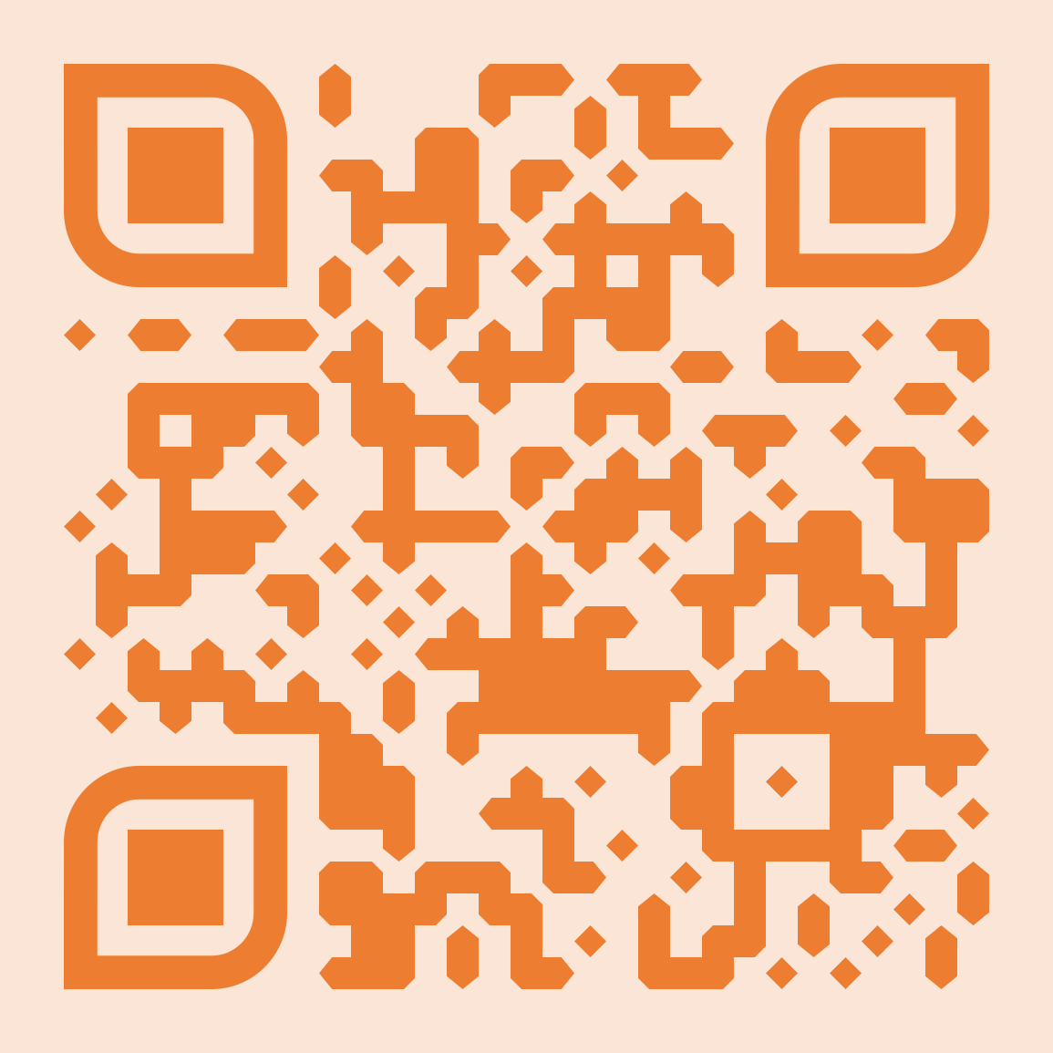
Deeper Dive
Forecast > Fear > Future
Downloads: https://orgiq.org/home/downloads/
  Gecko CheatSheet: https://orgiq.org/wp-content/uploads/2025/01/OrgIQ_GeckoCheatSheet_Release_EN.pdf
  DSS CheatSheet: https://orgiq.org/wp-content/uploads/2025/07/OrgIQ_DSS-CheatSheet_Release_EN.pdf
  Relationships: https://orgiq.org/wp-content/uploads/2025/01/OrgIQ_RelOrgCheck_Release_EN.pdf
  Trust: https://orgiq.org/wp-content/uploads/2025/11/OrgIQ_DeepDive_TrustBetrayal_Release_EN.pdf
  NextStep; https://orgiq.org/wp-content/uploads/2025/10/OrgIQ_Leading2NextStage_Release_DE.pdf
    for coaching, only German so far
  Leadership: https://orgiq.org/wp-content/uploads/2025/05/OrgIQ_DeepDive_LeadershipIntro_Release_EN.pdf &
  https://orgiq.org/wp-content/uploads/2024/10/OrgIQ_DeepDive_Leadership_Release_EN.pdf
Blogs see QRCode

Slide 111
Problems 1-3
Fear of AI, which is basically uncertainty: What will happen? How will this change my life?
Clear separation of human and machine mode in daily work and life. Processes and also most companies still focus 97% on the machine mode. The rest is yet to be discovered.
One reason we avoid the “human side” is because we don’t understand it. We have no guide or handbook. This is addressed for the most relevant skills in 2030.
  Rory Sutherland story with the cheese and the rind
    first the new thing is cheese without rind
    second new thing is bringing authenticity back and sell cheese with rind again (and make it look cool)
  That’s the same thing here
    First machine mode was cool (be a human robot)
    Second human mode is cool again … we need this frame now

Slide 112
Value
Not fear, but anticipation!
If we give uncertainty and fear too much space, then the gecko takes over, we go even more into survival mode and are even less able to create.
That's why preparation, direction and clarity are so important. Because change is coming, but we are not just prepared, we are expectant. That gives us a completely different energy. That creates design.
To do this, we take a concrete look at the skills (as deep as time allows). So it's totally concrete.

Slide 113
Questions 1-3
Questions 1-3
How safe are the predictions?
  Kind of unsure, because even between the call for papers and the conference itself, the techonolgies changed dramatically
  But current direction is: It will be faster than we think.
Why those skills?
  Okay, the skills forecast comes from data, but there is also a logic to it.
  Basically we must separate between skills that are easy replaceable through AI (mainly because they were never human competence first hand, but we were trained to act as machines, because there were no machines)
What do I need to survive?
  Most likely the change will be way deeper than the last technical revolutions. This is what scares us. And if we are scared, we go into survival mode.
  Which is a huge problem, because survival is most of the time “me against the others”.
  But actually, we don’t have an enemy, but an opportunity. So we need to rethink work and life, to adapt. Which means being intelligent: The ability to predict, learn, and adapt, to prosper.

