Slide 1

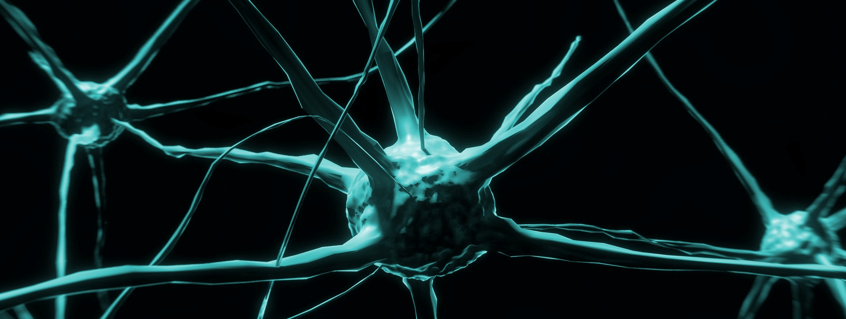
SPICE 4 Collaboration Capability @ VDA SYS 2025
A Systematic Approach For Psychological Safety in Healthy And Human-Centered Environments

Slide 2
Agenda
Fail > Learn > Anticipate

Slide 3
Intro
  The processes and indirection
  SPICE does not describe how I make software; there are only basic principles for the processes
    If we apply these, the probability increases dramatically
  This is how we do it with collaboration
    Environment: Probability for humanity increases dramatically

Slide 4
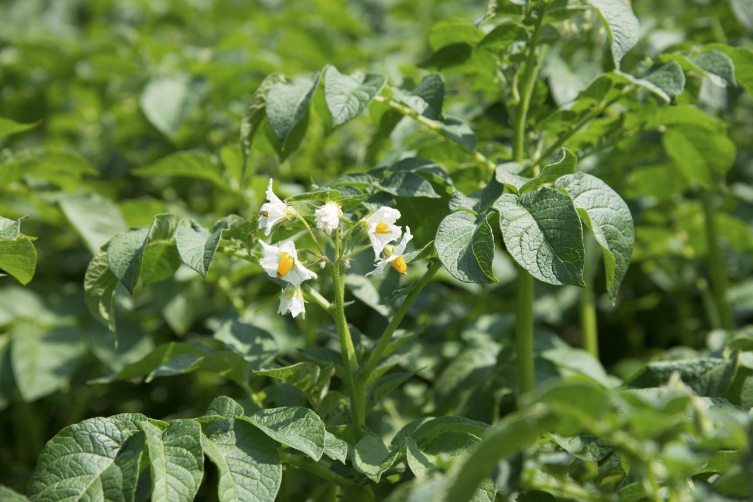
Intro
We’ve been the Pioneers Who Fought This …

Slide 5
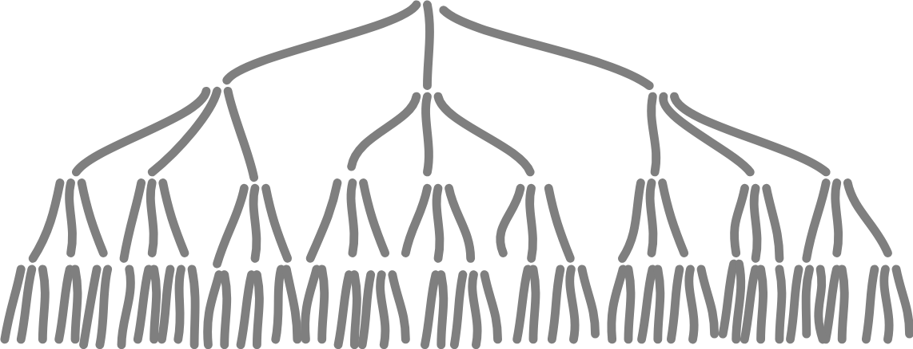
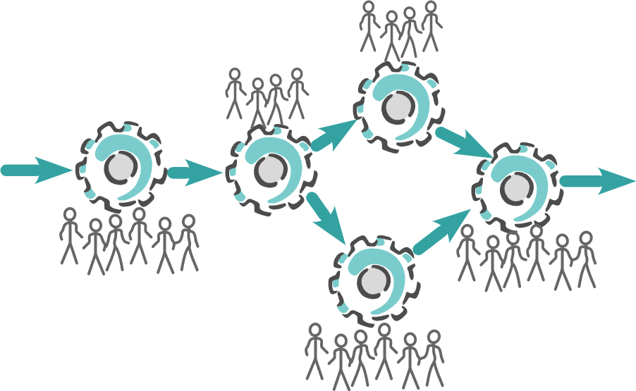
Intro
30 Years Ago: From Chain of Command to Processes

Slide 6
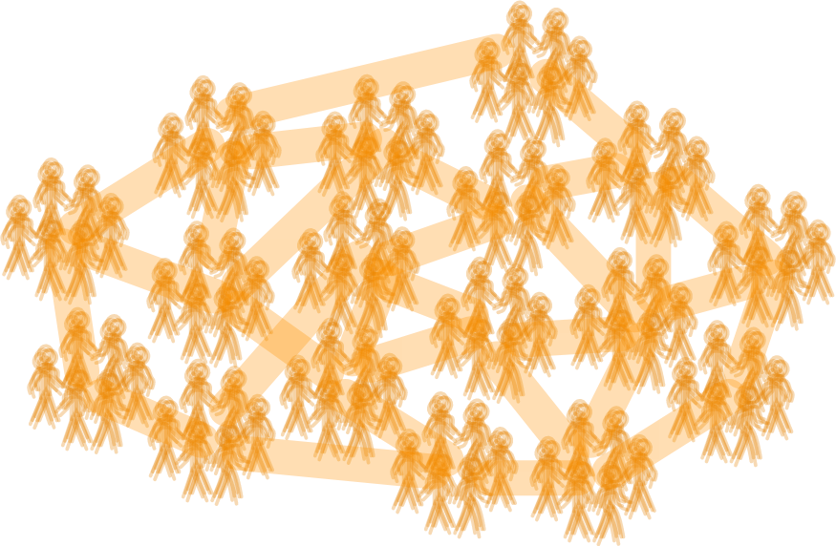
Intro
10 Years to Late: Healthy Social Intelligent Systems as Foundation

Slide 7
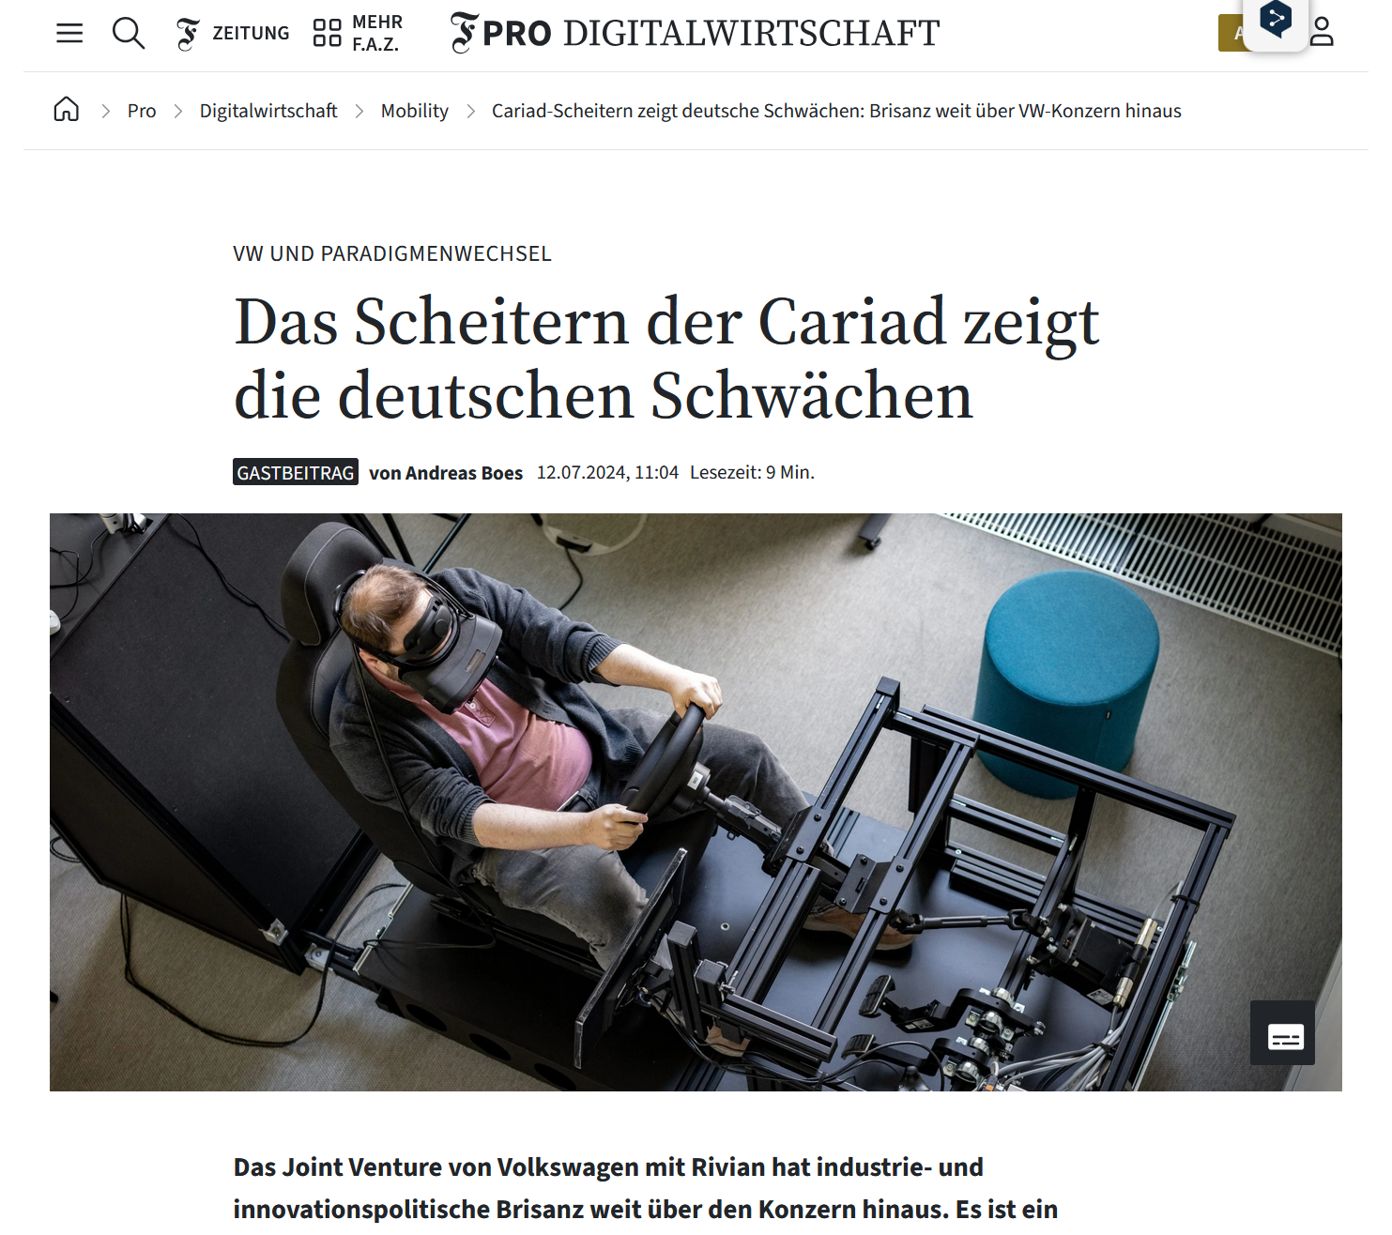
Intro
An Example: Cariad
  Could we have foreseen and avoided the problems?
  Definition of Intelligence
    “Learning, Adapting, and Anticipating for System Survival and Success.”
  We have well known and understood principles for designing intelligent systems
    Neurology, Psychology, Sociology, Cybernetics, Synergetics and Systems Theory (in short: NPSCSST)
  So how can we apply this in future in advance?
  And why didn’t we do it, even lot of the science is around for 60 years?
https://www.faz.net/pro/digitalwirtschaft/mobility/cariad-scheitern-zeigt-deutsche-schwaechen-brisanz-weit-ueber-vw-konzern-hinaus-19844091.html
https://de.linkedin.com/pulse/der-aufstieg-und-fall-von-cariad-5-gr%C3%BCnde-f%C3%BCr-das-scheitern-raasch-ivgie
Notes:
Sidenote: It’s not about the people at Cariad. They are amazing. And I don’t know a single company that should mock them, because they all do the same stupid things.

Slide 8
Intro
Current Overview of Studies
  Just in the recent month
    Gallup Engagement-Index
    Deloitte Global Human Capital Trends 2025
    OECD Skills 2030-Study
    World Economic Forum Future of Jobs 2025 Study
Why are we so obsessed with building stupid organizations?

Slide 9
Intro
Core Belief: It Just Happens With Growth
  From Start-up to Big Business
    from Belonging to Fitting in
    from Purpose to Job
    from Responsibility to Service by the book
    from Smart to Blind
  For every software you will choose a different architecture if it’s 100 LoC or 10mio LoC
    And the architecture will need to match the needs of the system
It’s a
comfortable lie.
It’s not about growth, it’s about architecture.

Slide 10
Intro
Understand Humans, and Design for Their Needs
  So we need to understand
    Neurology, Psychology, Sociology, Cybernetics, Synergetics and Systems Theory
    (in short: NPSCSST)
Organizations are social systems.
They need
a human architecture.

Slide 11
Life is an Open Space
Four Principles
  Whoever comes, it's the right people – one or 25 doesn't matter, and everyone is important and motivated.
  Whatever happens, it's the only thing that could happen - the unplanned and unexpected is often creative and useful.
  It starts when the time is right – the important thing is energy (not punctuality).
  Over is over – Not over is not over – when the energy is over, the time is over.
Law
  Law of Two Feet – as an expression of freedom and self-responsibility: the participant stays in a group only as long as he or she considers it useful, i.e. as long as he or she can learn and/or contribute something.

Slide 12
Agenda
Fail > Learn > Anticipate

Slide 13
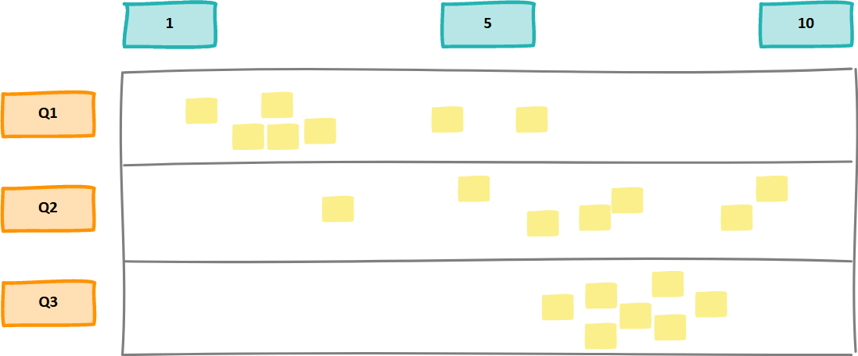
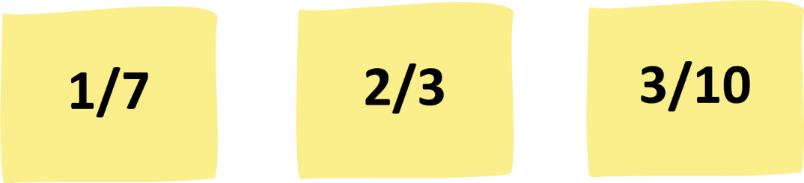
Konwlegde Chart
Our Baseline for Today
  How familiar is the theory behind “collaboration” and “productivity” for me? (Am I able to give a solid definition?)
  How would I rate my personal experience of collaboration in the last 6 month?
  What level of collaboration would I like to have (realistically)?
  Material
    Prepare wall: Qs + Scale
  Everyone gets 3 small stick-its
    for every question
    rate 1..10 (10 best)
    Write Q<No>/Rating
Notes:
Purpose
Baseline for understanding
Gap analysis between reality and wish

Slide 14

Our Goal
Get a grip on the ignored parts of our brain.
Have a systematic and professional access to collaboration, creativity, innovation, transformation, productivity.

Slide 15

Theory of the Day
Our Current Situation of Blindness

Slide 16

Theory of the Day
Situation With Collaboration Capability Maturity Assessment

Slide 17

Theory of the Day
Situation in 10 to 20 Years

Slide 18
Theory of the Day
Worldview: How and What We See

Slide 19
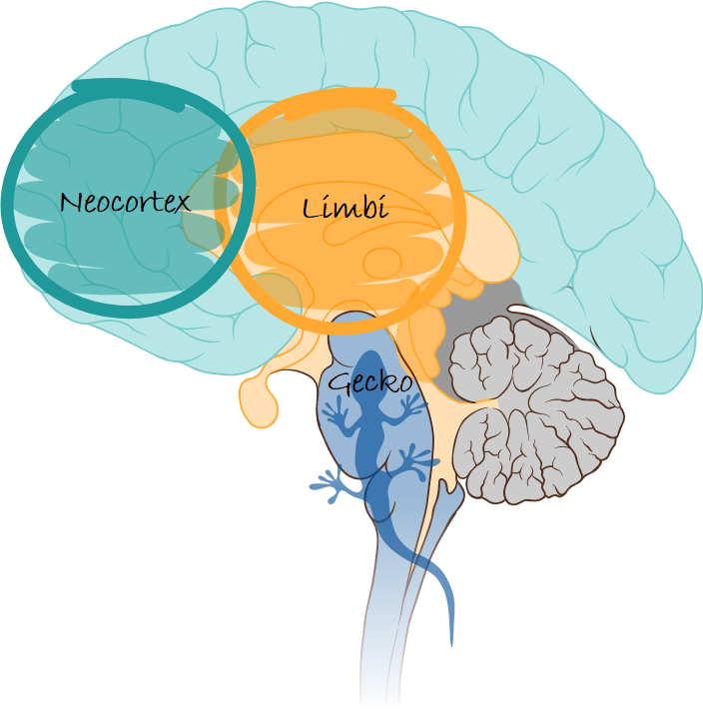
Theory of the Day

Slide 20
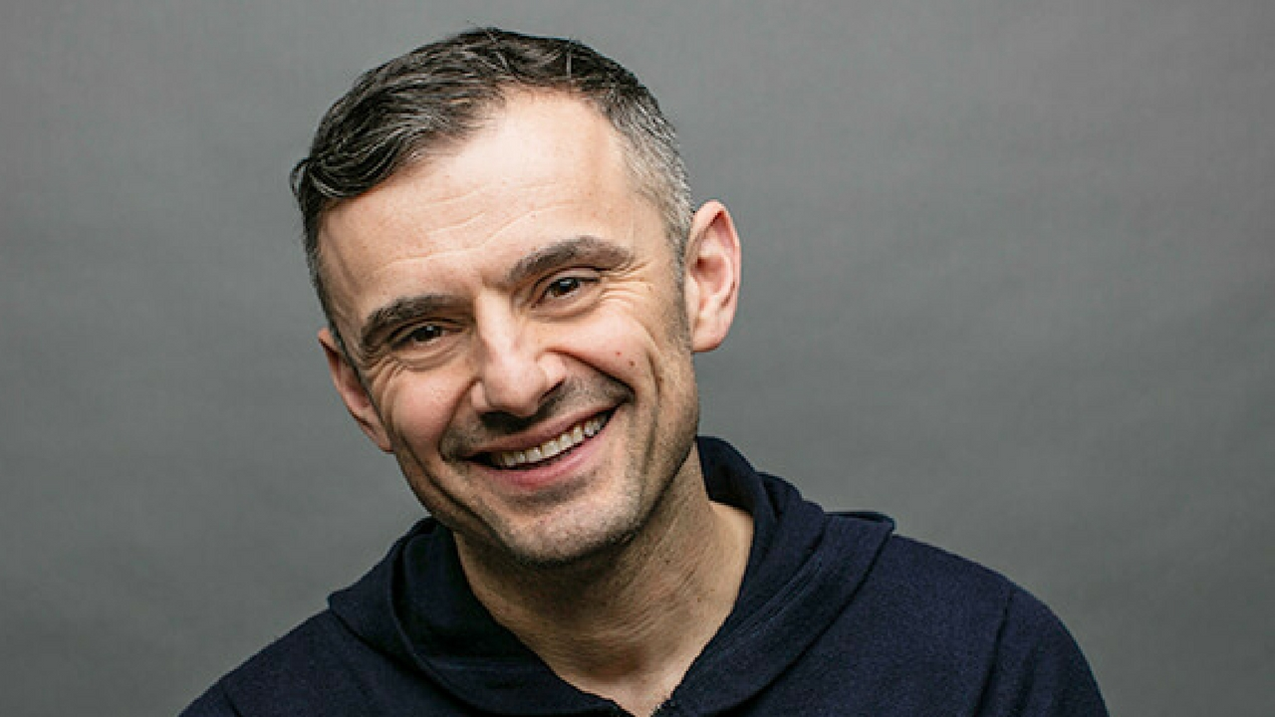
We are at the dawn of the era of emotional intelligence.
(Gary Vee, 2015)

Slide 21
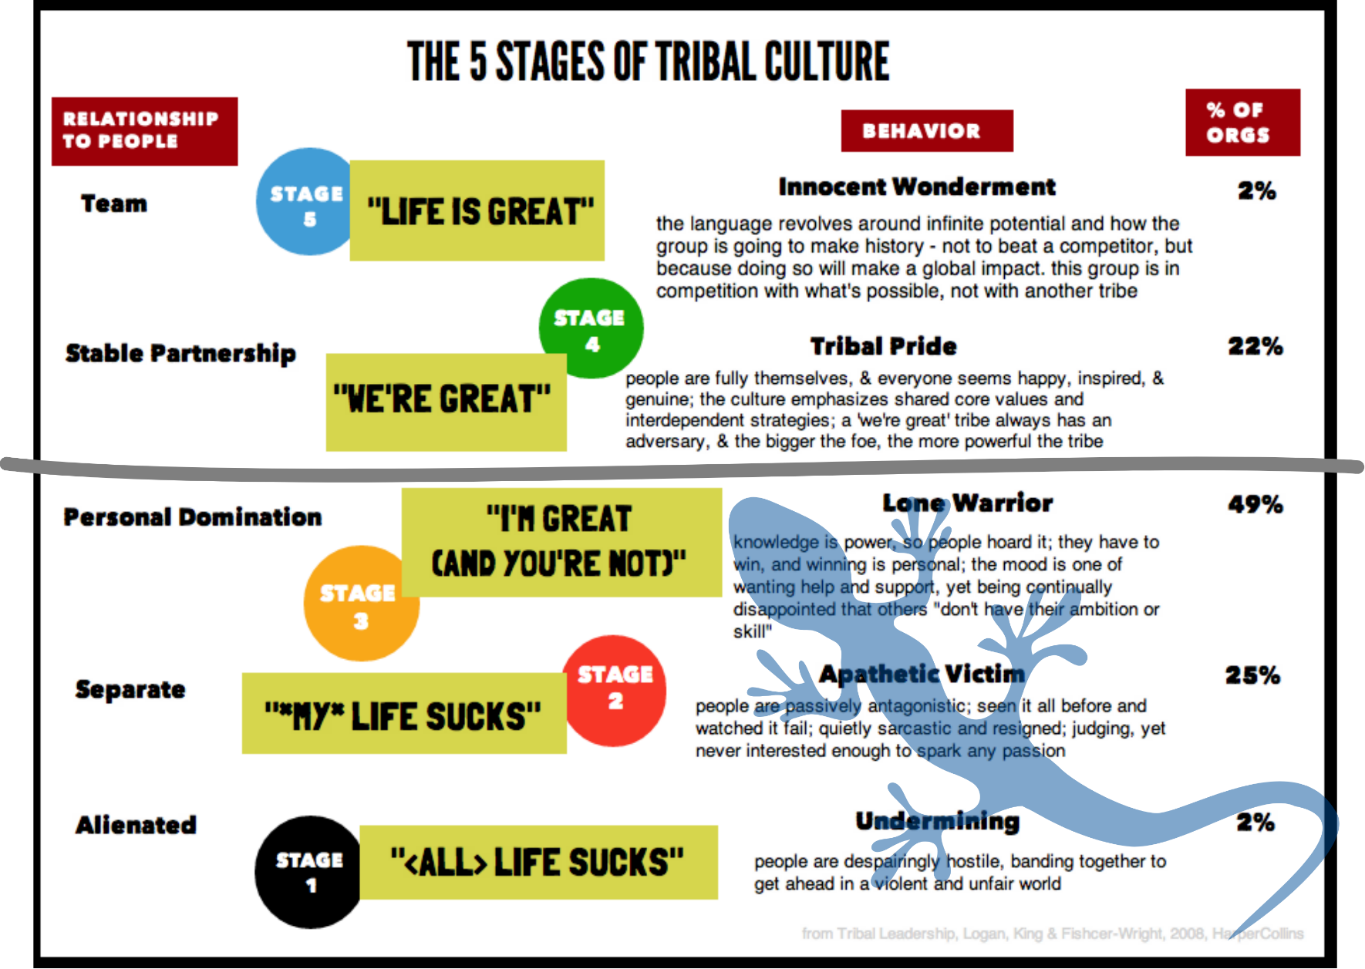
Theory of the Day
The Data

Slide 22
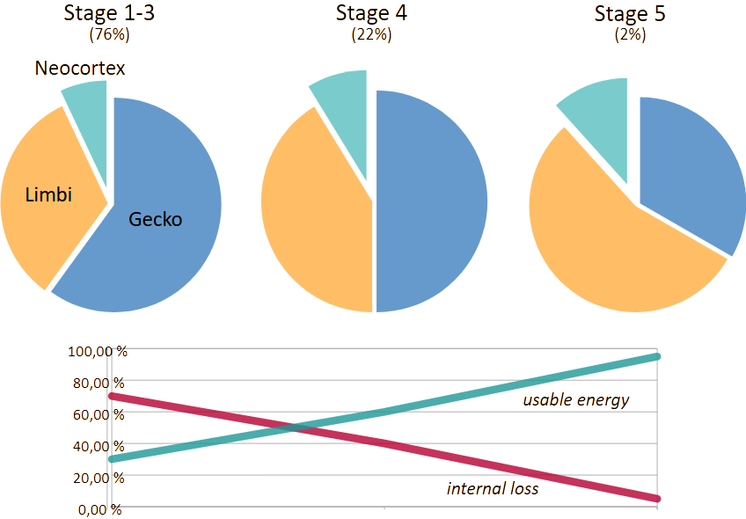
Theory of the Day
The Consequence

Slide 23
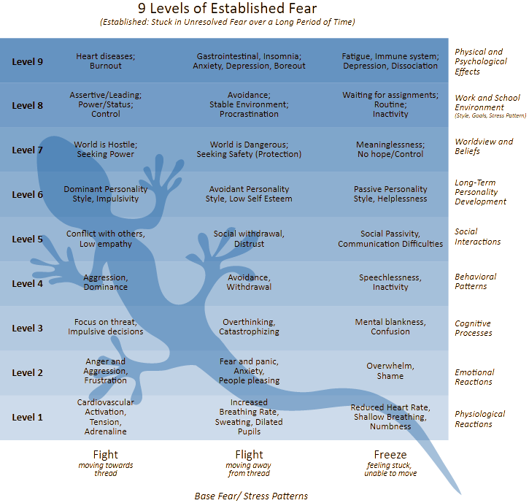
Theory of the Day
The Gecko

Slide 24
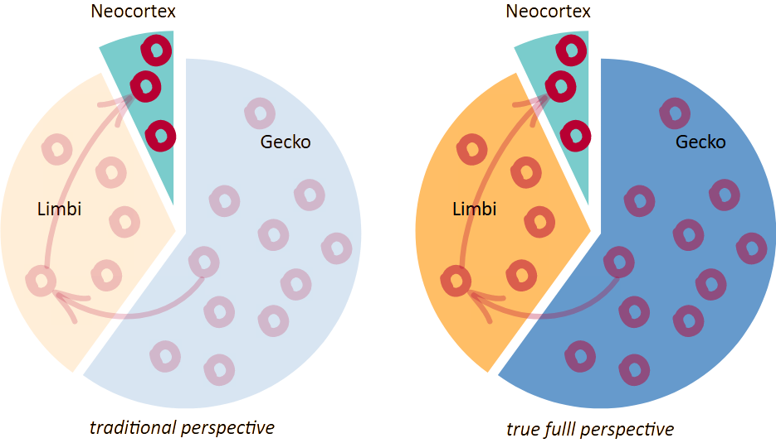
Theory of the Day

Slide 25
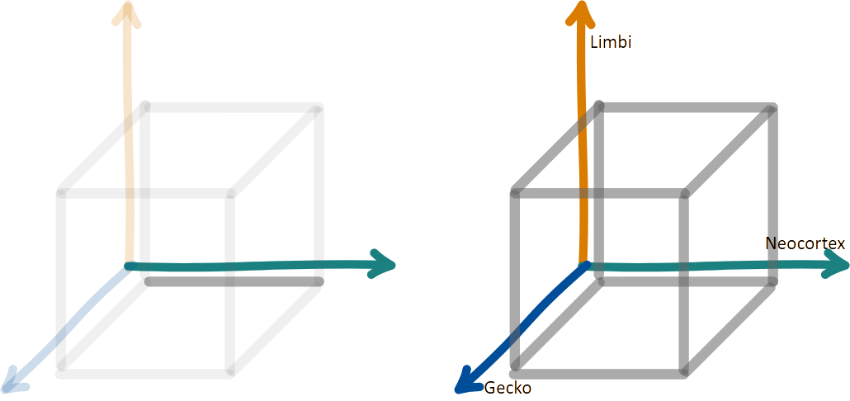
Theory of the Day
Problem Space and Solution Space: 1D

Slide 26
Theory of the Day
Problem Space and Solution Space: 1D vs 3D

Slide 27
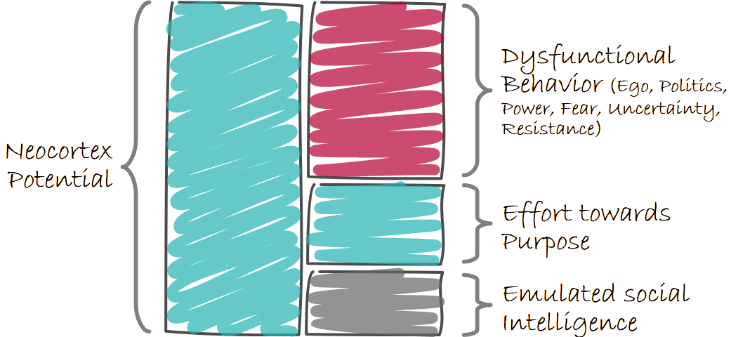
Theory of the Day
Productivity

Slide 28
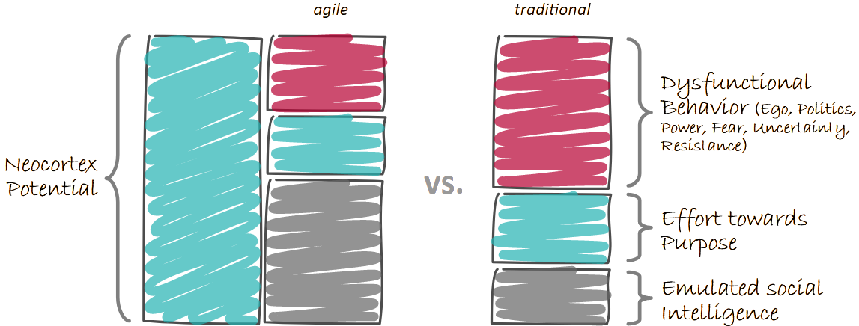
Theory of the Day

Slide 29
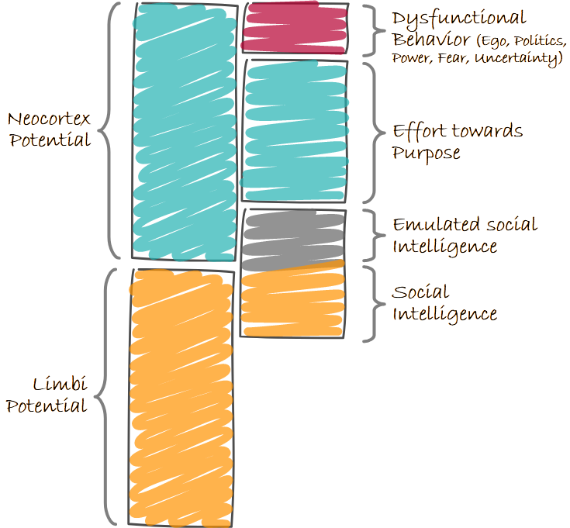
Theory of the Day

Slide 30
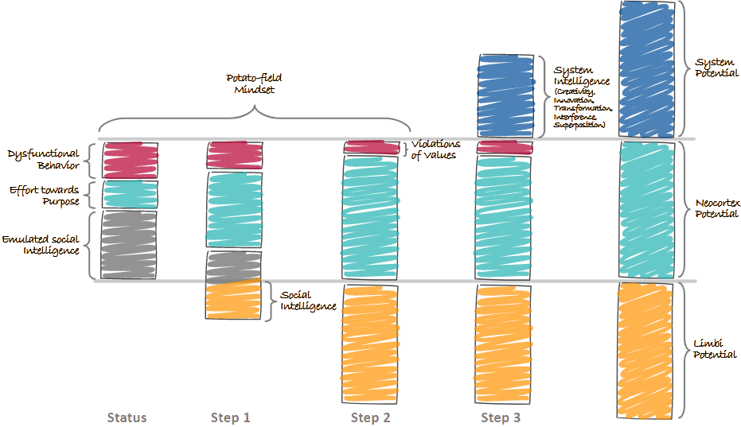
Theory of the Day

Slide 31
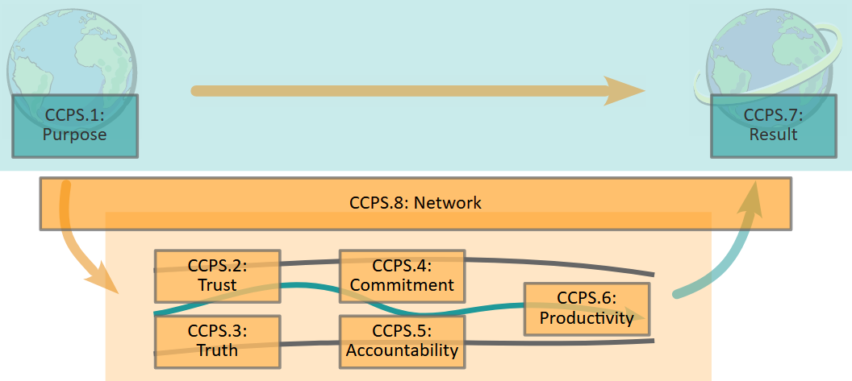
Theory of the Day

Slide 32
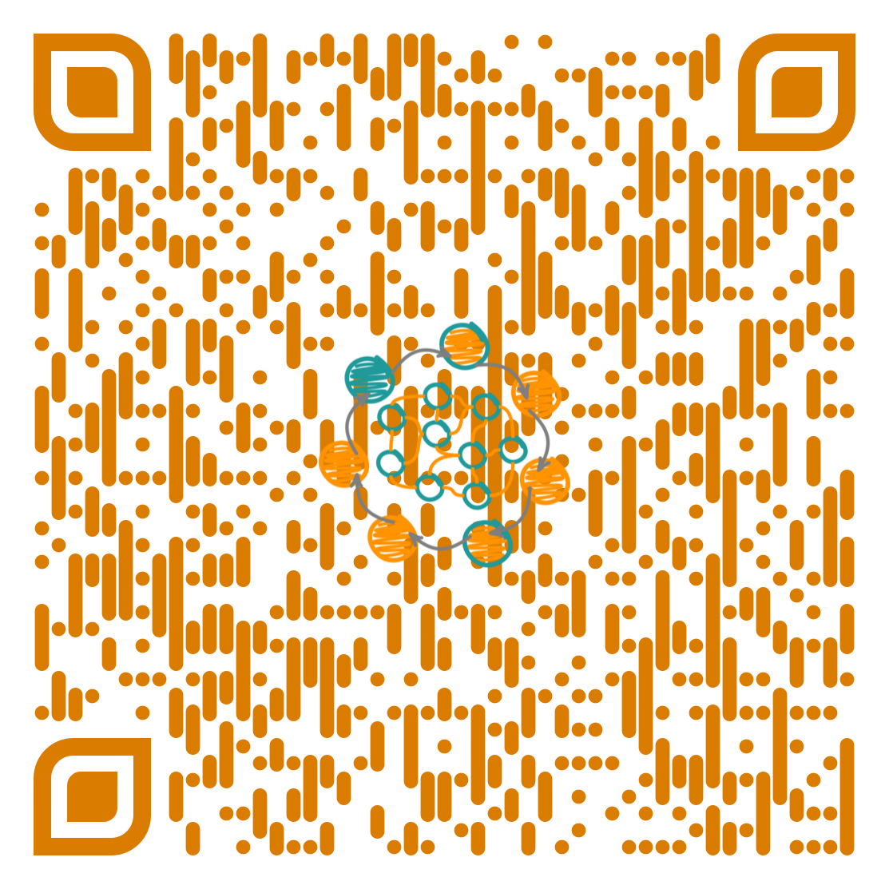
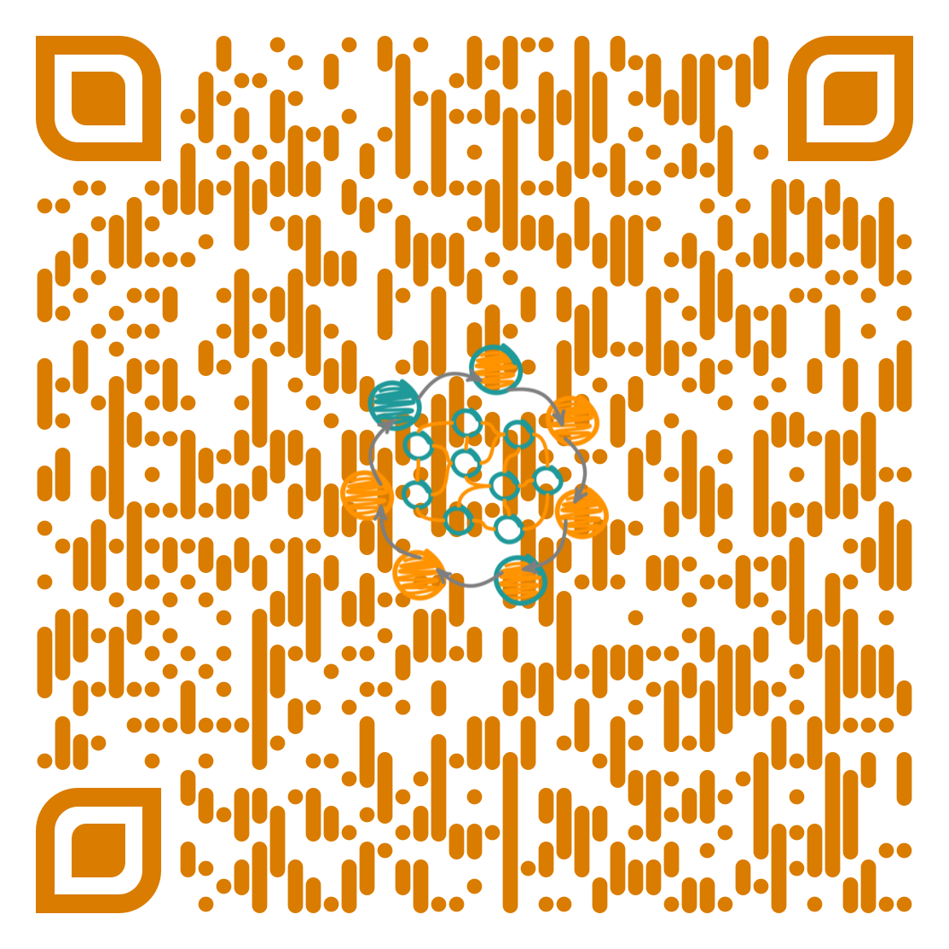
Practice
The Material
  The Full Assessment Modell
    https://orgiq.org/wp-content/uploads/2024/09/OrgIQ_AssessmentModel_v05.pdf
  Just the Tables (quick lookup)
    https://orgiq.org/wp-content/uploads/2025/06/OrgIQ_AssessmentModelOnlyTables_v06.pdf

Slide 33
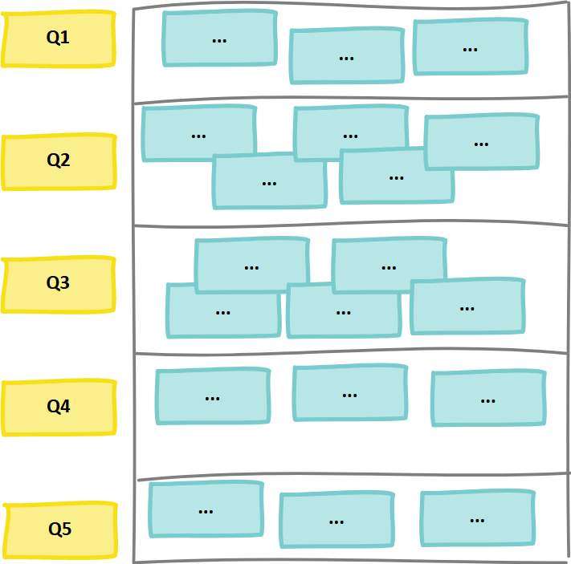
Discovery Action Dialog
Prep: Discovery Action Dialog
  Build Groups!
    Diverse as possible
    ~3 people
    Take Post-Its + Markers
      One stack of post-its per group + marker
      Everyone should write; try to collaborate
      Team: Network nor Hierarchy
    Gather around Meta-Plan/Wall
    For every question ~6 minutes
    The last question is for the WS not so important (but maybe for you)
Notes:
Draw a chart … as Example …

Slide 34
Discovery Action Dialog
Questions: Discovery Action Dialog
  What would the perfectly collaborative organization look like?
  Why is it “perfect”?
    This should include a realistic perspective on the “messiness of being a human”
    We all have experiences with “difficult people” and situations. How could we solve this? Which situations did we see unsolvable in the past?
  What are building blocks (ingredients) of that “perfect” organization? Especially: Dealing with difficult people
  Which examples do you have for these “patterns”? Once again focus on difficult people.
  What can you do now (without anyone else) to follow these examples? (your 15%)
Notes:
Draw a chart … as Example …

Slide 35
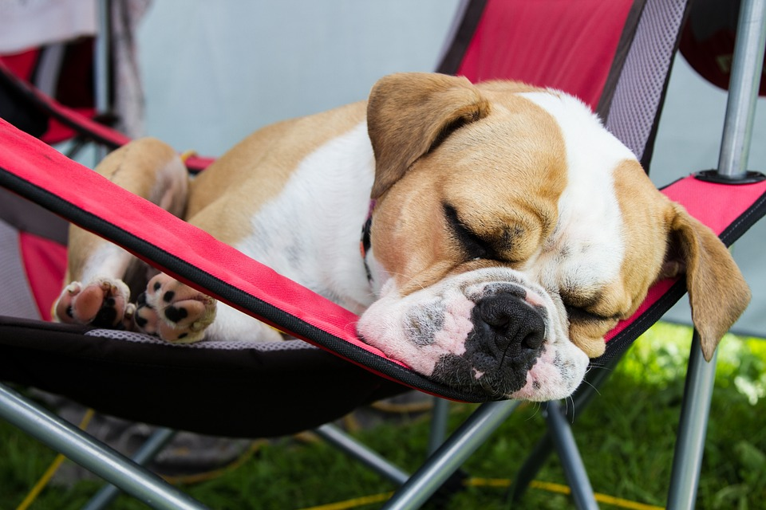
… before the next feature …
Take a break or a nap
Notes:
5 minutes (or 7-10 if needed)
Start 10:00h to 10:05h

Slide 36
Agenda
Fail > Learn > Anticipate

Slide 37
Collaboration Capability Model

Slide 38
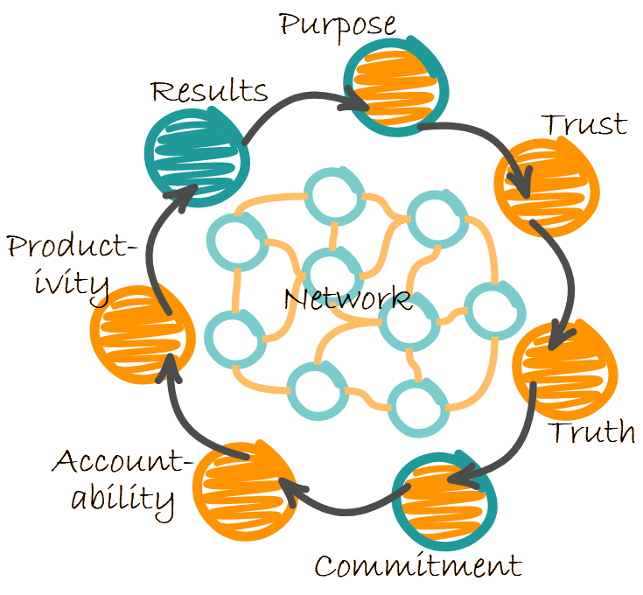
Collaboration Capability Model
Purpose
  Be crystal clear on why you are here
  and where you are heading!
    Purpose addresses also the Limbic brain
    You can’t repeat it often enough!
    At least 50% of your steering & prc mgmt is purpose
    If this is clear, everything else is simple
      even if no process exists, people will do the right things

Slide 39
Collaboration Capability Model
Trust
  Trust is built!
    Trust is part of relationships … you can’t force it,
    you can’t command it
    Trust is about being courageous and vulnerable
    Trust is the concept of a Safe Space
    Being creative is always connected to failure
    (Trust to be [rejection free experienced
    authenticity → autonomy])
Notes:
authenticity is the precondition again. I must show myself and if (and only if) I experience no rejection, I can live my autonomy. I am a singular and whole pillar that goes into interdependence.

Slide 40
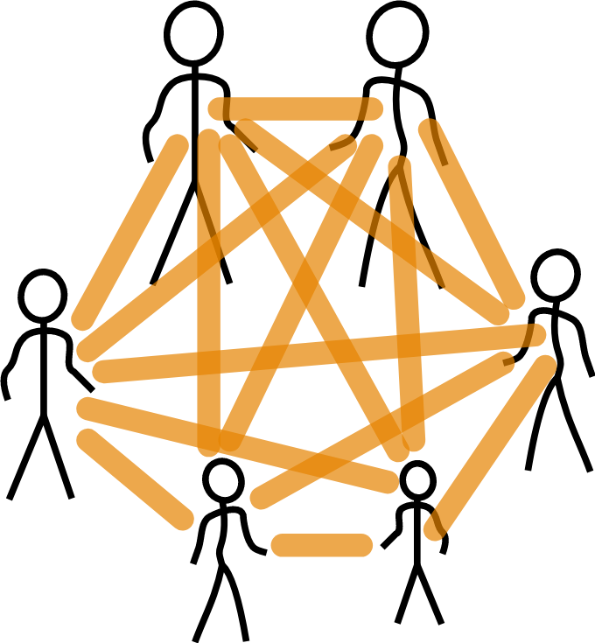
Collaboration Capability Model
How we imagine trust …
  Yeah, we all have a signed contract/are a team /…
  and “now we trust each other”
  This is not trust, but social fear
    “If we can’t see, if moral is on the inside or outside,
    it is the most dangerous situation, we can create”

Slide 41
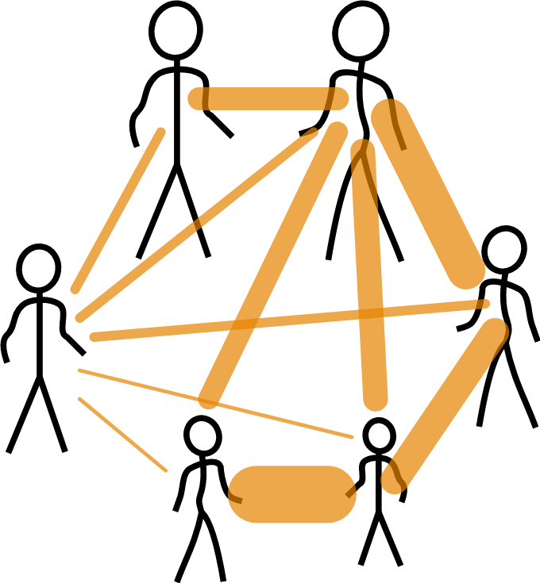
Collaboration Capability Model
How it would look like …
  It looks completely different …
    Suddenly I can understand, what is happening
  Assumption behind this model:
  “Relationships are mutually identical”
    this is not true!
    even the refined model is helpful, but also wrong
    we have to show to connections, for every pair

Slide 42
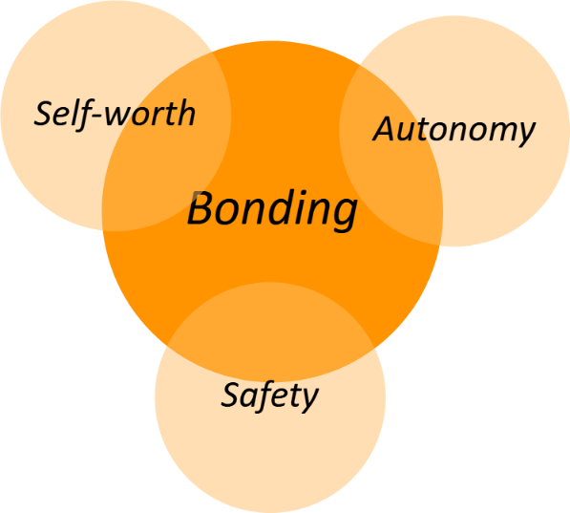
Collaboration Capability Model
Truth
  Truth is found
    Truth comes from relationships, but is about the solution
    It can be a struggle to wrestle for the truth
    It is not about opinions, but “what is best for the system”
    It never endangers the relationship
    Truth can only be found inside a Safe Space,
    otherwise, it becomes politics (and lies)
    (Trust to contribute + improve [self-worth])
Notes:
Here I already fulfilled my four basic needs… I have a connection/bonding and can life authenticity and be creative [self-worth] and nothing happens, then I am safe.

Slide 43
Collaboration Capability Model
Commitment
  Commitment is a decision
    We choose one option
    Commitment is only possible if I feel seen,
    heard, and understood
    There is a decision to be made for a direction
    There are always countless possibilities,
    but there is only one thing we can put into practice
      Cost of oppotunities
    Even if it is not my idea/opinion, but it is about sth
    being the best (we know yet) for the system
      Resistance based decision making
    (Result from Trust to Contribute)

Slide 44
Collaboration Capability Model
Accountability
  Accountability is an attitude
    Do I live my values
    Accountability is the most crucial and difficult element
      it is the realization (implementation) of trust
      it is intangible, but needs to be regularly addressed
    It is based on common values
    We must be very sensitive, if values are proclaimed
    but trampled on in real life
      e.g., even smallest lies (and omissions) are a warning signal
    (DSS; part of trust)
    (Value-Model + Value Watcher)

Slide 45
Collaboration Capability Model
Productivity
  Performance is accountability in practice
    Let’s talk about Flow [Mihaly Csikszentmihalyi]
    Performance is competence in a Safe Space
    Flow is the state between bore out and burn out
      a balanced Anxiety-Boredom Continuum
    This is what we need to measure and optimize!
    Depending on size and world view use
      guidelines or
      processes or
      patterns
    (Trust to challenge other [older] Creativity)
Notes:
Fokus of the process: Some ideas to measure … flow (percentage of day), learning, meeting (usefulness), positive communication
http://www.forbes.com/sites/bruceupbin/2011/12/13/five-new-management-metrics-you-need-to-know/

Slide 46
Collaboration Capability Model
Results
  Results are (just) the proof
    We reap what we saw
    This is feedback!
    When we measure results, there need to be a link
    to the “real metrics”
    Results validate the Purpose and can further inspire us

Slide 47
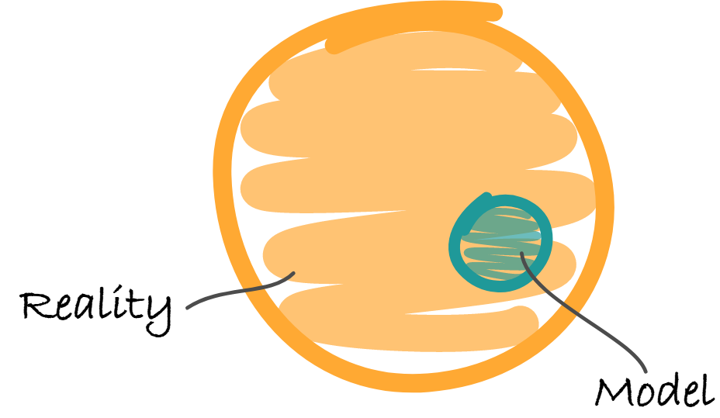
Collaboration Capability Model
Network (Neuronal Network)
  Different perspectives in and on organizations
    We need a simple framework (model) for purpose and guidance
    We need the full complexity (as a super power) for the operational work
    Neither should become the limit or bottleneck for the other

Slide 48
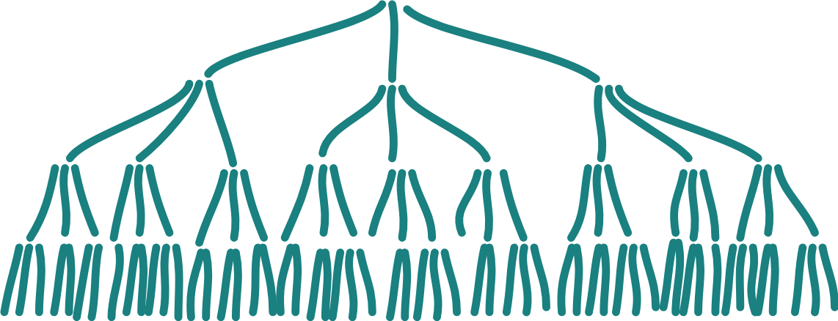
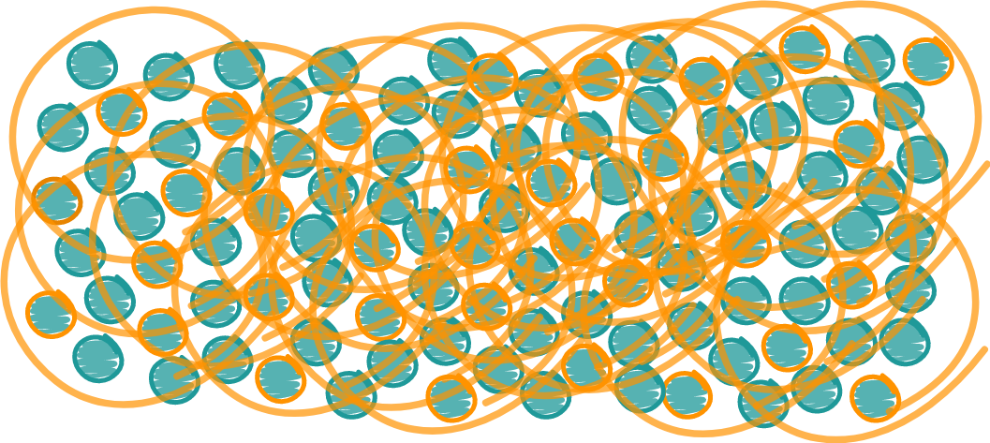
How we see
Organizations
(Clockwork)
How Organizations
really are
(Network)

Slide 49
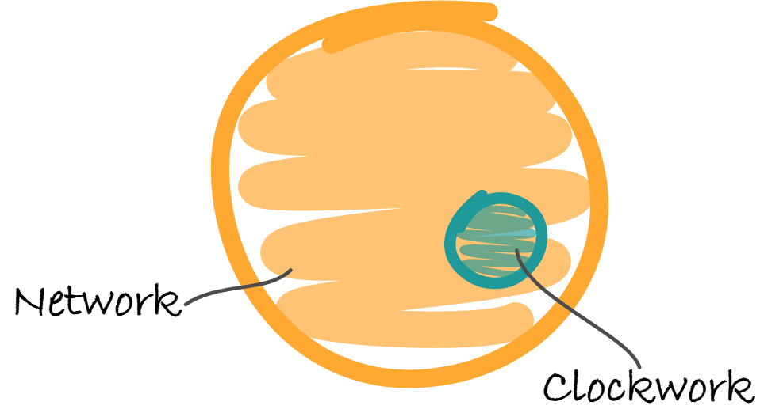
Collaboration Capability Model
We need both perspectives
  We are very good with the Clockwork
  But “not existing” with the Network

Slide 50
Collaboration Capability Model
  We need models, to give direction and purpose in complex environments
  Models are useful and necessary
  The cost of every model is that the model itself limits the solution space
    For solutions outside the model we are blind be definition

Slide 51
Collaboration Capability Model
Network (Neuronal Network)
  Operational Independence from Clockwork
    no waiting, no power games, no control, no politics
    BUT clear purpose and direction … everyone knows,
    which decisions will serve purpose and direction
    (and serving the purpose and direction is the only thing
    that is rewarded)
  Trust over Control
    “Super Creative Mode”
    Intelligent Organizations
    → Learn to Adapt to Survive

Slide 52
Collaboration Capability Model
Application

Slide 53
Practice
Practice
  Work in groups
  Start with the problems (easiest: difficult people)
    Goal: Understand that it’s the system
    Go through the Outcomes of one process to make the first steps
      Trust, Accountabiliy, Network
  Analysis of the Situation
  Try to solve it (widen Solution Space)
  We focus on one or two outcomes
  of the process. The focus is to give
  a deeper understanding of the
  basic notion rather than completeness.
Notes:
Das wird wieder schwer, weil sie vermutlich nur im Neocortex denken; also frü hinführen

Slide 54
Practice
The Material
  The Full Assessment Modell
    https://orgiq.org/wp-content/uploads/2024/09/OrgIQ_AssessmentModel_v05.pdf
  Just the Tables (quick lookup)
    https://orgiq.org/wp-content/uploads/2025/06/OrgIQ_AssessmentModelOnlyTables_v06.pdf

Slide 55
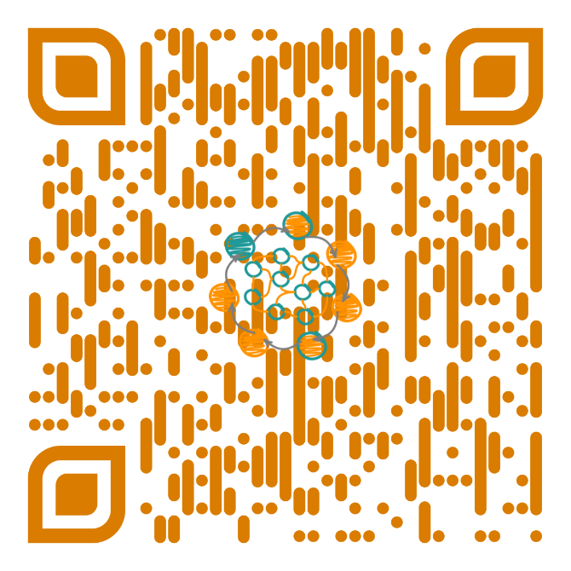
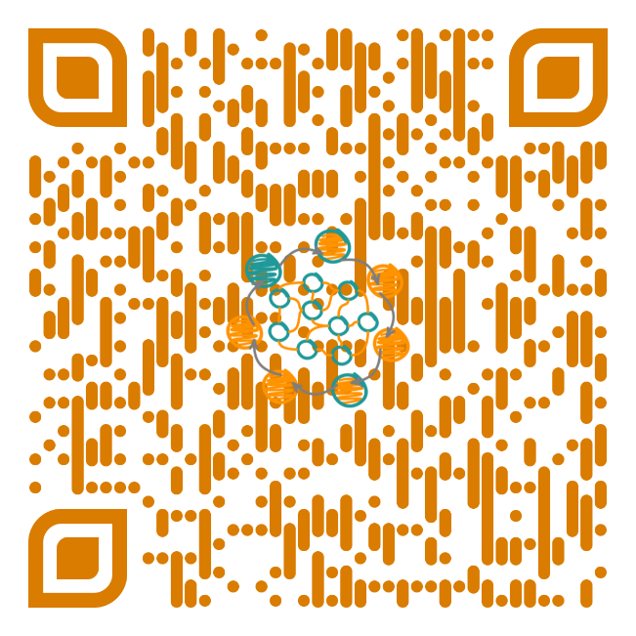
Practice
Three Deep Truths – as Inspiration
  English Version
    https://orgiq.org/blog/three-deep-truths/
  German Version
    https://orgiq.org/blog/die-drei-tiefen-wahrheiten/

Slide 56
Practice
Feedback & Shared Experiences
  Learn from each other …

Slide 57
… before the next feature …
Take a break or a nap
Notes:
5 minutes (or 7-10 if needed)
Start 10:00h to 10:05h

Slide 58
Agenda
Fail > Learn > Anticipate

Slide 59
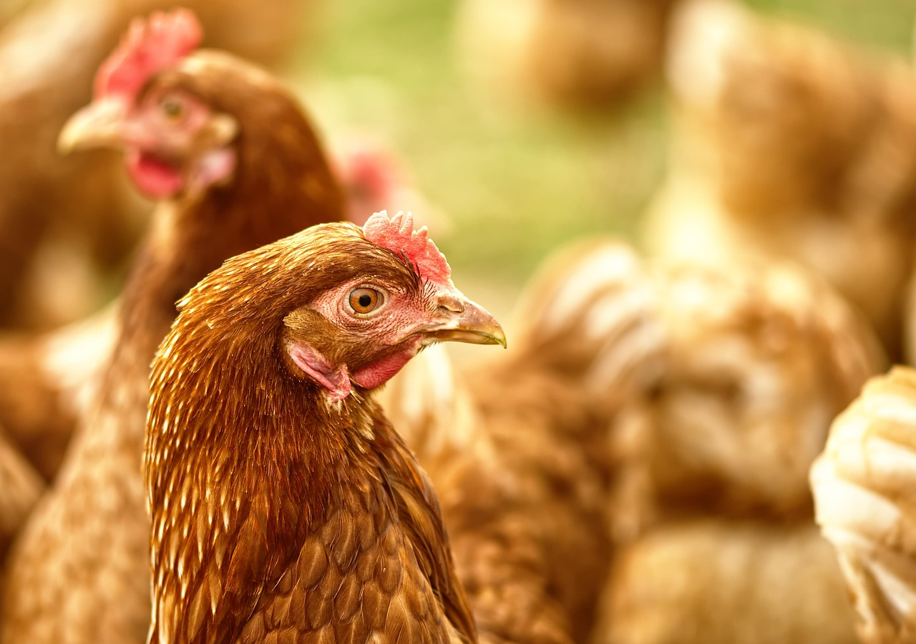
Chicken
Jim Tamm: Radical Collaboration … Chicken
  Purdue University
    https://www.researchgate.net/profile/William-Muir
  Red-Zone: Groups with High Performer
    Visible High-Performer … but with a cost
    #Eggs
  Green-Zone: Collaboration
    No High-Performer
    Just being nice with each other
    Boring?
  https://www.ted.com/talks/jim_tamm_first_step_to_collaboration_don_t_be_so_defensive
Notes:
Radical Collaboration: Zone Chickens
In a TED talk, Jim Tamm discussed collaboration studies at Purdue University. It’s about chickens—groups of high-performing chickens and groups without high performers.
Why are the high performers considered high performers? Not because they’re so amazing, but because they suppress the other chickens. If I make the others look bad, I become the best. (This is about egg production, so we’re talking about female chickens, but the same principle applies in all social structures.)
So, the question is: Would chickens that think and act collaboratively—without high performers, just good, social interactions—be productive enough?
These chickens were selected, isolated, and bred for this behavior. They are the green zone chickens.
After five generations, the productivity of the red and green zone chickens was compared. The differences were dramatic: the green zone chickens were healthy and productive, while the red zone chickens were in a terrible state—over half of them were dead, pecked to death by the others.
Productivity in the green zone increased by about 260% in one year (five generations).
Lessons Learned: Red-zone environments (internal conflicts, hostile thinking) create red-zone behavior. Instead of external competition, we find internal competition. In the red zone, individuals only think about their small system (ego) and want to be the best within it. The larger system doesn’t interest them. On the contrary: they’re willing to destroy the system for personal gain.
Green-zone environments, where people support each other, think and act cooperatively, and train collaboration skills (like DSS—Deep Soft Skills), produce more output.
Now, we each have to decide which culture we want. Leadership clearly aligns with the green zone, with collaborative systems. Management systems are based on red zone assumptions. Especially dangerous are red zone systems that paint themselves green—we see this often today. It’s crucial to recognize the true nature of a system. And for that, we need...

Slide 60
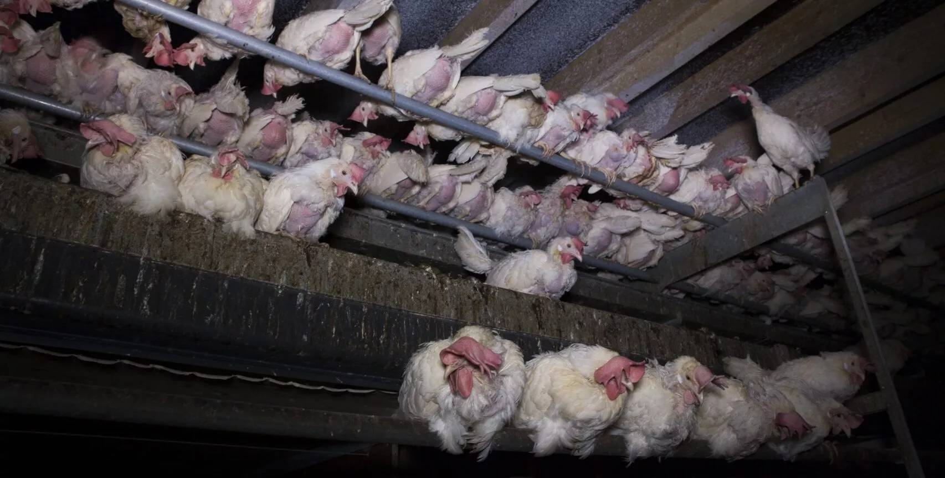
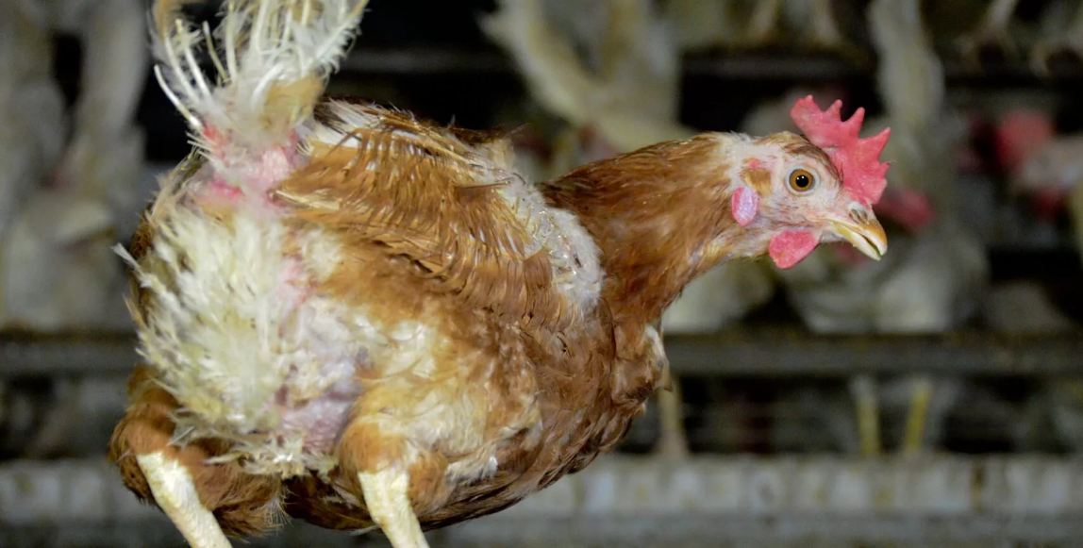
Chicken
Red-Zone Reality
  Everyone is miserable and looks miserable
  High-performer, perform relatively high
    on cost of others
    “suppress others to shine”
  Bullying (pecking, killing) comes with a cost
    High overall loss
    Low system performance
    Difficult to stop the pecking/suppressing
  Alternative?
    Could nice chickens be
    productive enough?

Slide 61
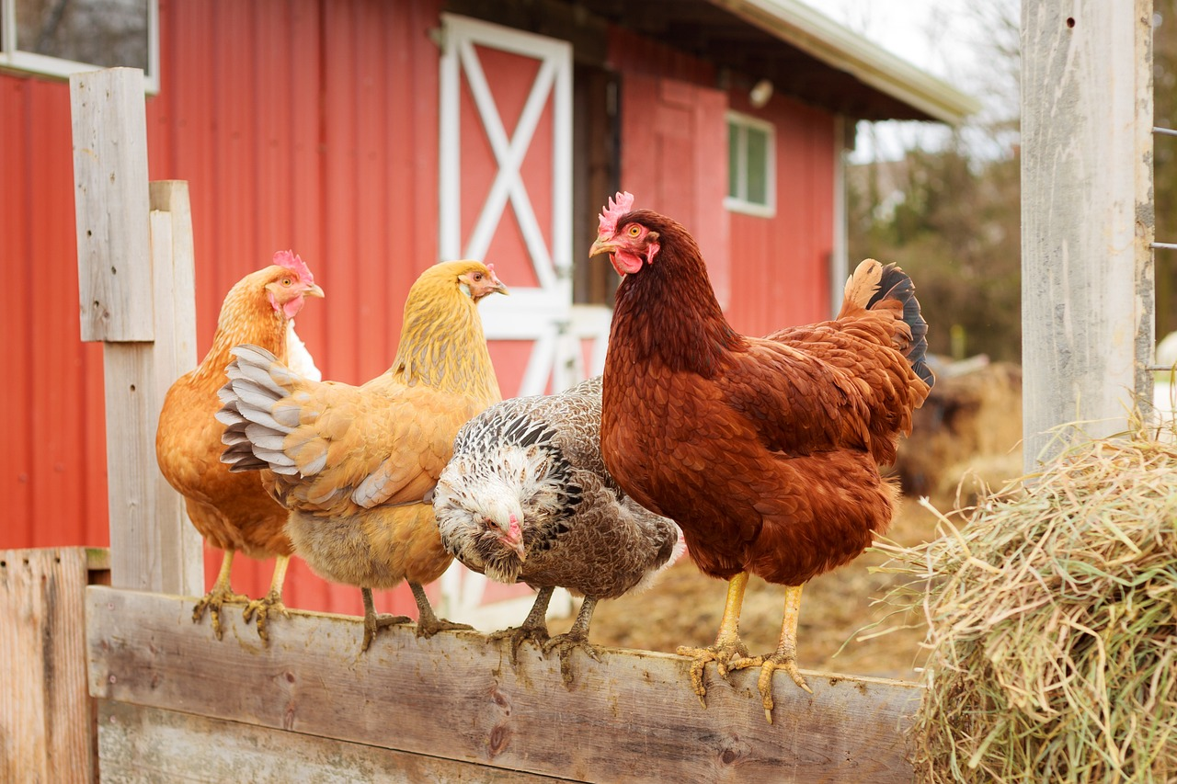
Chicken
Green-Zone
  5 Generations Collaboration
    Productivity: +260%
  How?
    Just by avoiding harm
  I know … it’s way too simple

Slide 62
Chicken
Lessons Learned
  Red-zone environments create red-zone behavior
    internal conflicts, hostile thinking
  Internal competition
    instead of external competition
  Red-zone individuals think about their small system (ego)
  The larger system doesn’t interest them
    They’re willing to destroy the system for personal gain
  Pain driven
  Green-zone environments produce outcome
    people support each other
    think and act cooperatively
    train collaboration skills (Deep Soft Skills)
  Purpose driven

Slide 63
Higher Levels
Practice: Level 2-5
  Build Groups
    Relax, no high-performance needed
    Just be nice to each other
    Create some ideas how to build Level2-5 environments
  Level 2
    Vision of Collaborative Environment
  Level 3
    Standard Environment & Deployment
  Level 4
    Quantitative Control of the Environment
  Level 5
    Environment Innovation
Notes:
Pick a level as group and collect some ideas howwe can achieve this ☺

Slide 64
Higher Levels
Final Feedback
  How satisfied are you with the workshop?
  How worthwhile do you see a systematic approach to psychological safety (collaboration)?
  How realistic do you see a systematic approach to psychological safety (collaboration)? Is there a market?
      Do you believe there is a chance to really affect culture with a systematic approach, or will it just be another “nice on paper”?
  Material
    Prepare wall: Qs + Scale
  Everyone gets 3 small yellow Post-Its
    for every question
    rate 1..10 (10 best)
    Write Q<No>/Rating

