Slide 1

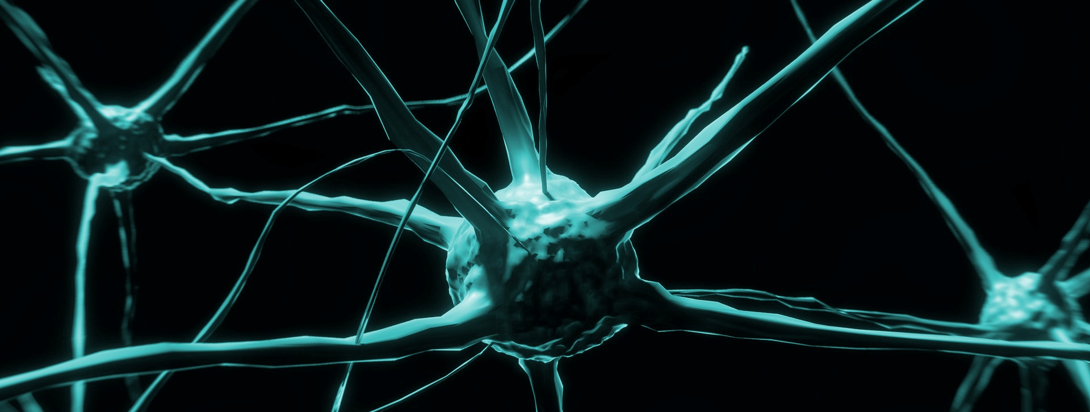
SPICE 4 Collaboration Capability @ VDA SYS 2025
A Systematic Approach For Psychological Safety in Healthy And Human-Centered Environments

Slide 2
Additive Bias
Notes:
Story of the person with knife in the leg … You don’t add a process or method or tool; it won’t help
First you have remove something that there is space. As long as the pain controls every thought, it’s not worthwhile.

Slide 3
From the Keynote Today …
“The world is to messy, to code it down … we need AI to figure it out”
(in organizations we shouldn’t use AI, but SI – social intelligence – because
humans naturally build neuronal networks)

Slide 4
Definition of Intelligence
  “Learning, Adapting, and Anticipating
  for System Survival and Success.”
  What hinders (big) organizations to be in their intelligence?
  If we remove all hinderance, what can we train?

Slide 5
Intro
Current Overview of Studies
  Just in the recent month
    Gallup Engagement-Index 2024
    Deloitte Global Human Capital Trends 2025
    OECD Skills 2030-Study
    World Economic Forum Future of Jobs 2025 Study
    …
Why are we so obsessed with building stupid organizations?

Slide 6

Theory of the Day
Our Current Situation of Blindness

Slide 7

Theory of the Day
Situation With Collaboration Capability Maturity Assessment

Slide 8

Theory of the Day
Worldview: How and What We See

Slide 9
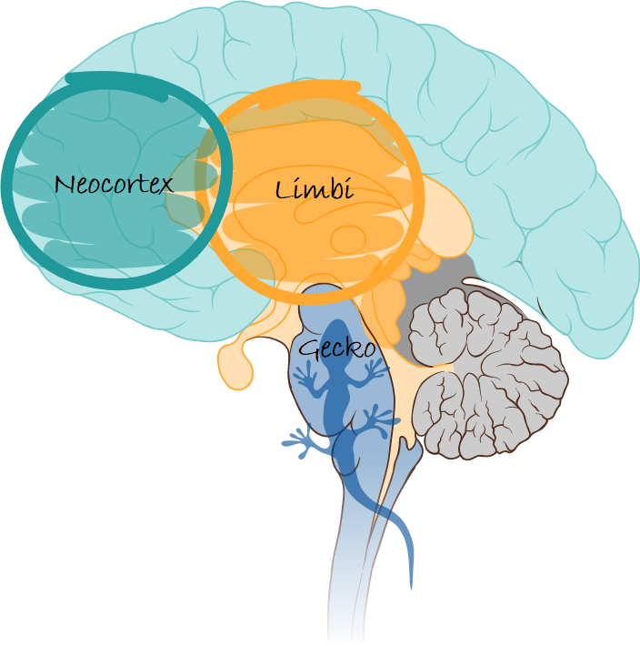
Theory of the Day
Gecko > Limbi >> Neocortex

Slide 10
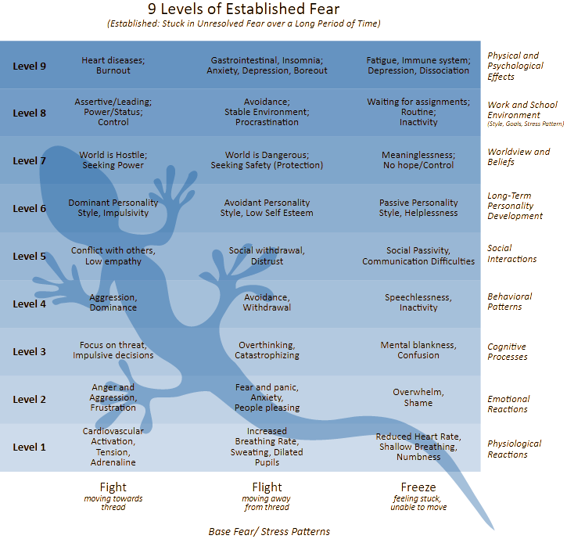
Theory of the Day
The Gecko

Slide 11
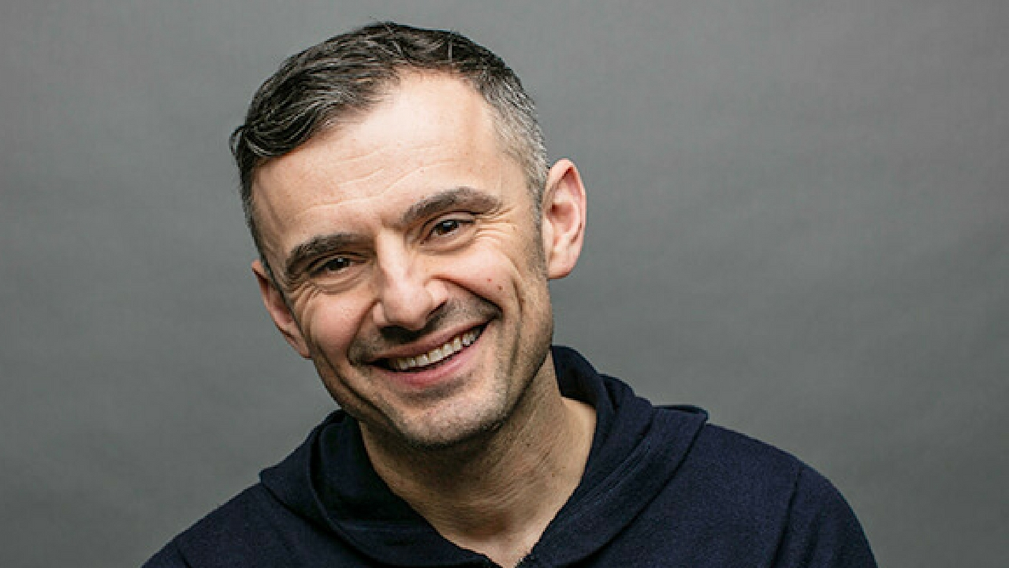
We are at the dawn of the era of emotional intelligence.
(Gary Vee, 2015)

Slide 12
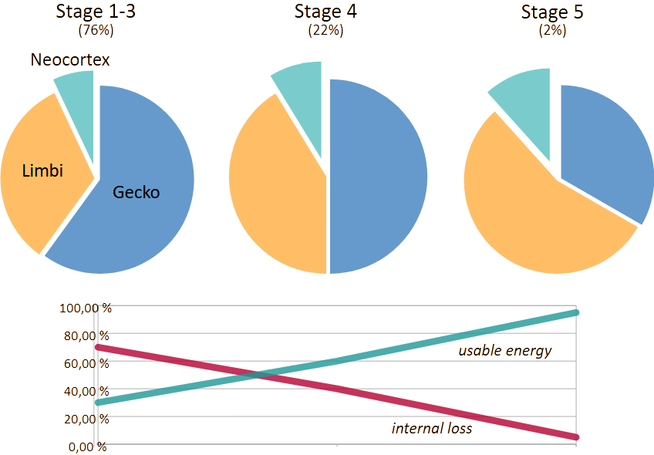
Theory of the Day
The Consequence

Slide 13
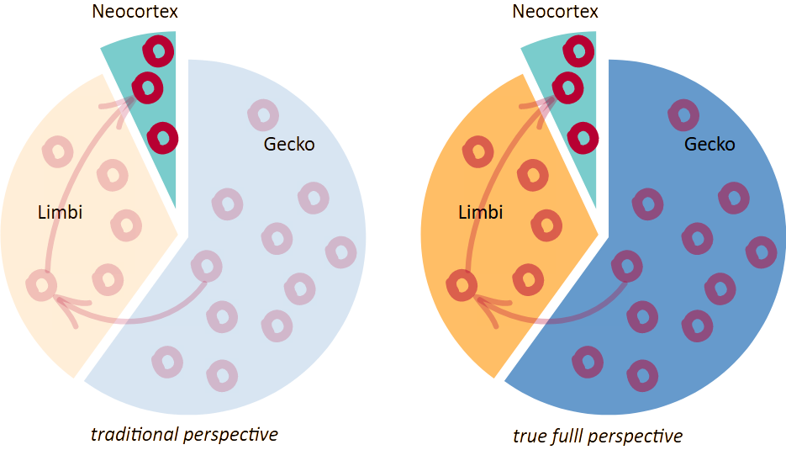
Theory of the Day

Slide 14
Intro
Understand Humans, and Design for Their Needs
  So we need to understand
    Neurology, Psychology, Sociology, Cybernetics, Synergetics and Systems Theory
    (in short: NPSCSST)
Organizations are social systems.
They need
a human architecture.

Slide 15
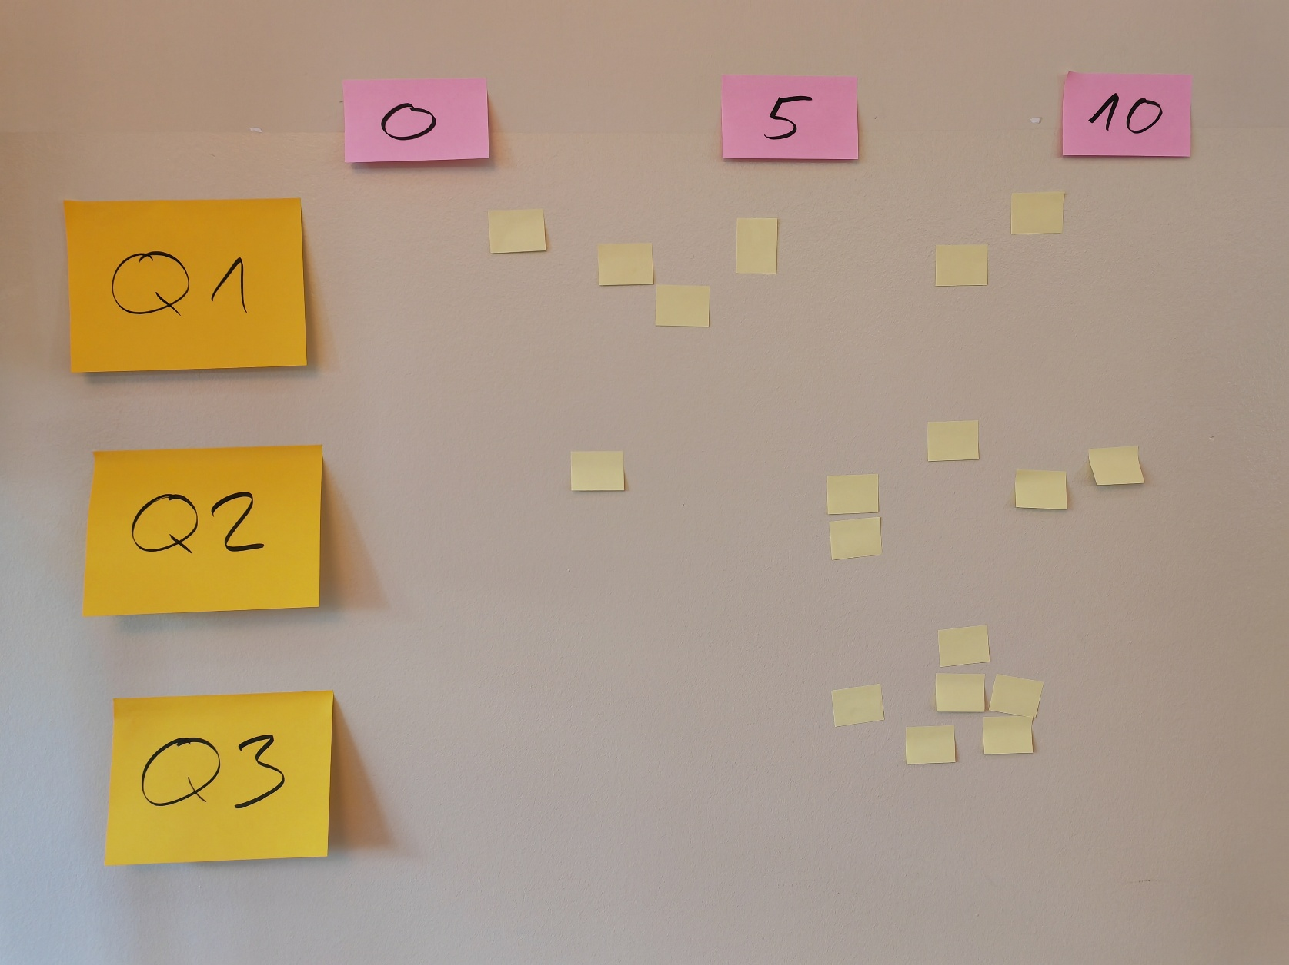

Slide 16
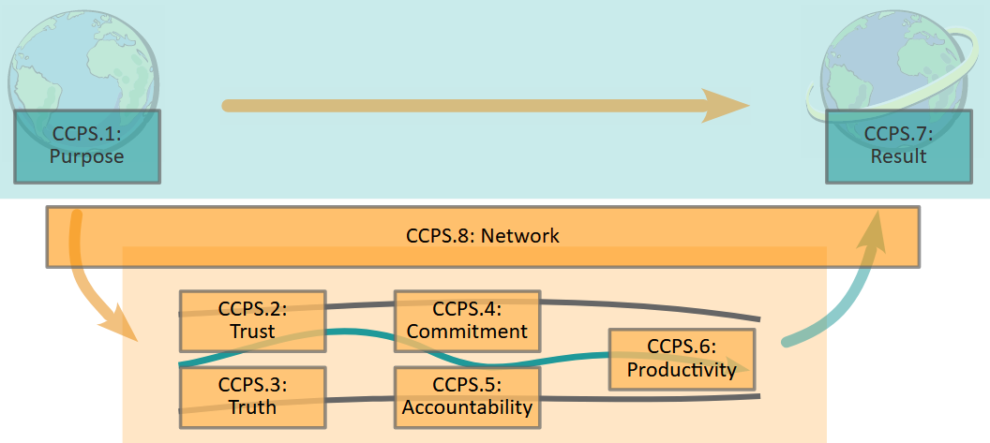
Theory of the Day

Slide 17
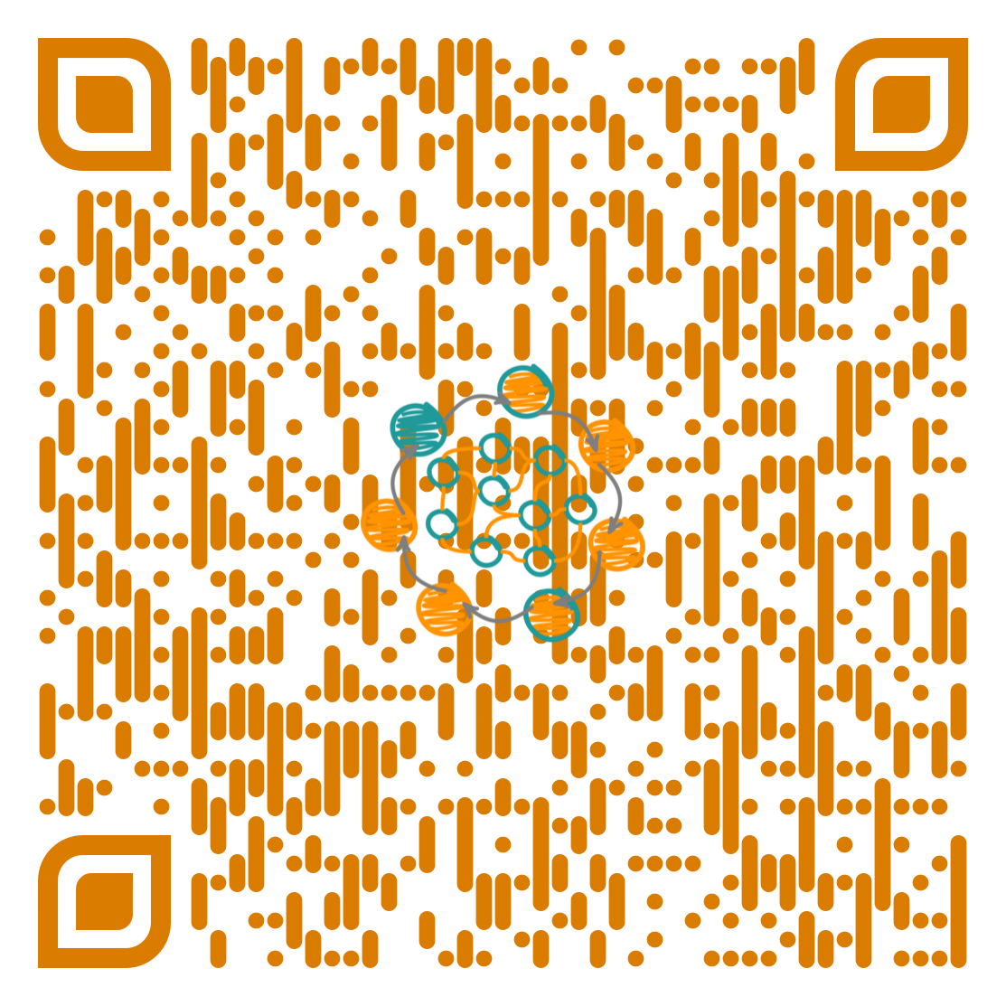
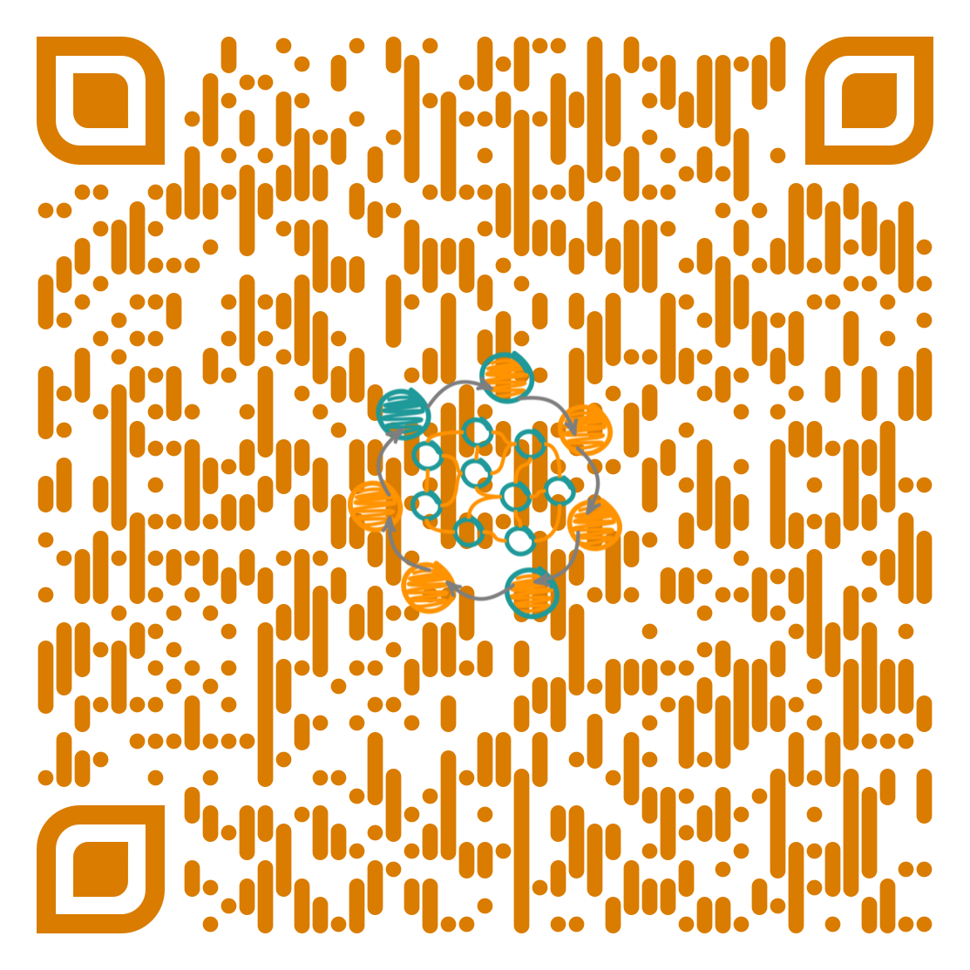
Practice
The Material
  The Full Assessment Modell
    https://orgiq.org/wp-content/uploads/2024/09/OrgIQ_AssessmentModel_v05.pdf
  Just the Tables (quick lookup)
    https://orgiq.org/wp-content/uploads/2025/06/OrgIQ_AssessmentModelOnlyTables_v06.pdf

Slide 18
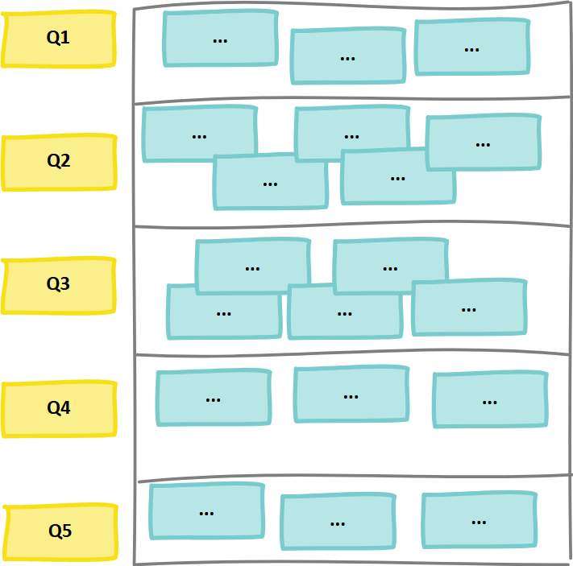
Discovery Action Dialog
Questions: Discovery Action Dialog
  What would the perfectly collaborative organization look like?
  Why is it “perfect”?
    This should include a realistic perspective on the “messiness of being a human”
    We all have experiences with “difficult people” and situations. How could we solve this? Which situations did we see unsolvable in the past?
  What are building blocks (ingredients) of that “perfect” organization? Especially: Dealing with difficult people
  Which examples do you have for these “patterns”? Once again focus on difficult people.
  What can you do now (without anyone else) to follow these examples? (your 15%)
Notes:
Draw a chart … as Example …

Slide 19
DAD
  Patterns and factors for Collaboration
    and hinderance, obstacles, and blocking
  Focus on “difficult people” and “difficult situation”: What makes difficult people difficult?
    They make me feel negative
    Narcistic Leaders
    “being right”
    Ego & Blame Game
    Subconscious reason for every human interaction:
    “I want you to fell how I feel”
Notes:
A little bit into the future, but some brave pioneers joint and tried it …

Slide 20
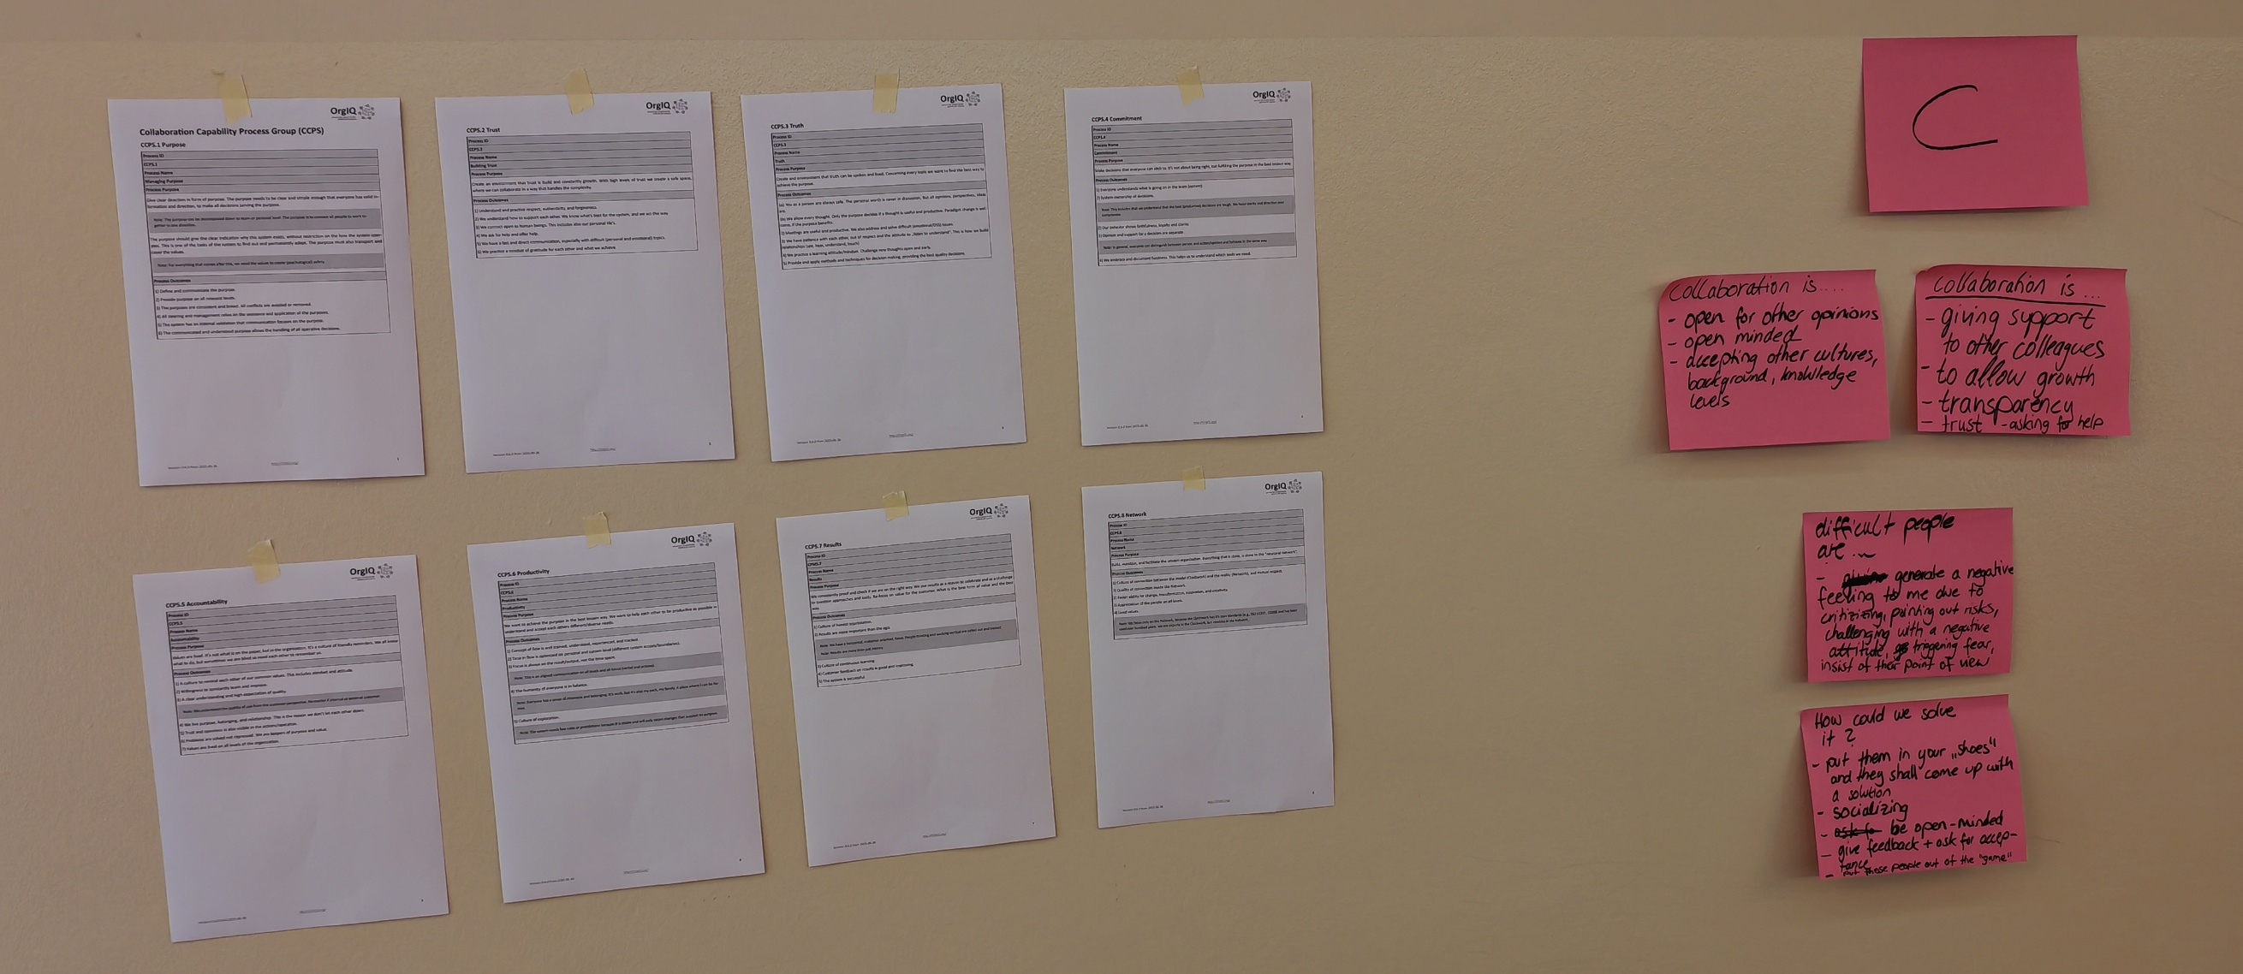

Slide 21
Theory of the Day
Diagnosis

Slide 22

Higher Levels
Practice: Level 2-5
  Level 2
    Vision of Collaborative Environment
  Level 3
    Standard Environment & Deployment
  Level 4
    Quantitative Control of the Environment
  Level 5
    Environment Innovation
Notes:
Pick a level as group and collect some ideas howwe can achieve this ☺

